Slide 1

Welcome reception,
Bishop Erasm Ciolek Palace,
Monday, 19th September 2016
Kraków , Poland

Slide 2
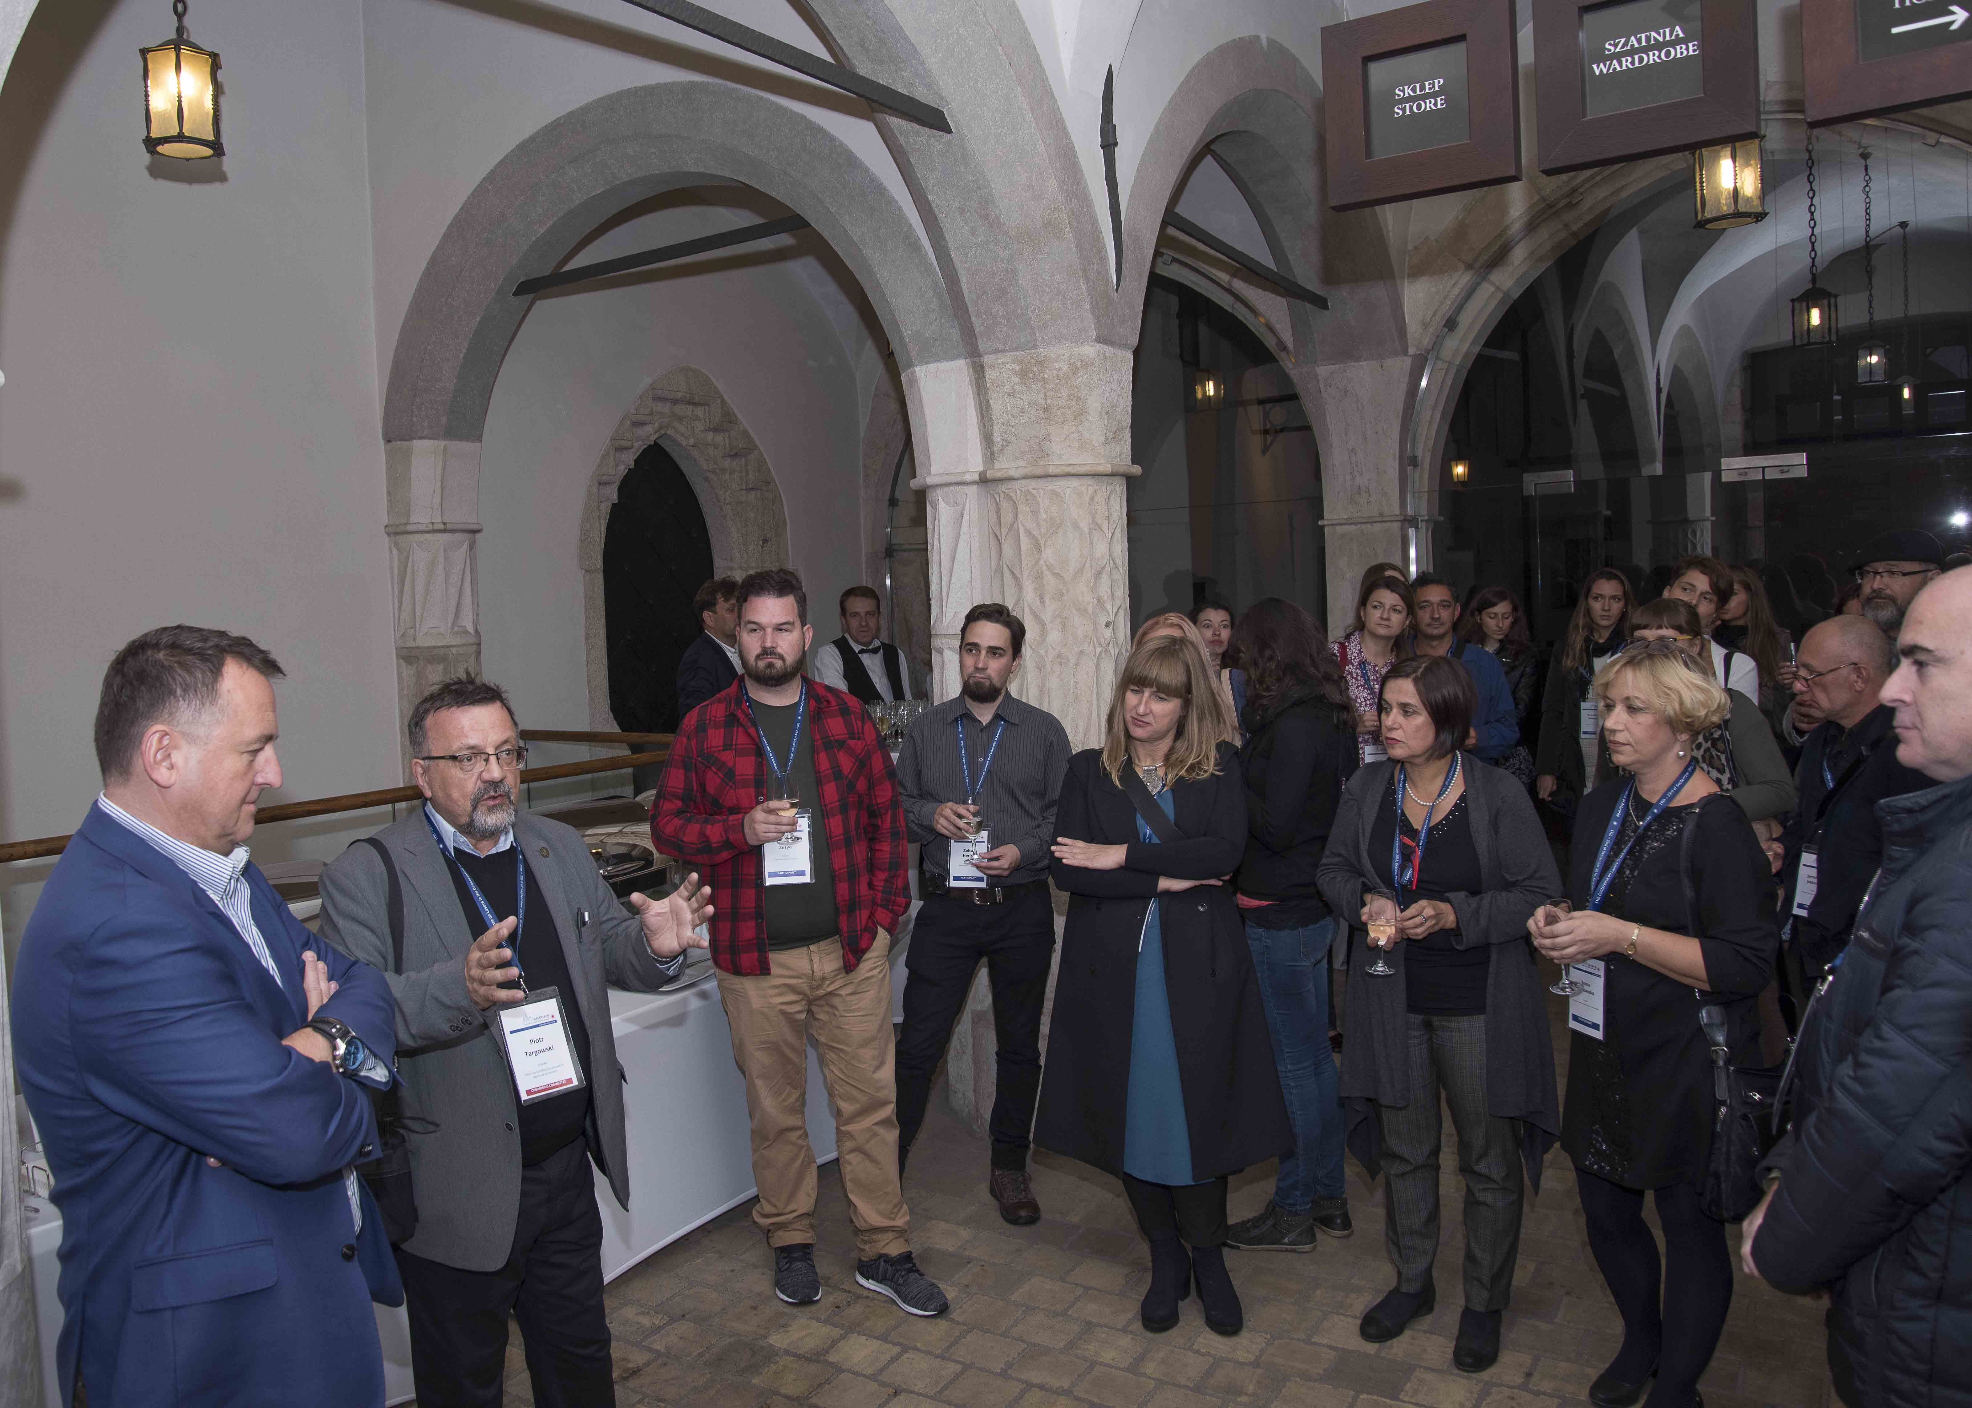

Slide 3
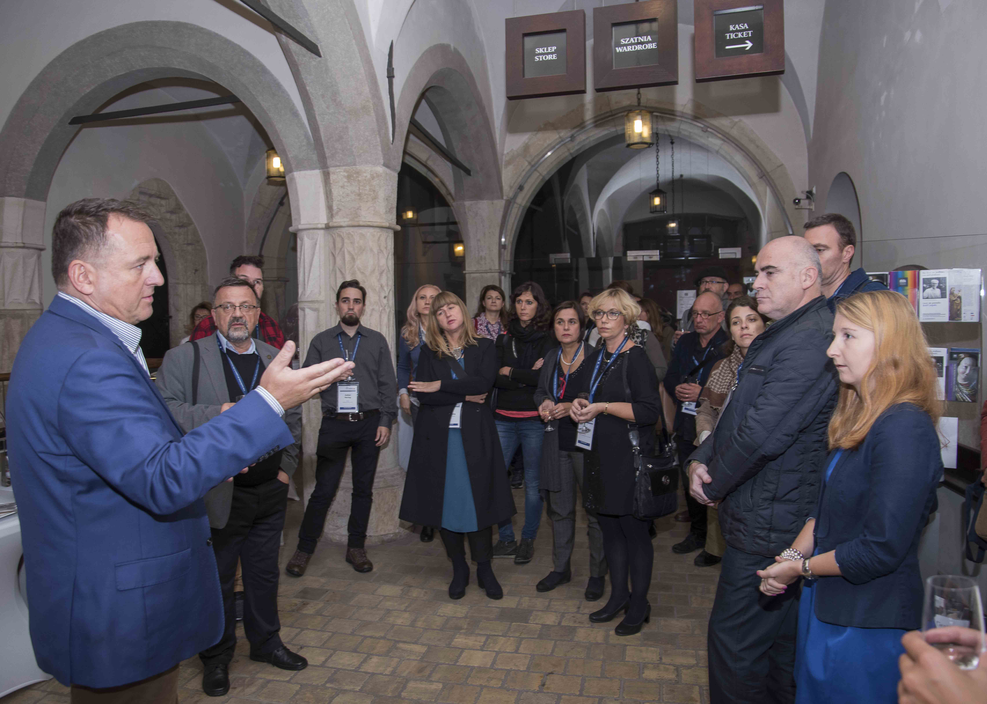

Slide 4
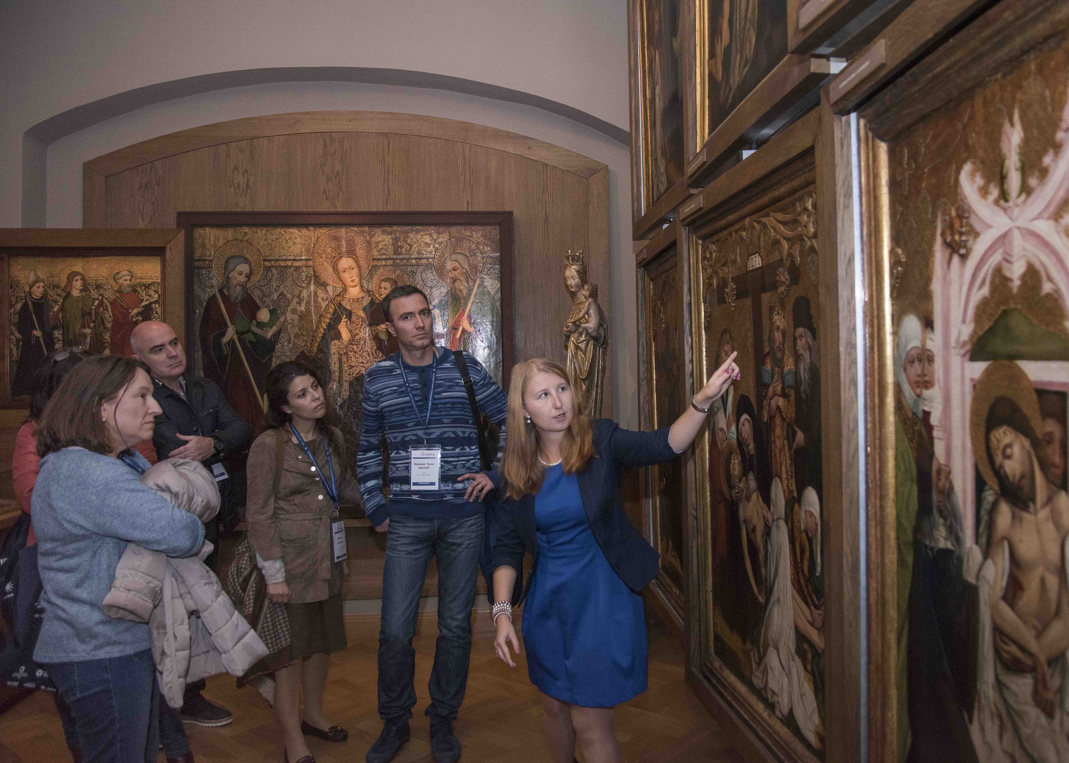

Slide 5
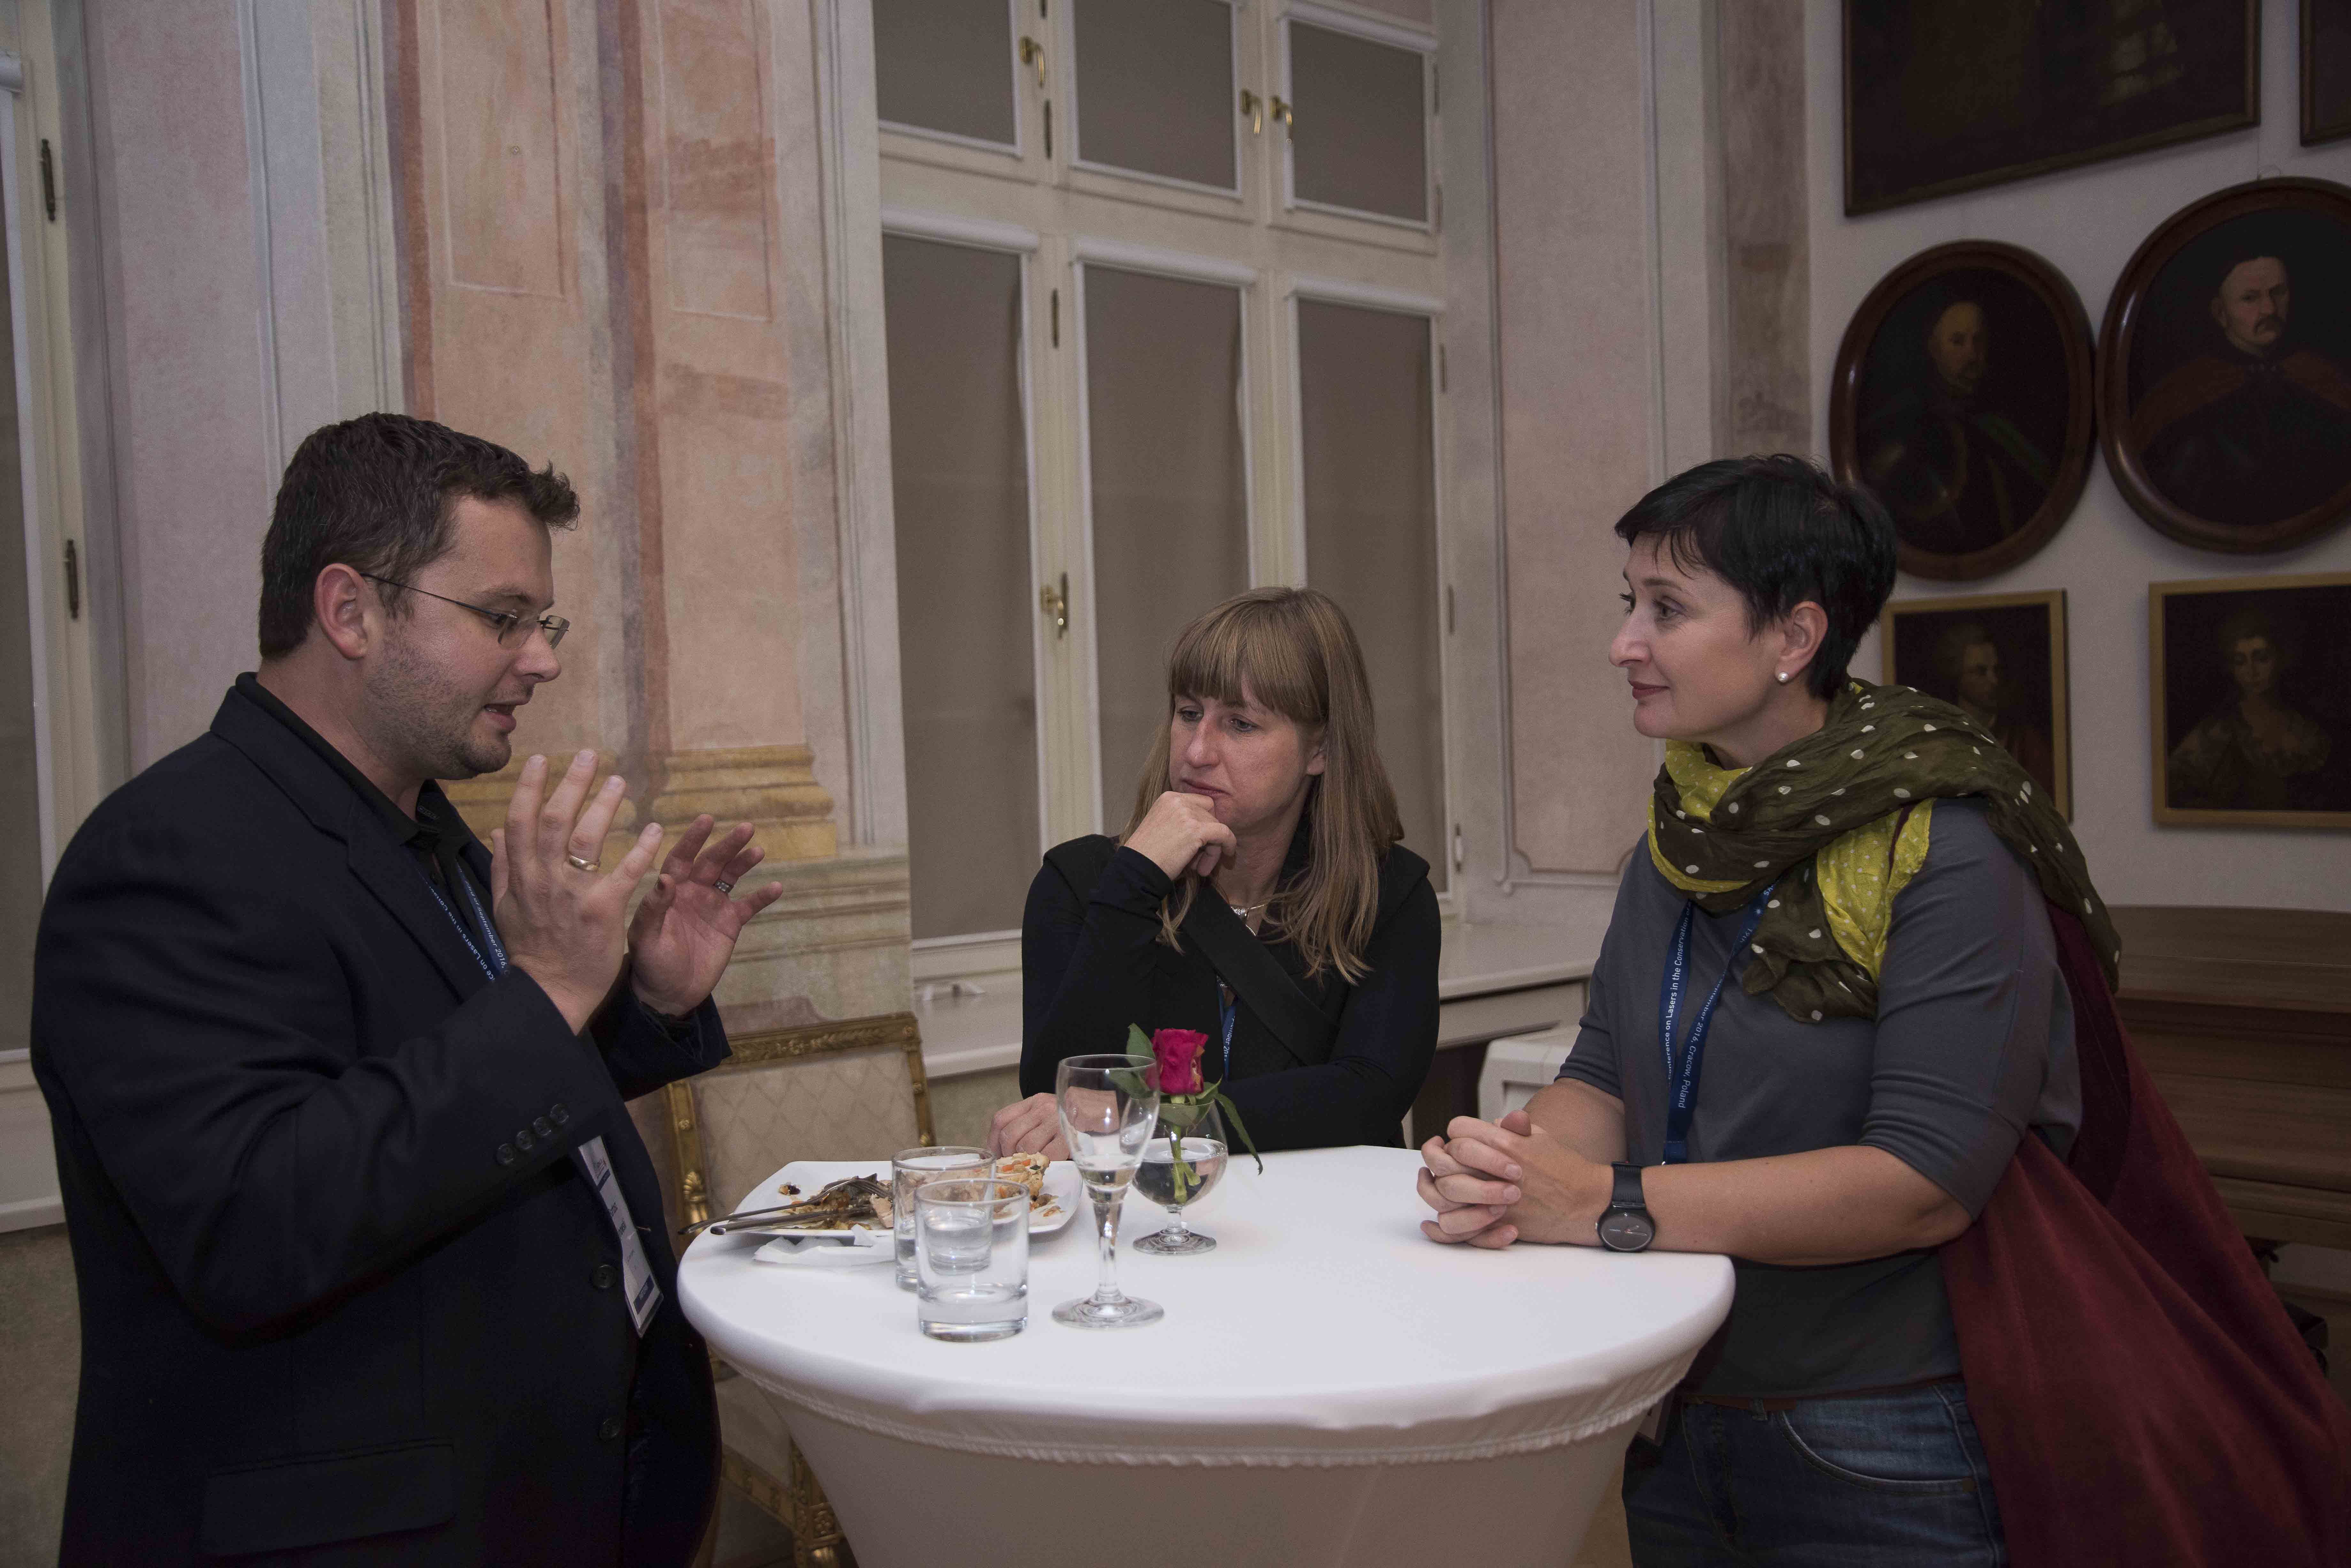

Slide 6
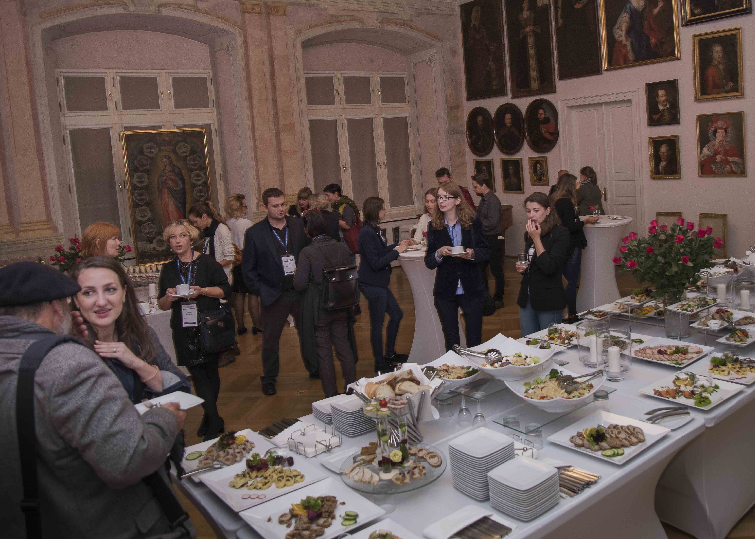

Slide 7
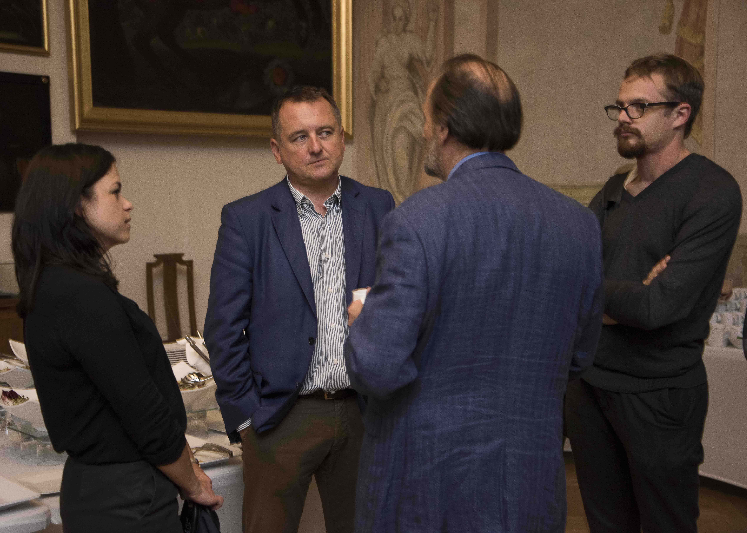

Slide 8
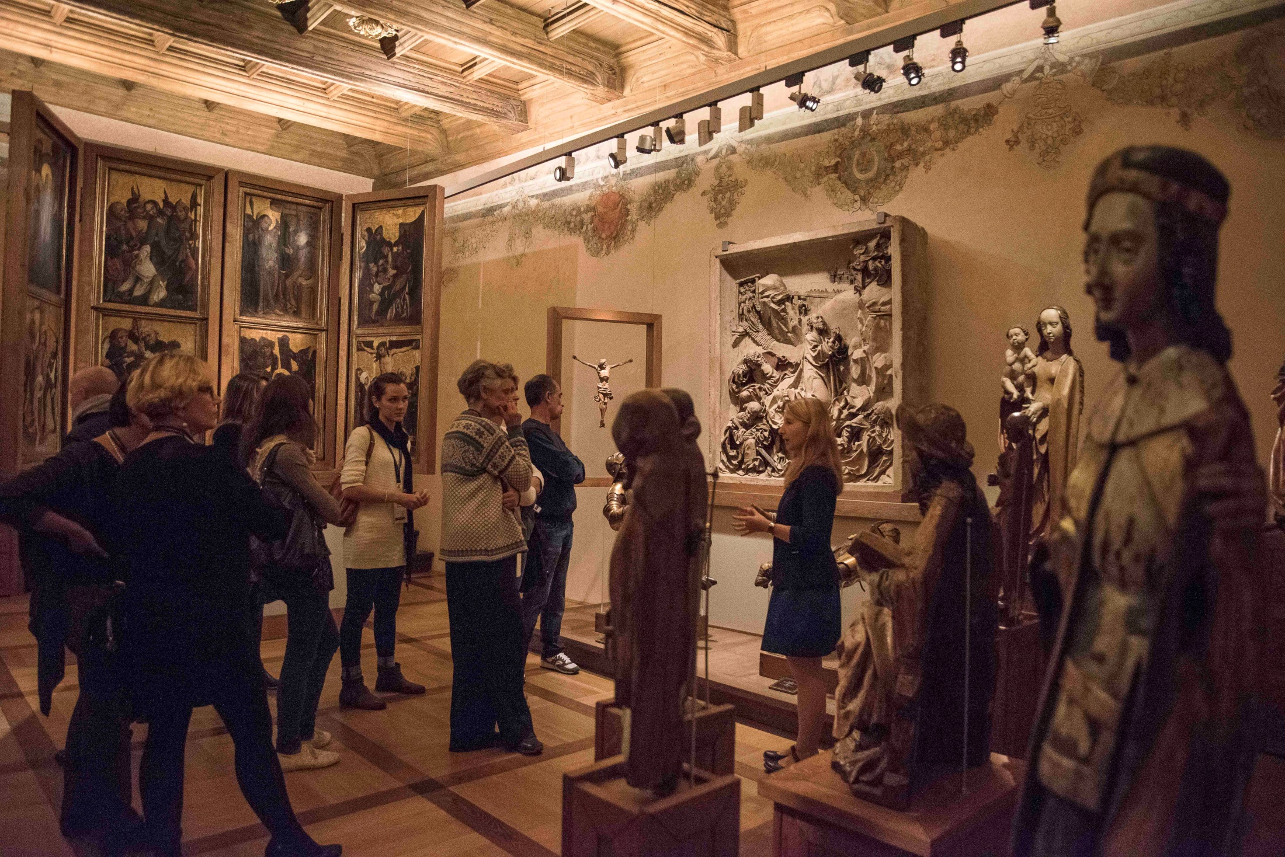

Slide 9
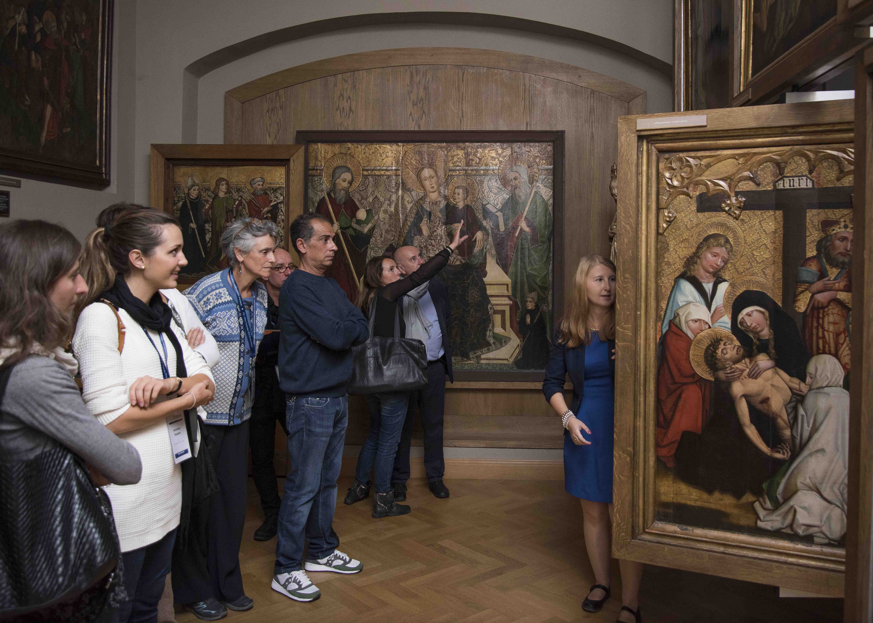
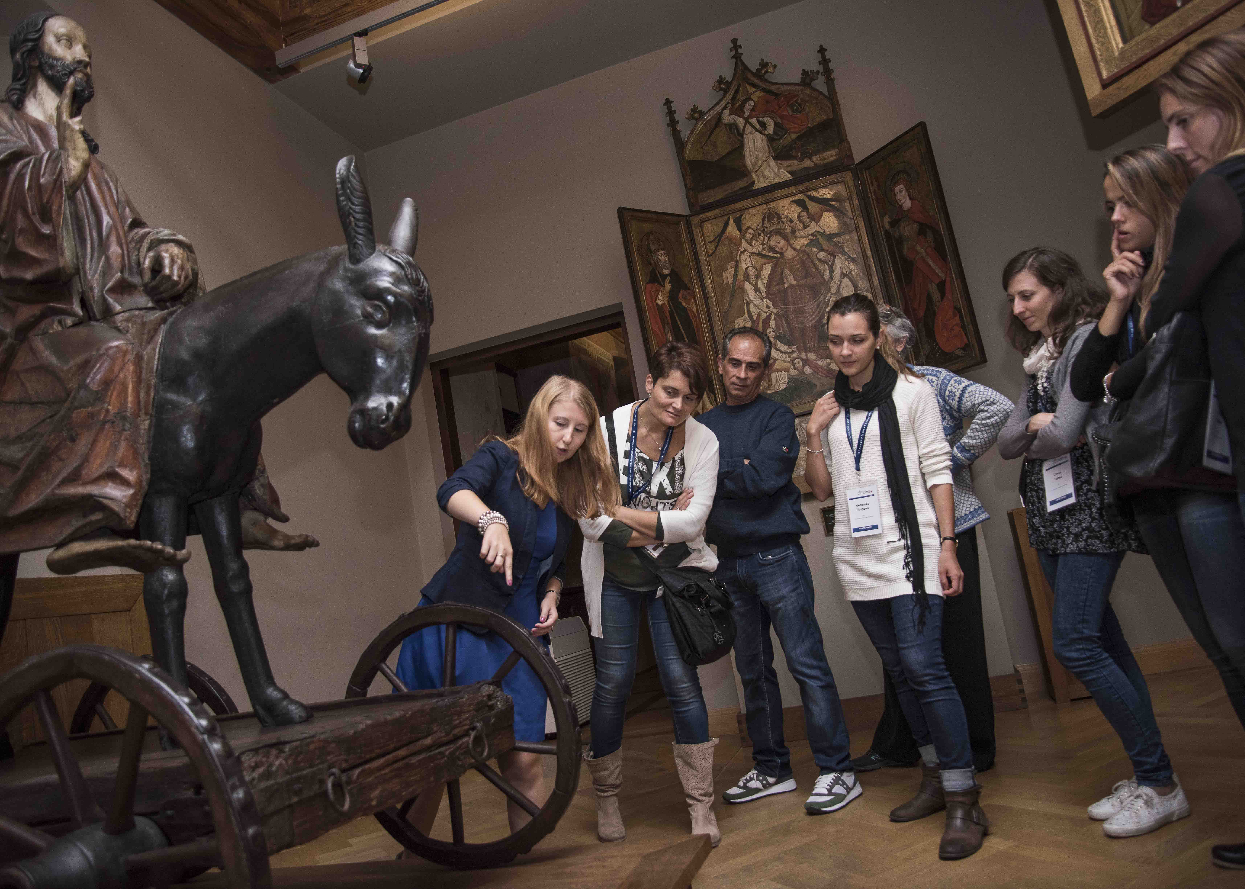

Slide 10
Opening,
Jan Matejko Academy of Fine Arts
Tuesday, 20th September 2016
Kraków , Poland

Slide 11
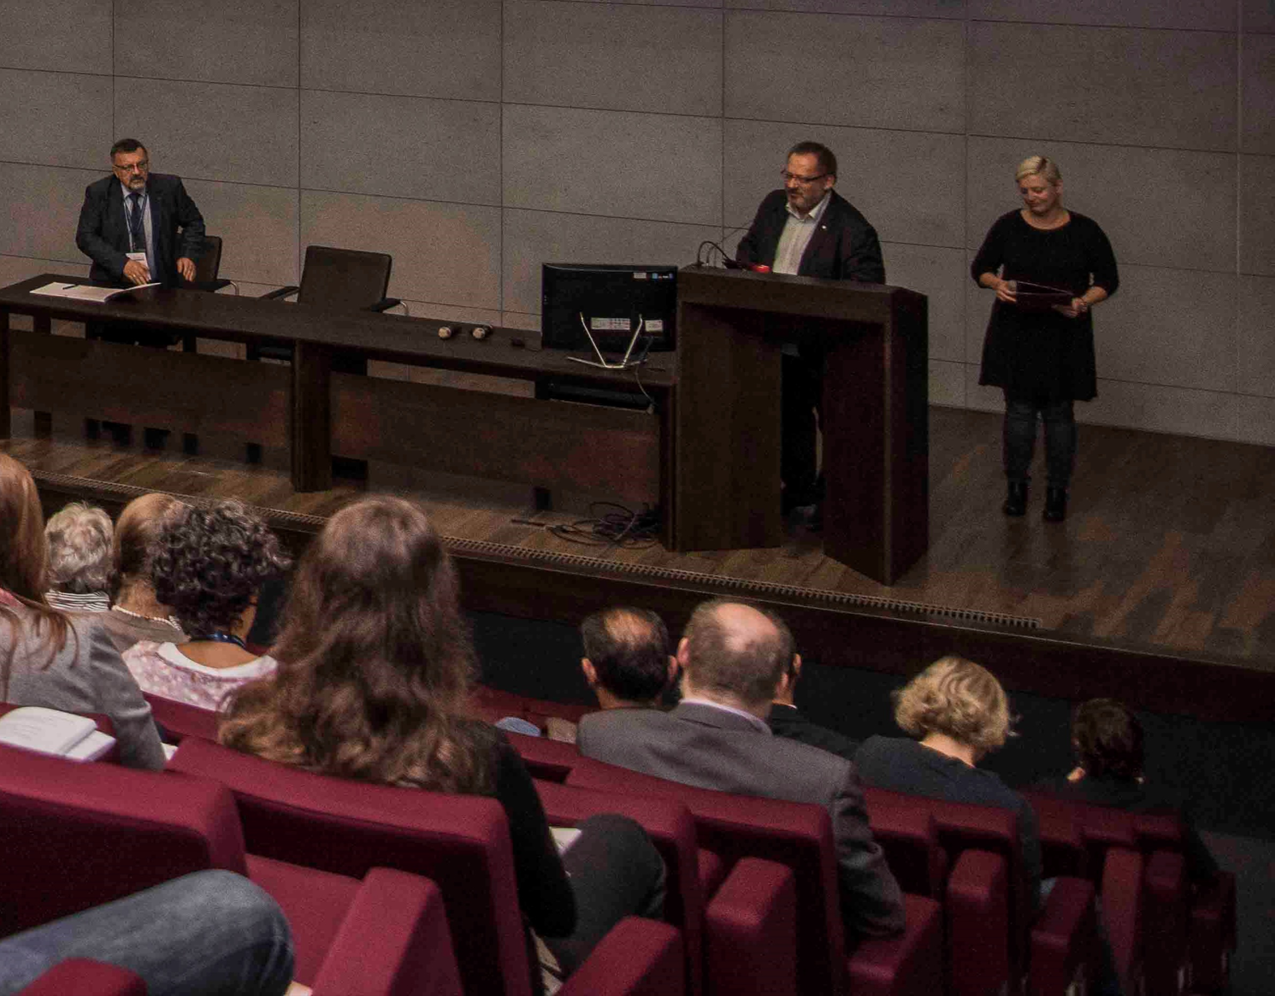
Notes:
His Magnificence Rector (President) of the Academy of Fine Arts, professor Stanisław Tabisz

Slide 12
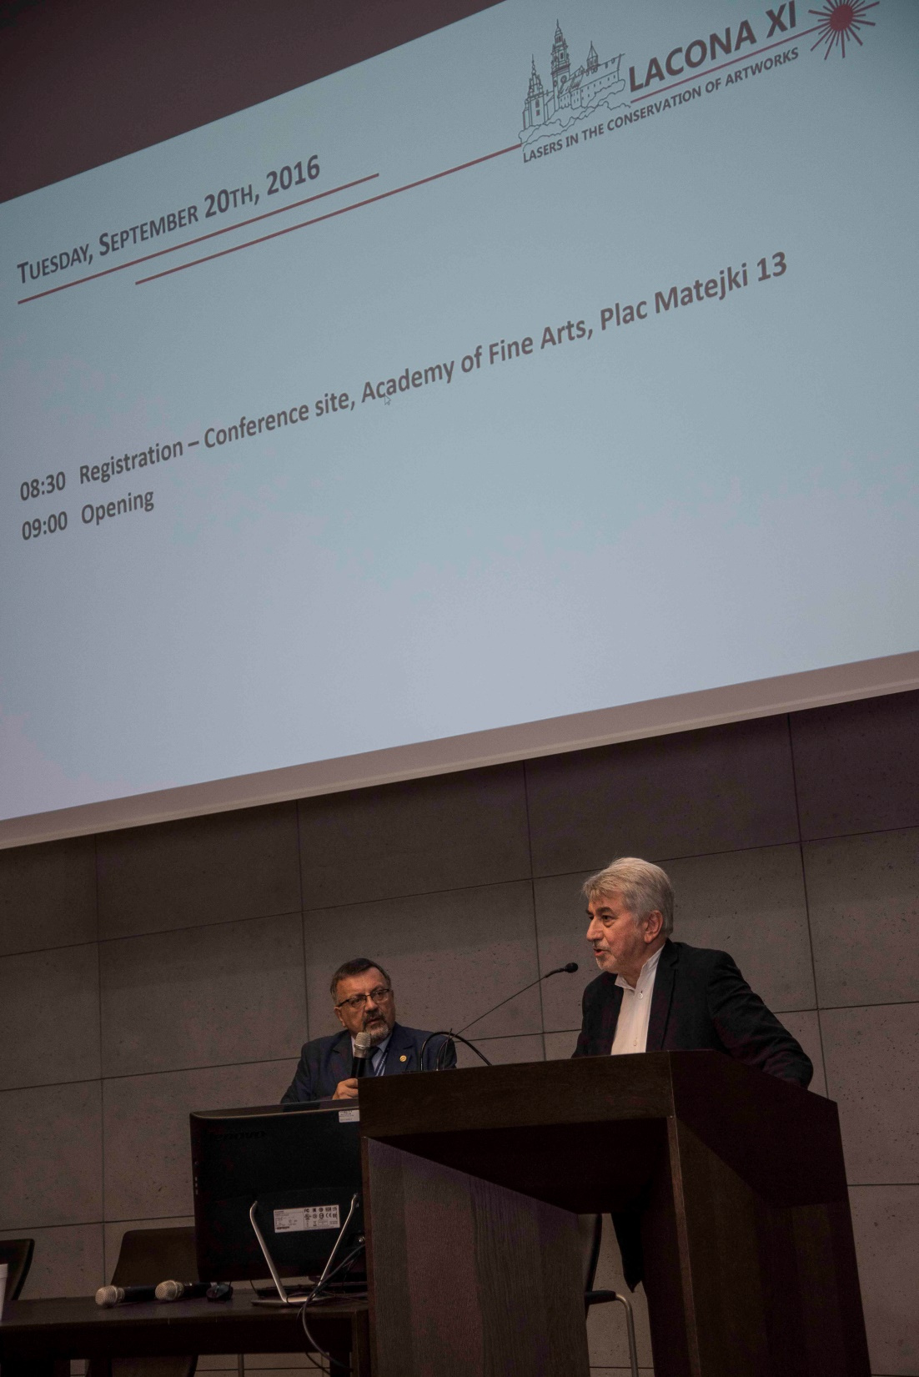
Notes:
Vice President of Interacademic Institute of Conservation, professor Ireneusz Płuska

Slide 13
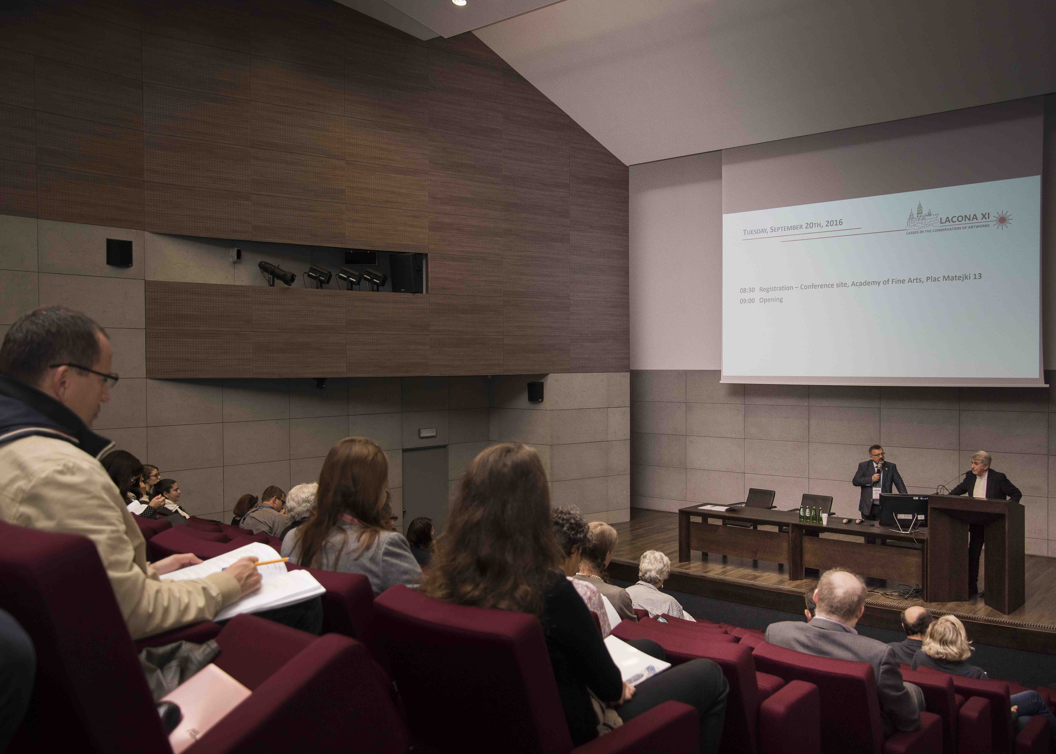

Slide 14
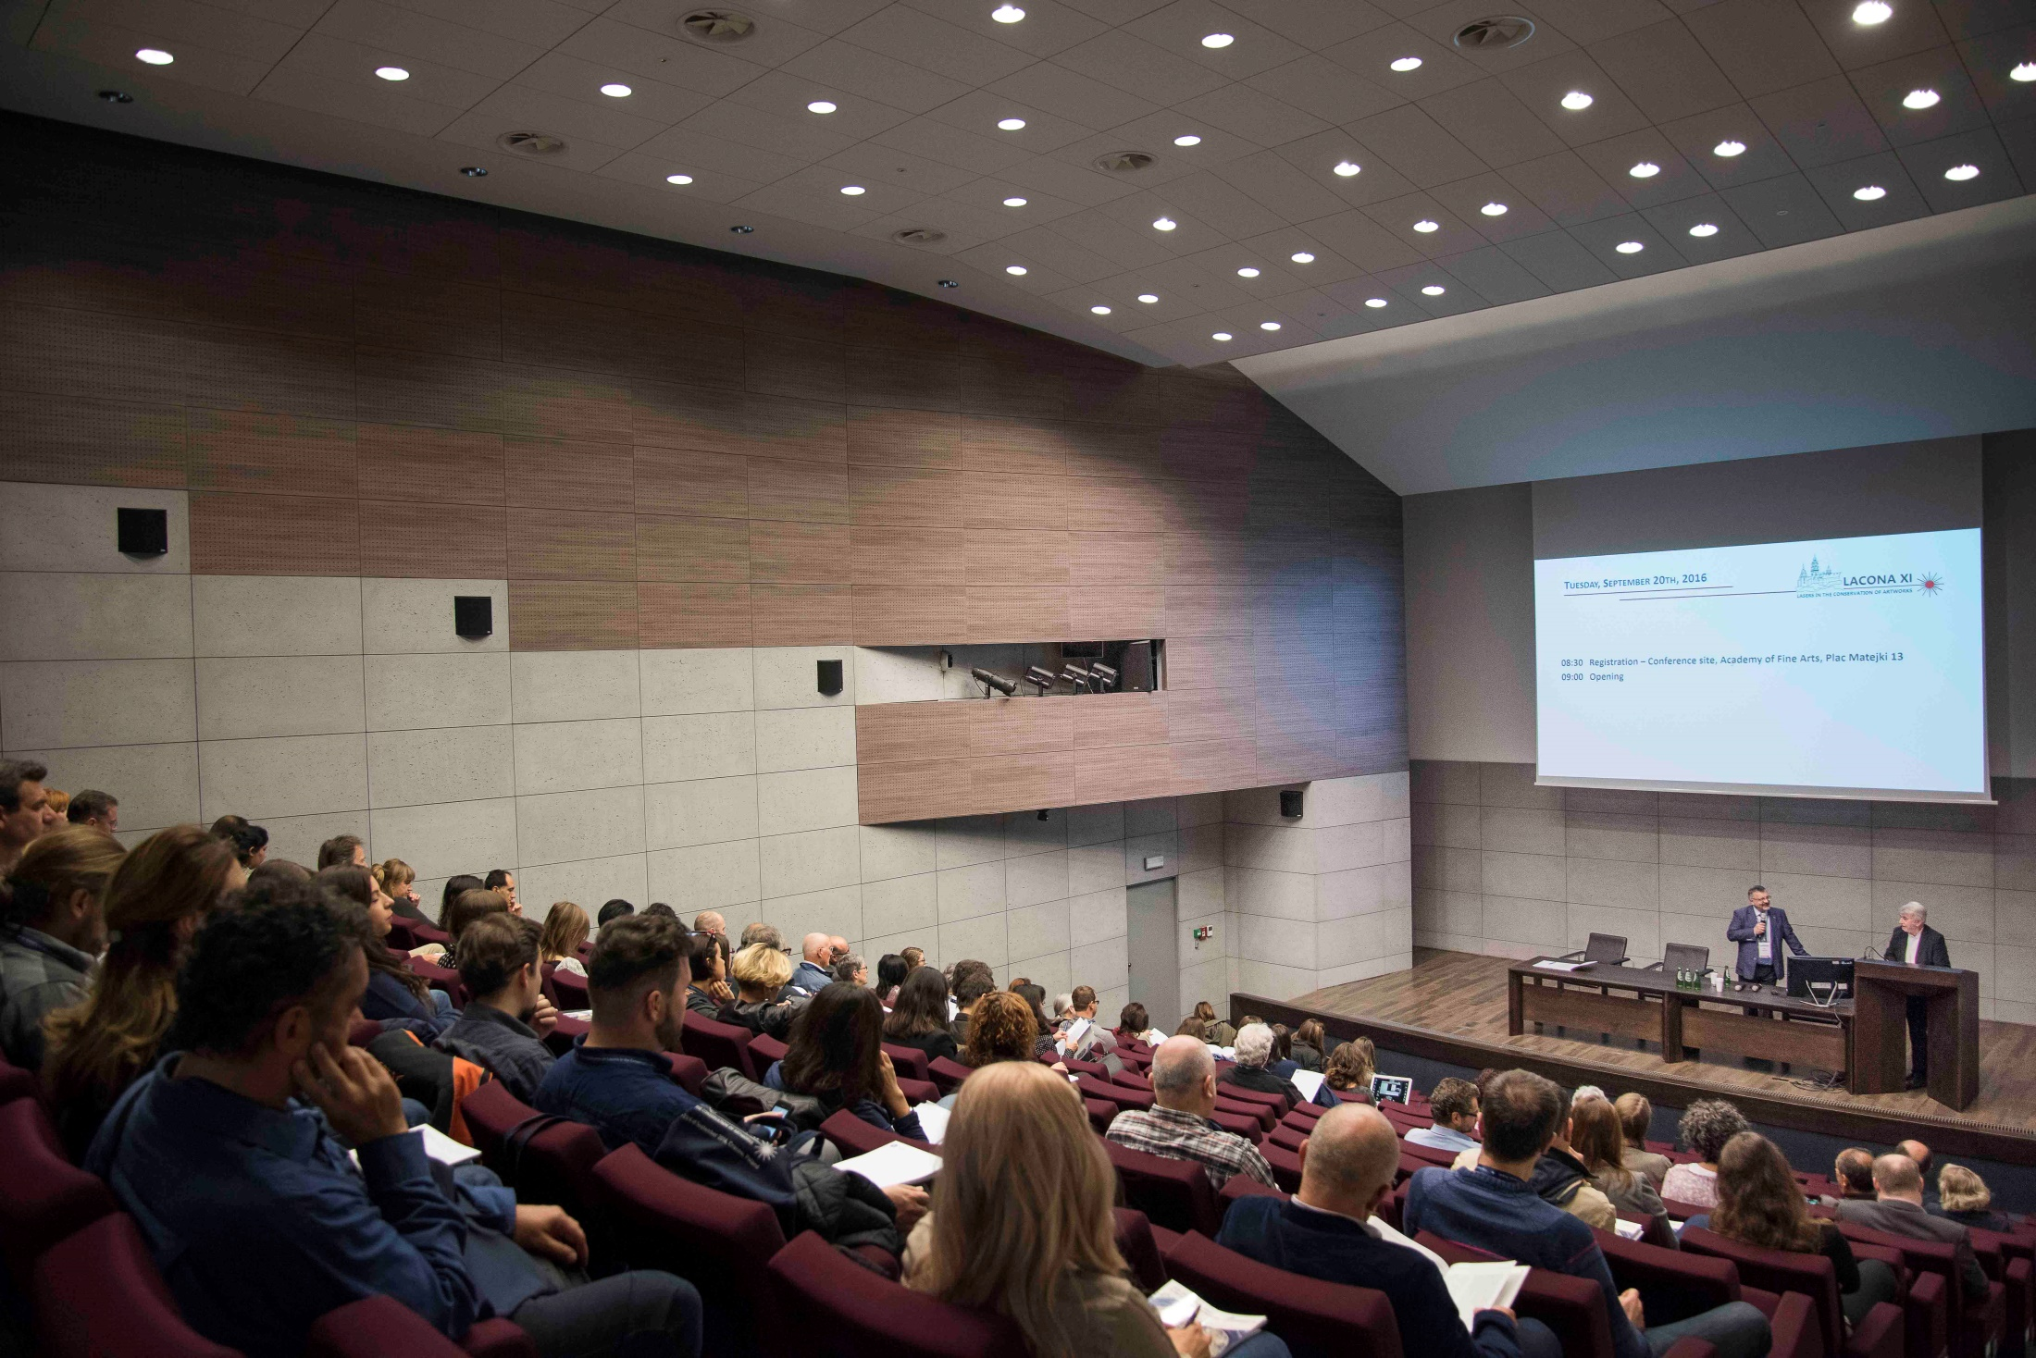

Slide 15
Session 1: Developments in laser removal of unwanted substances on culturally-important objects and monuments
Jan Matejko Academy of Fine Arts
Tuesday, 20th September 2016
Kraków , Poland

Slide 16
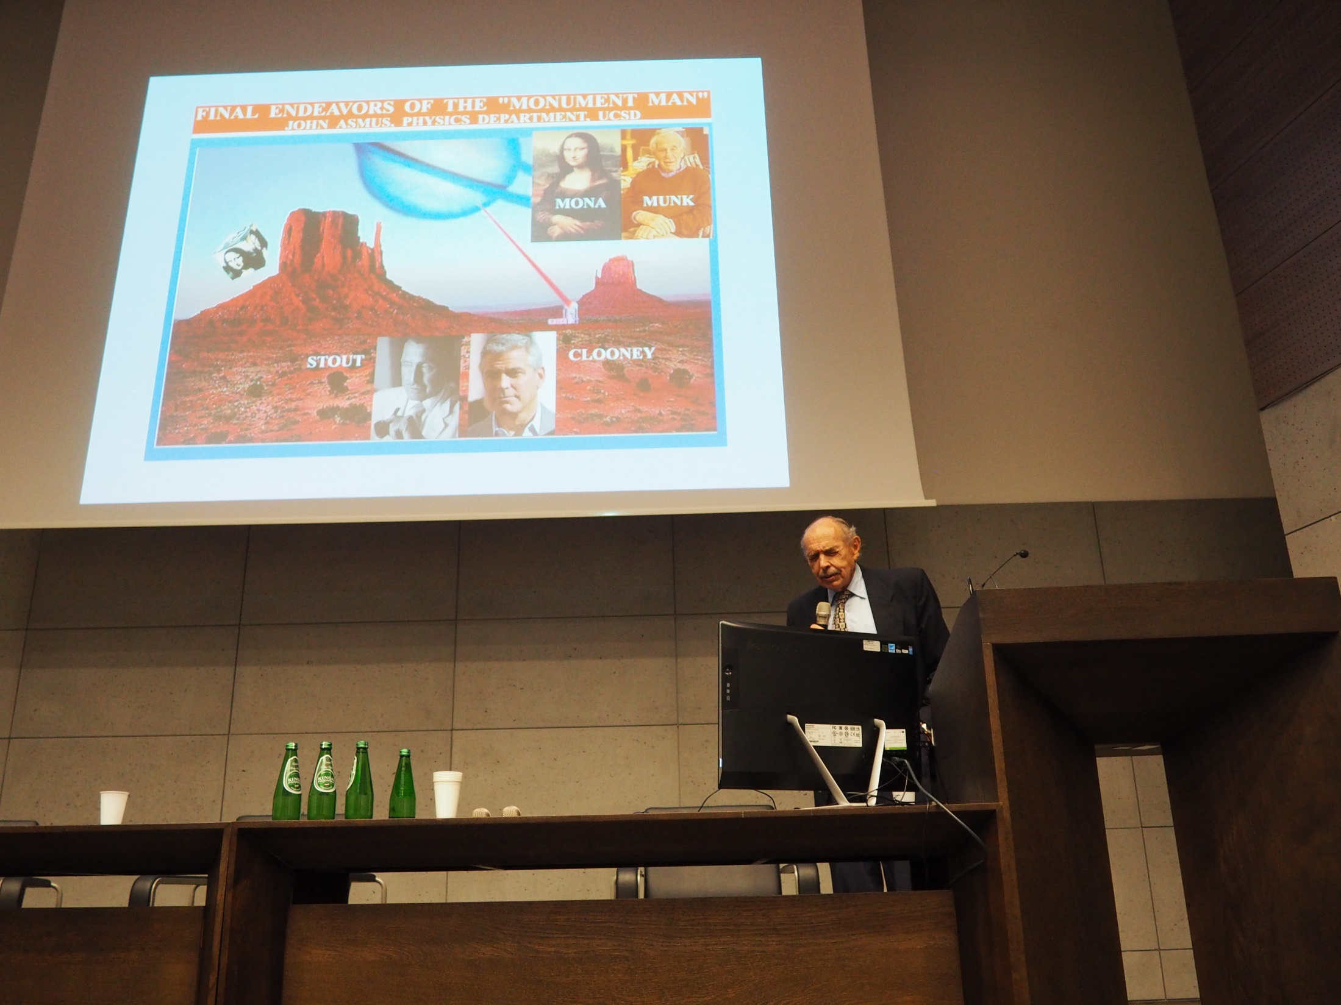
Notes:
John Asmus: Final endeavor of “Monument Man” – key-note lecture

Slide 17
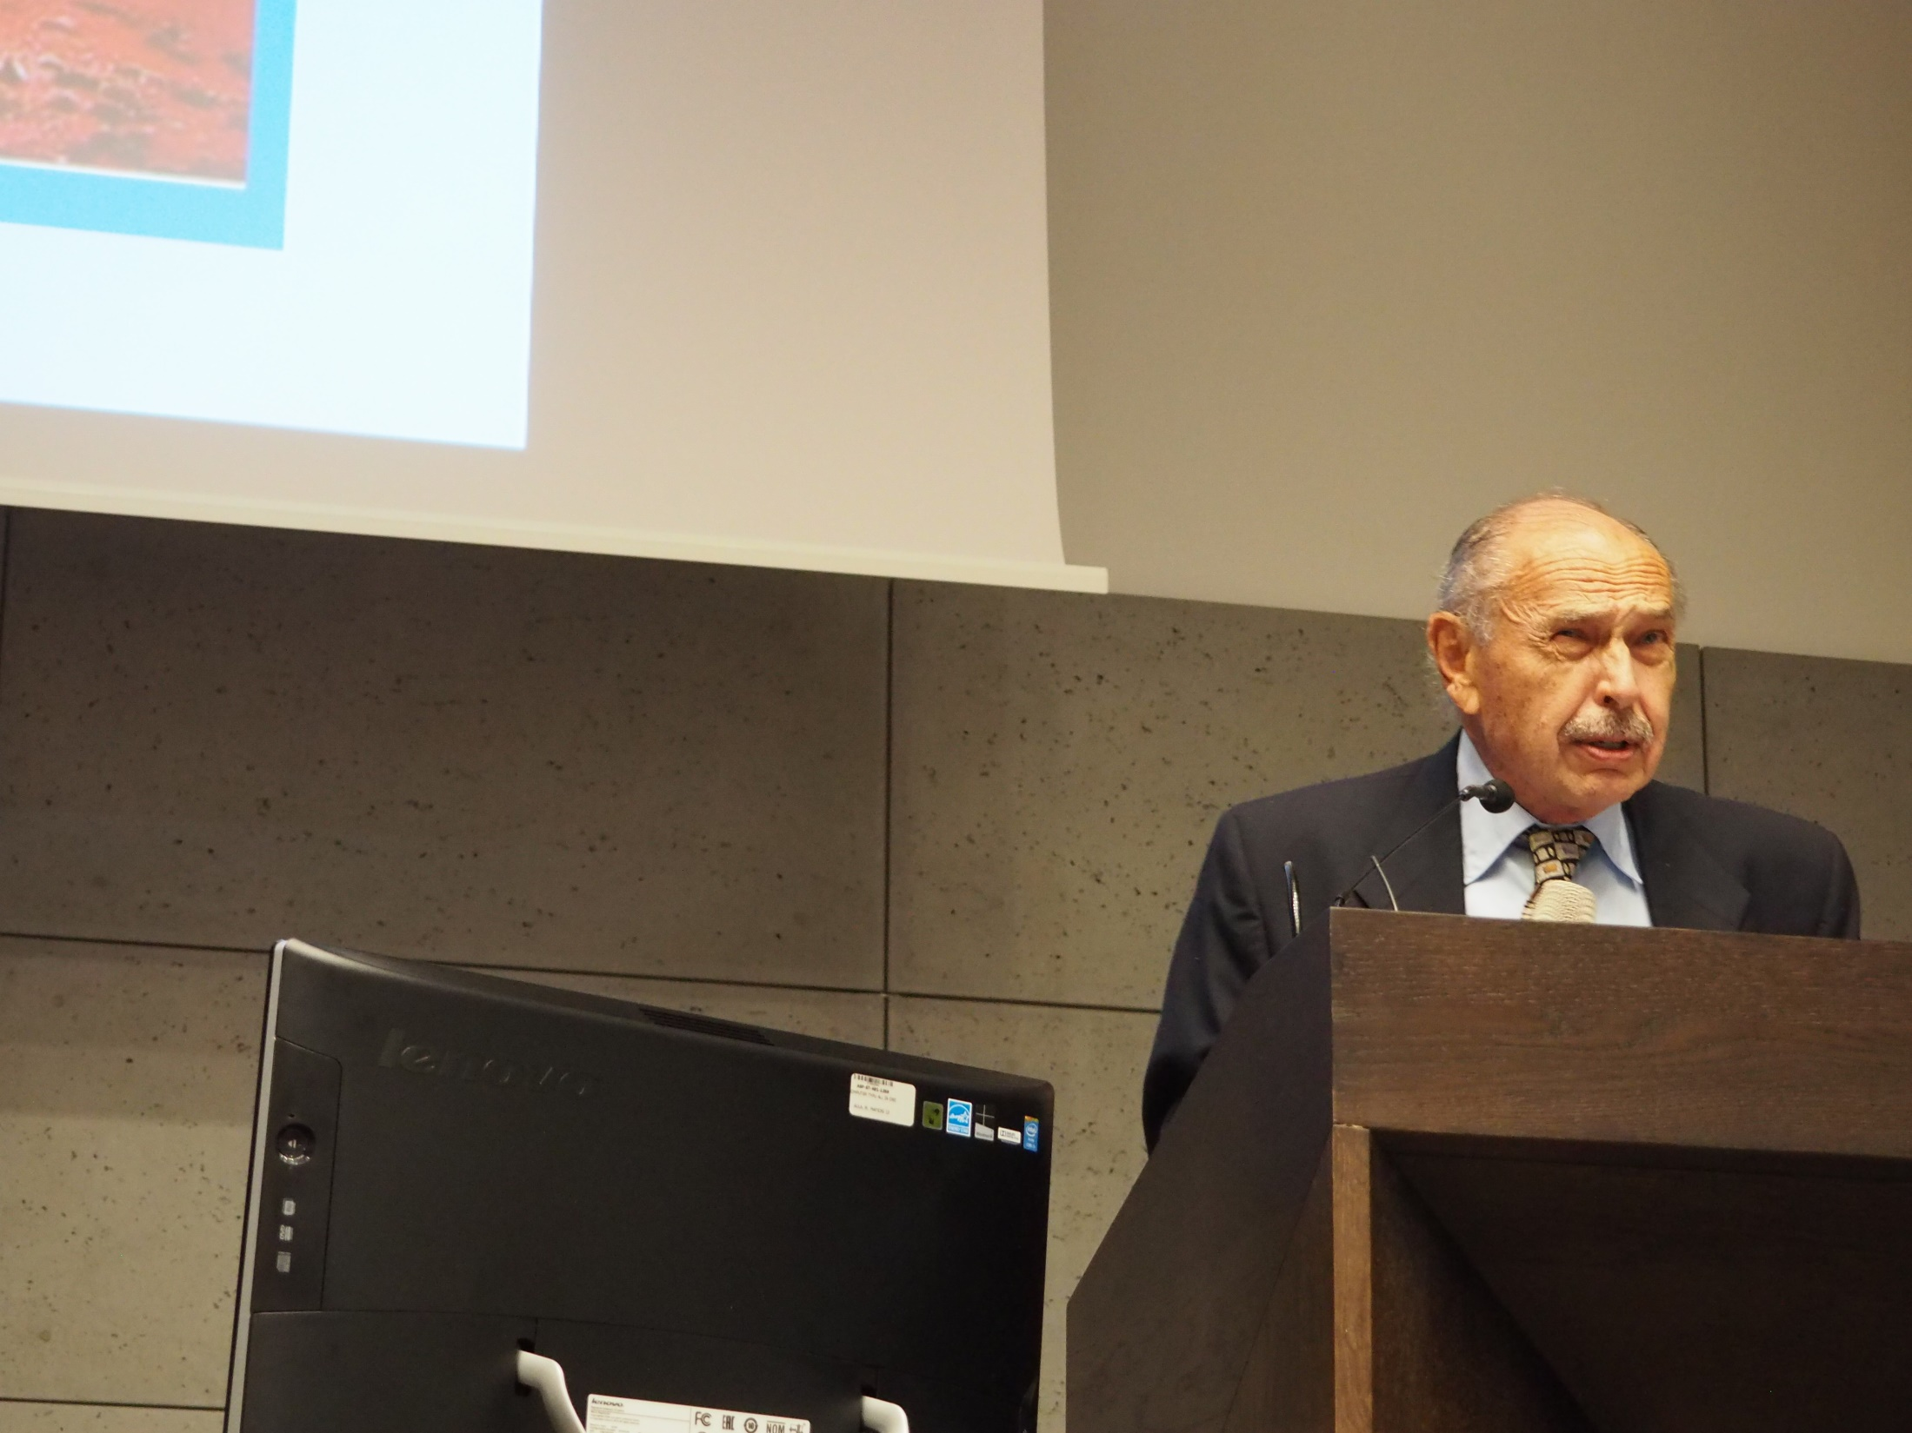
Notes:
John Asmus: Final endeavor of “Monument Man” – key-note lecture

Slide 18
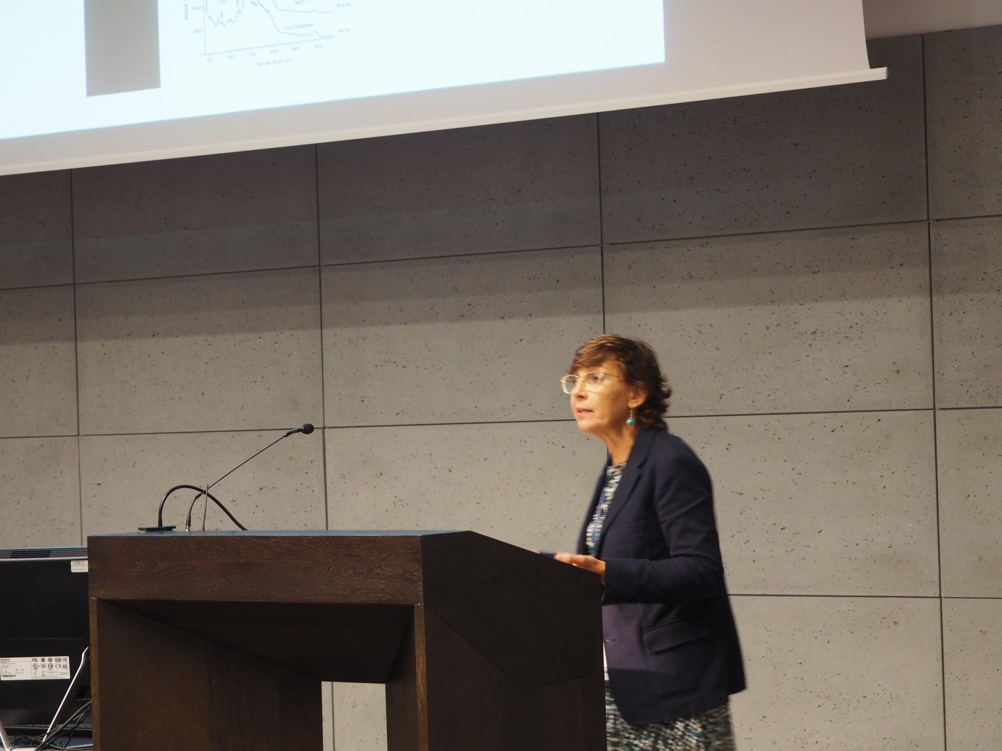
Notes:
Marta Castillejo: Non-linear microscopies for the assessment of photochemical modifications upon laser removal of varnishes used in paintings

Slide 19
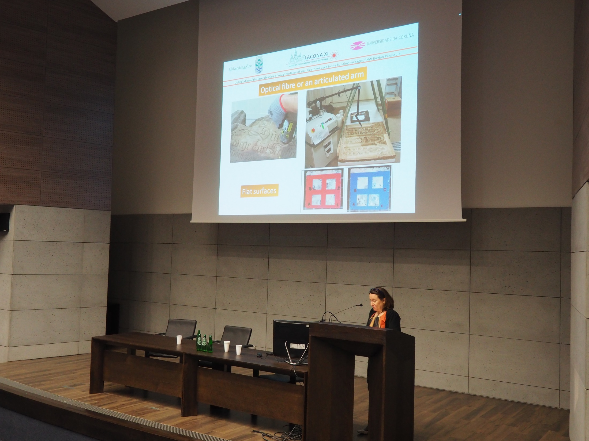
Notes:
Ana J. López,
Optimization of the laser cleaning of rough surfaces of granitic stones used in the building heritage of NW Iberian peninsula

Slide 20
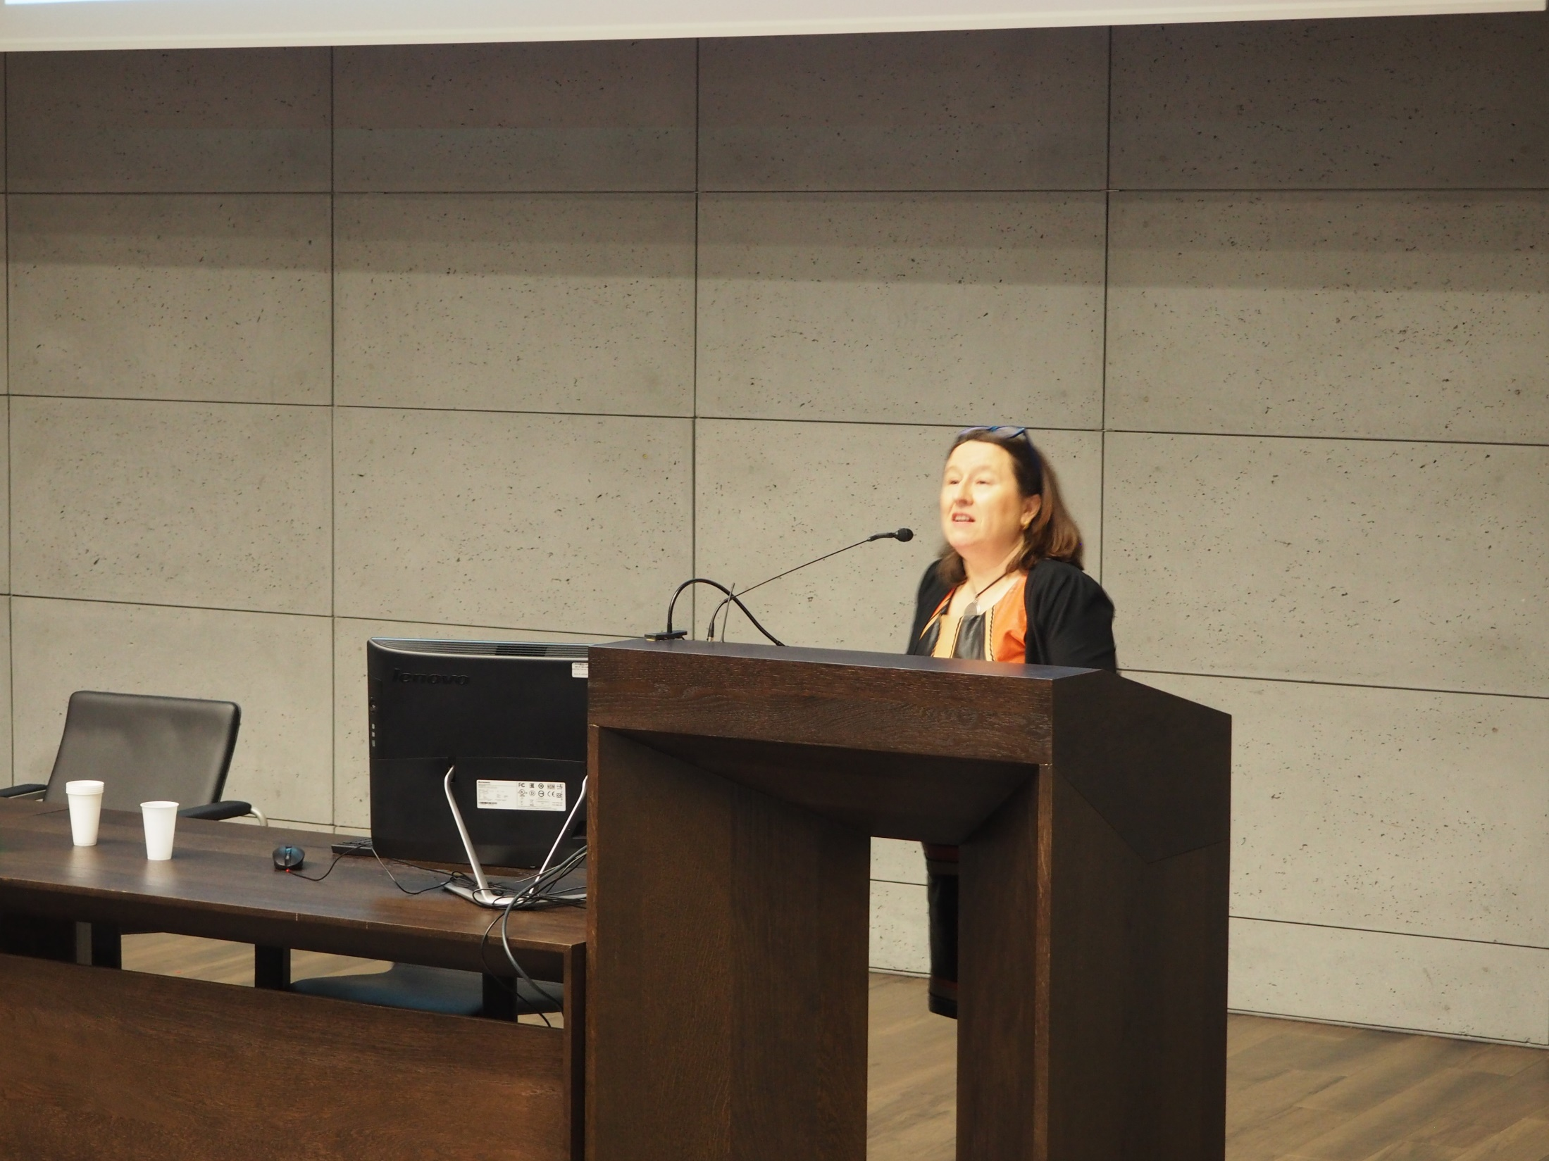
Notes:
Ana J. López,
Optimization of the laser cleaning of rough surfaces of granitic stones used in the building heritage of NW Iberian peninsula

Slide 21
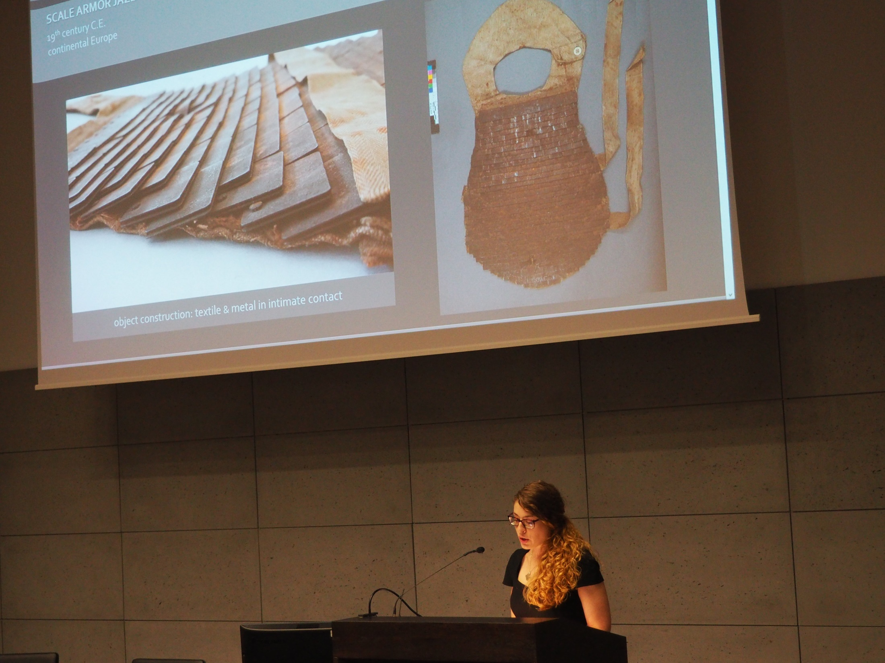
Notes:
Marlene April Yandrisevits,
Wavelength-dependent absorption and scattering effects on laser cleaning of a corroded iron alloy European scale armor

Slide 22
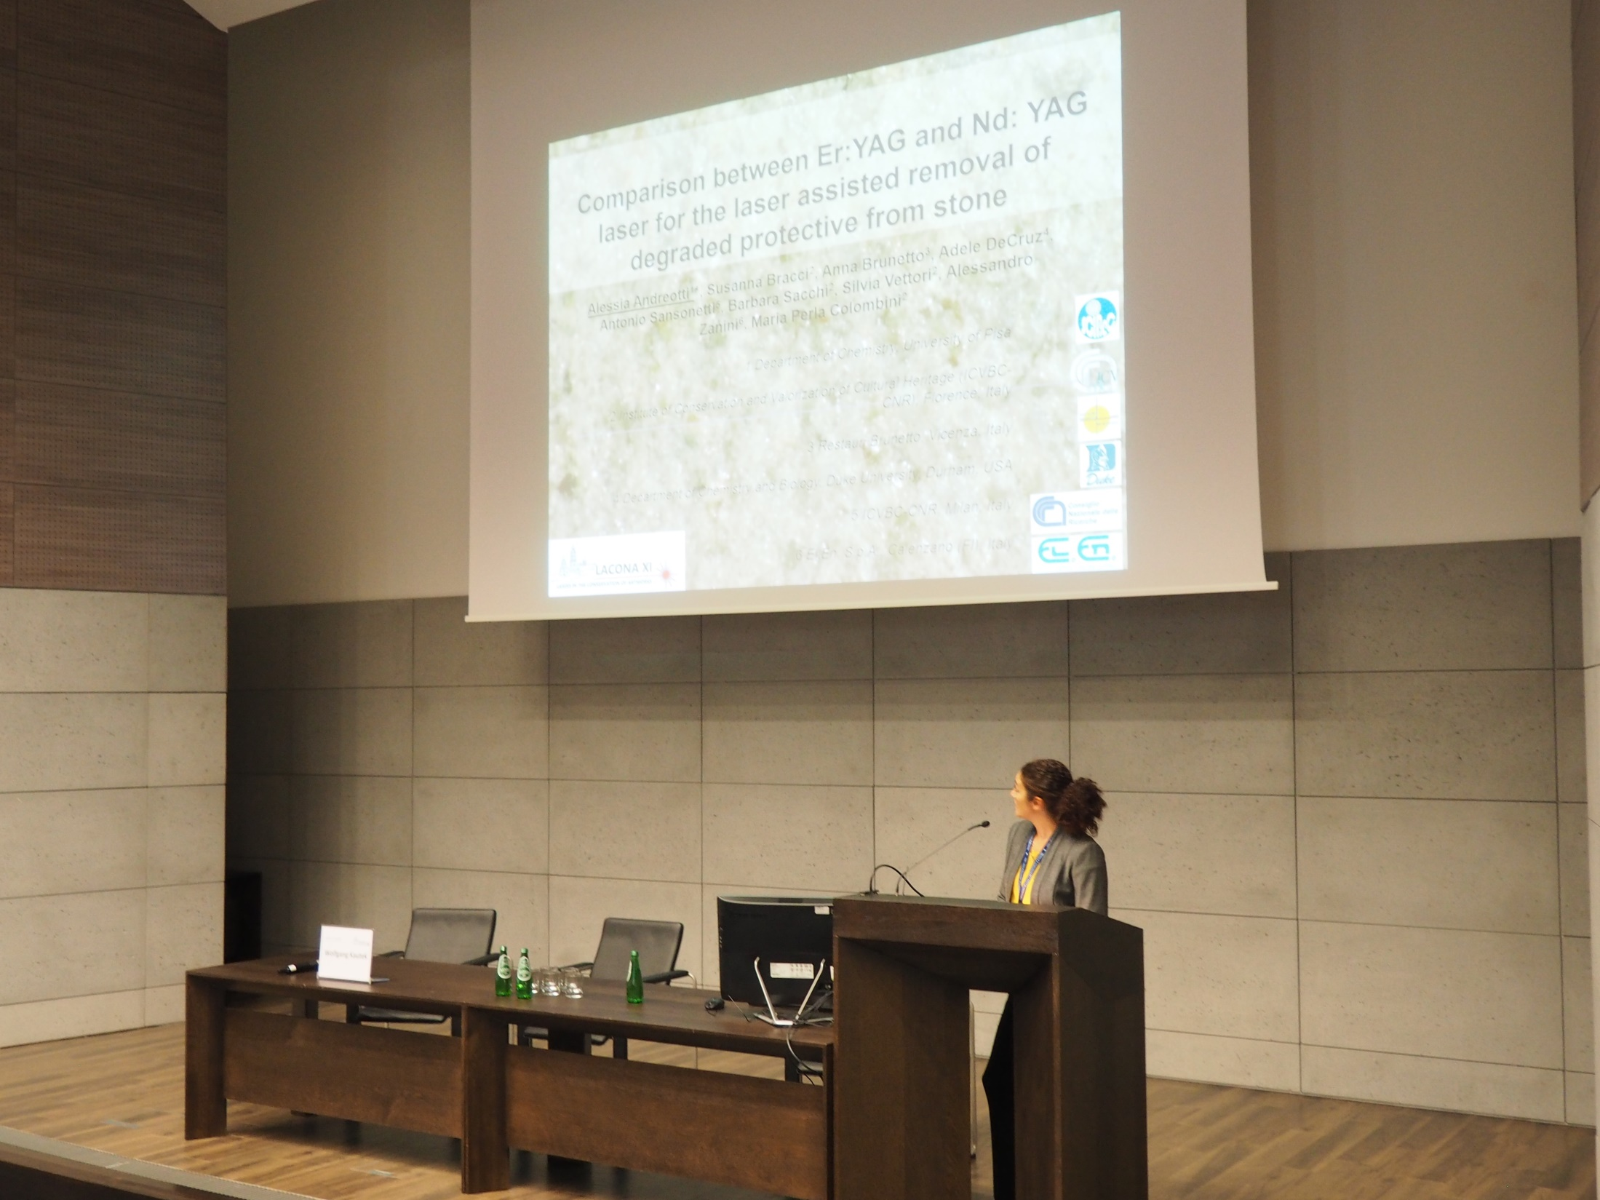
Notes:
Alessia Andreotti
Comparison between Er:YAG and Nd:YAG laser for the laser assisted removal of degraded protective from stone

Slide 23
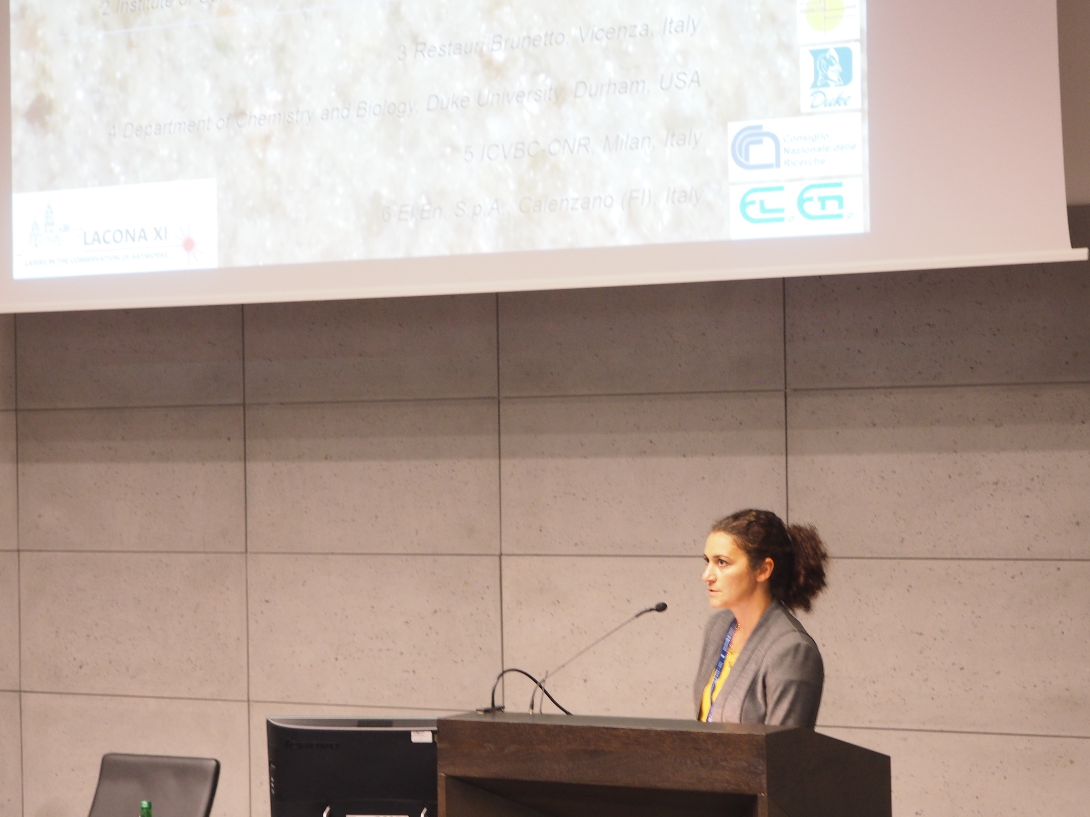
Notes:
Alessia Andreotti
Comparison between Er:YAG and Nd:YAG laser for the laser assisted removal of degraded protective from stone

Slide 24
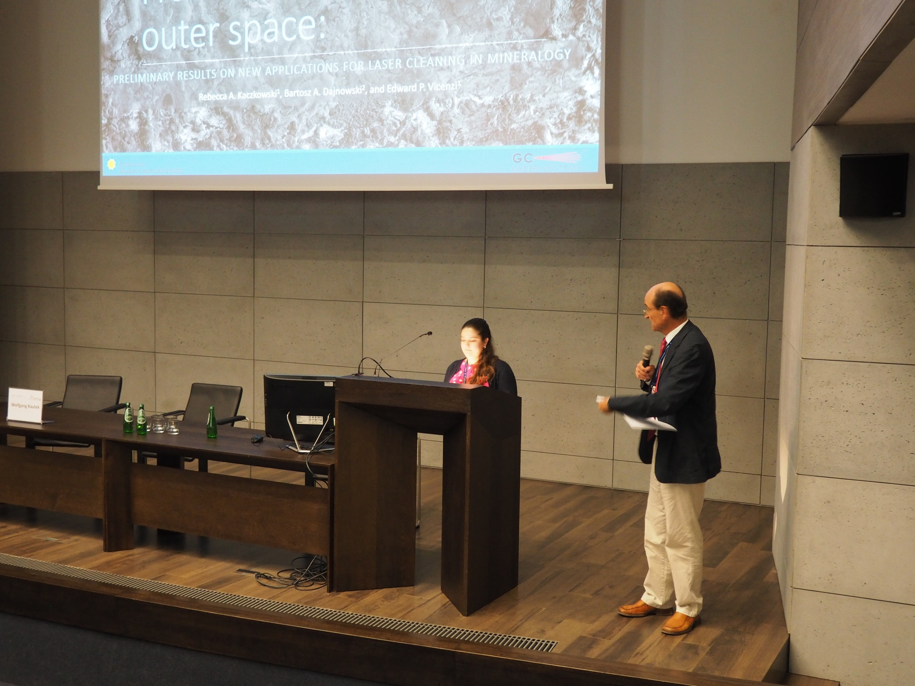
Notes:
Rebecca Kaczkowski & Wolfgang Kautek (Chair)
From underground to outer space: new applications for laser cleaning in mineralogy

Slide 25
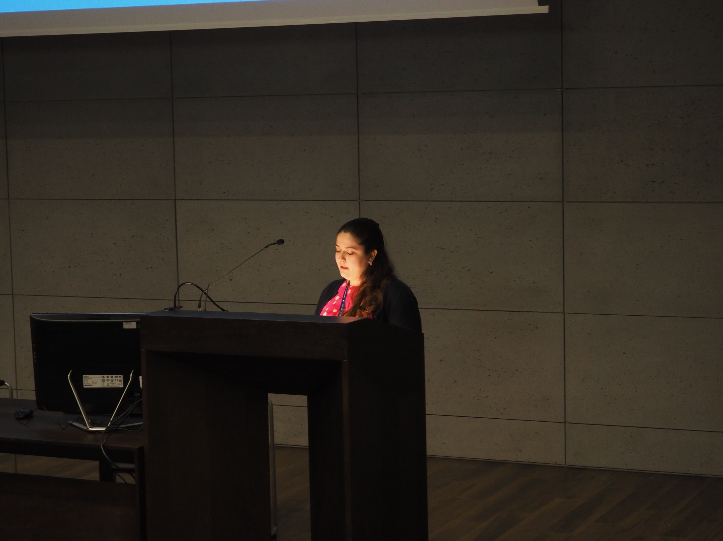
Notes:
Rebecca Kaczkowski
From underground to outer space: new applications for laser cleaning in mineralogy

Slide 26
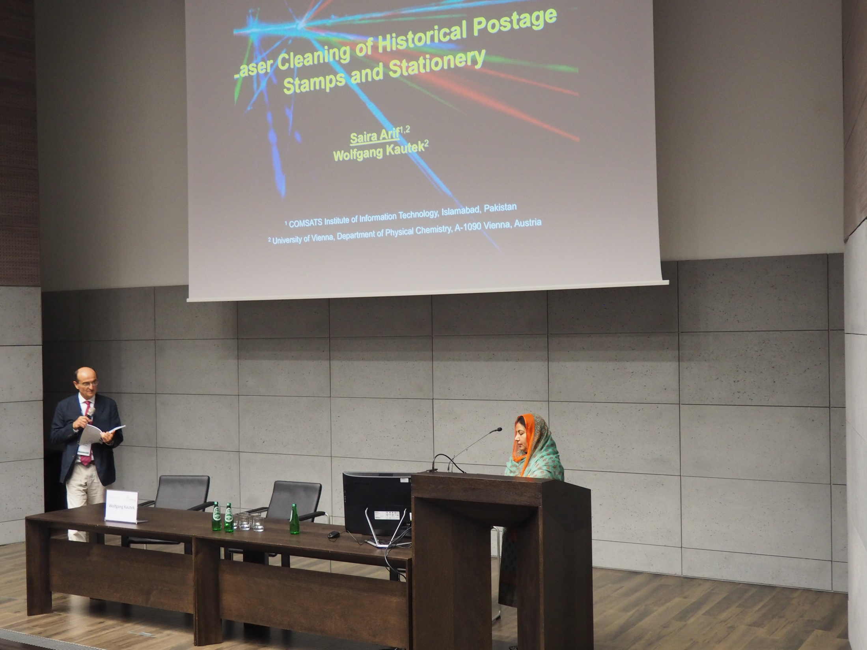
Notes:
Saira Arif,
Laser cleaning of historical postage stamps and stationery

Slide 27
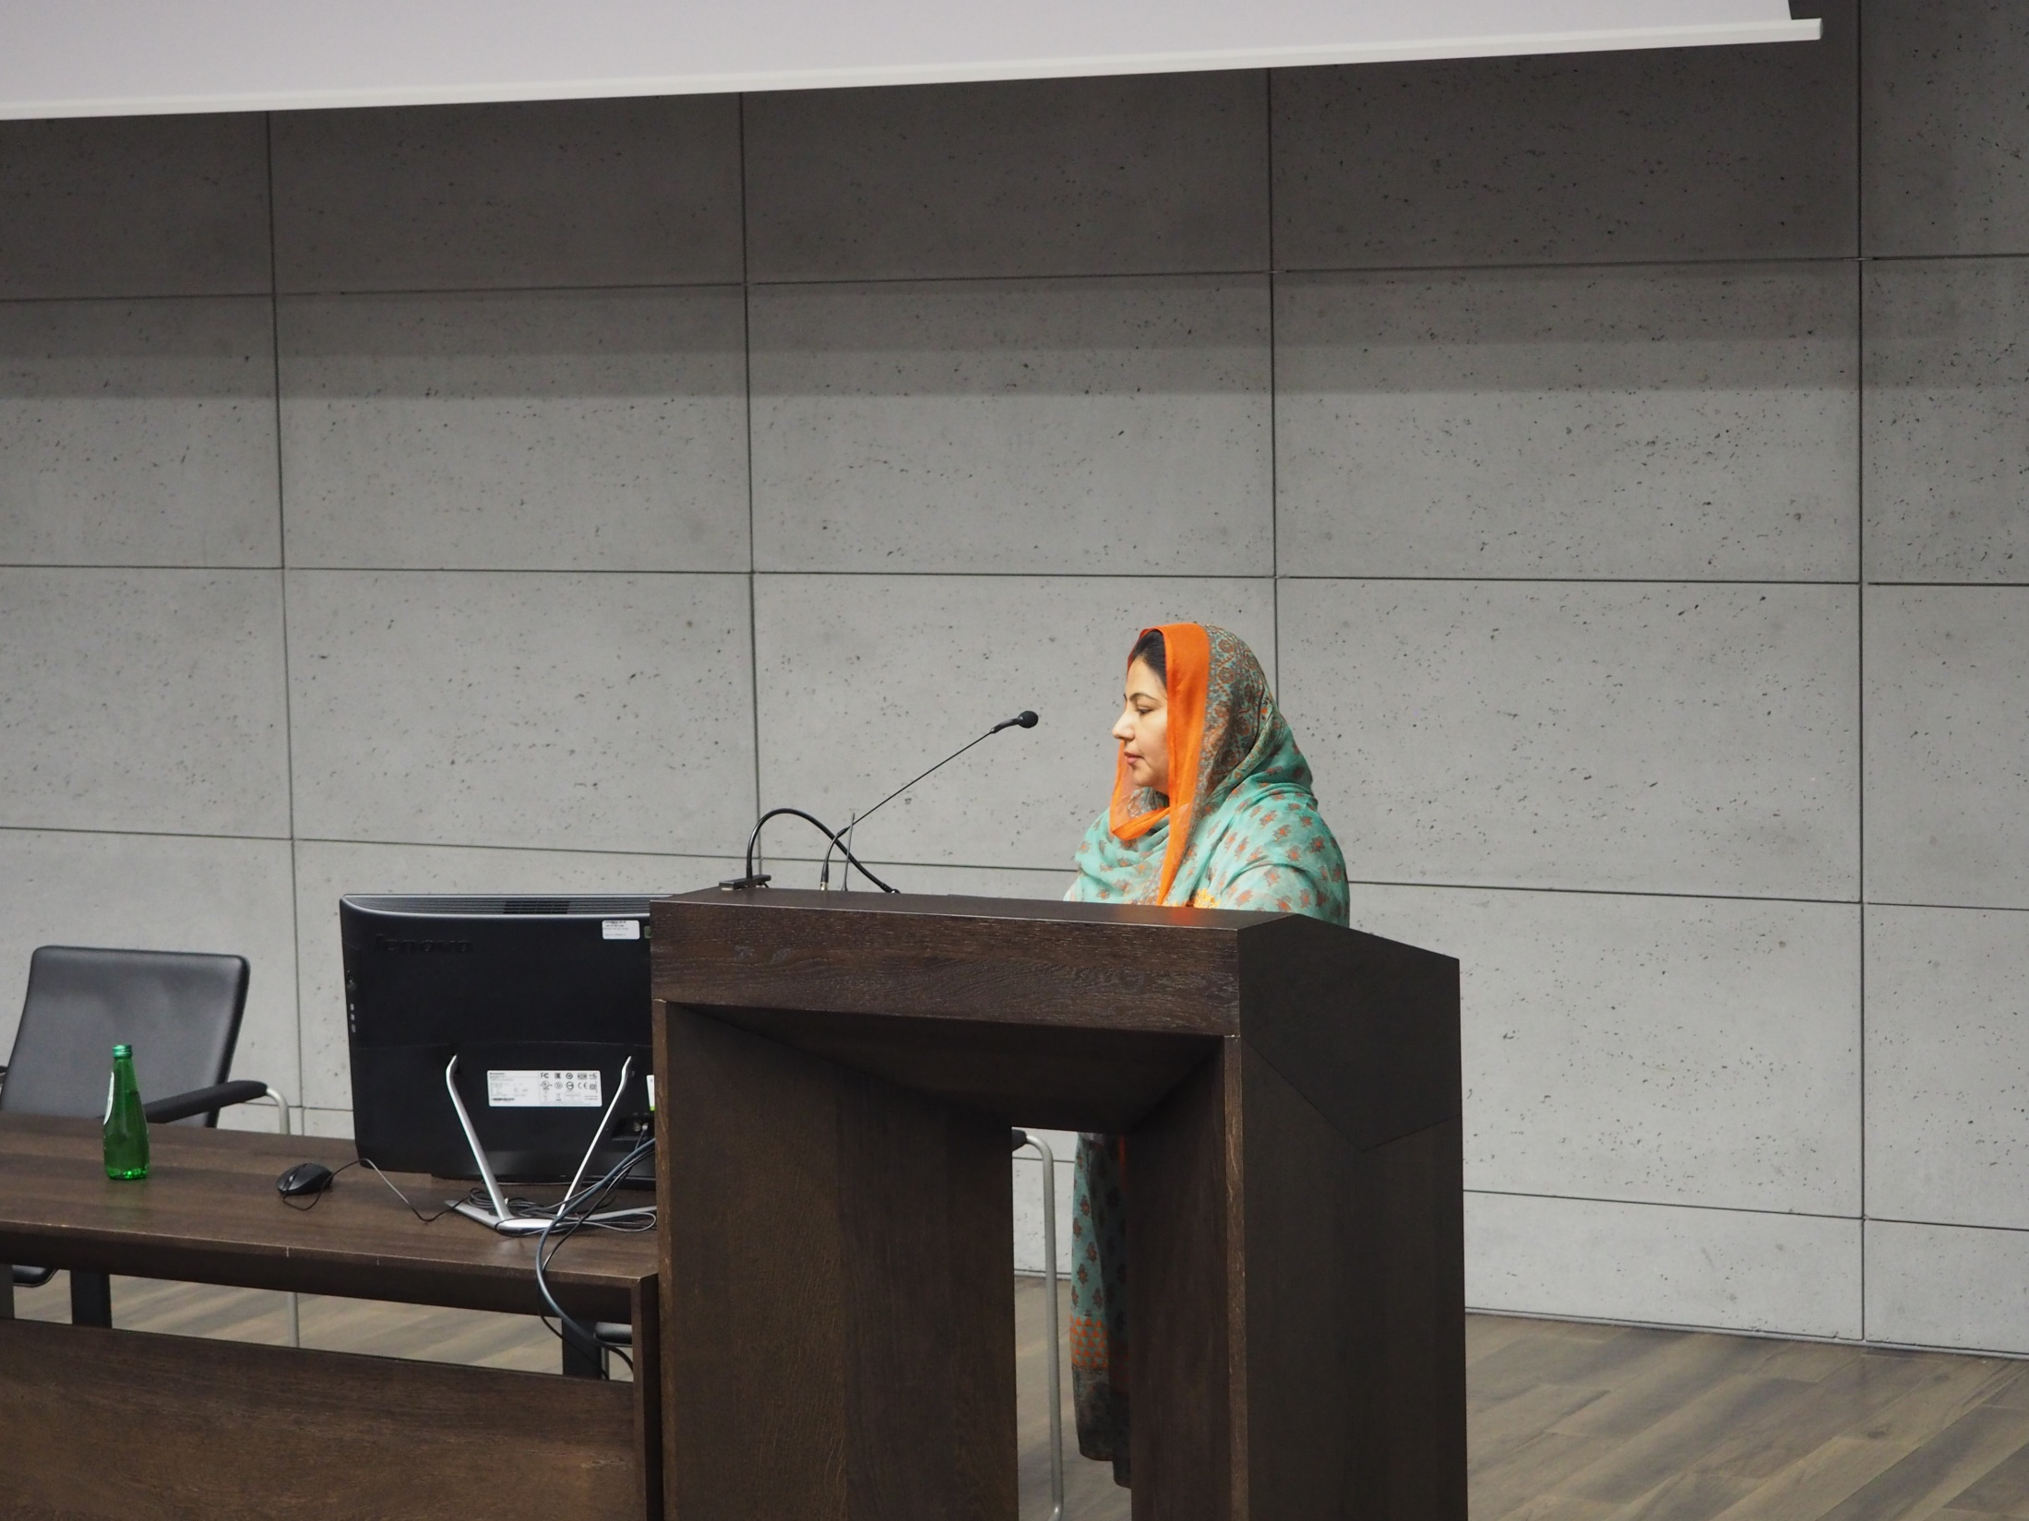
Notes:
Saira Arif,
Laser cleaning of historical postage stamps and stationery

Slide 28
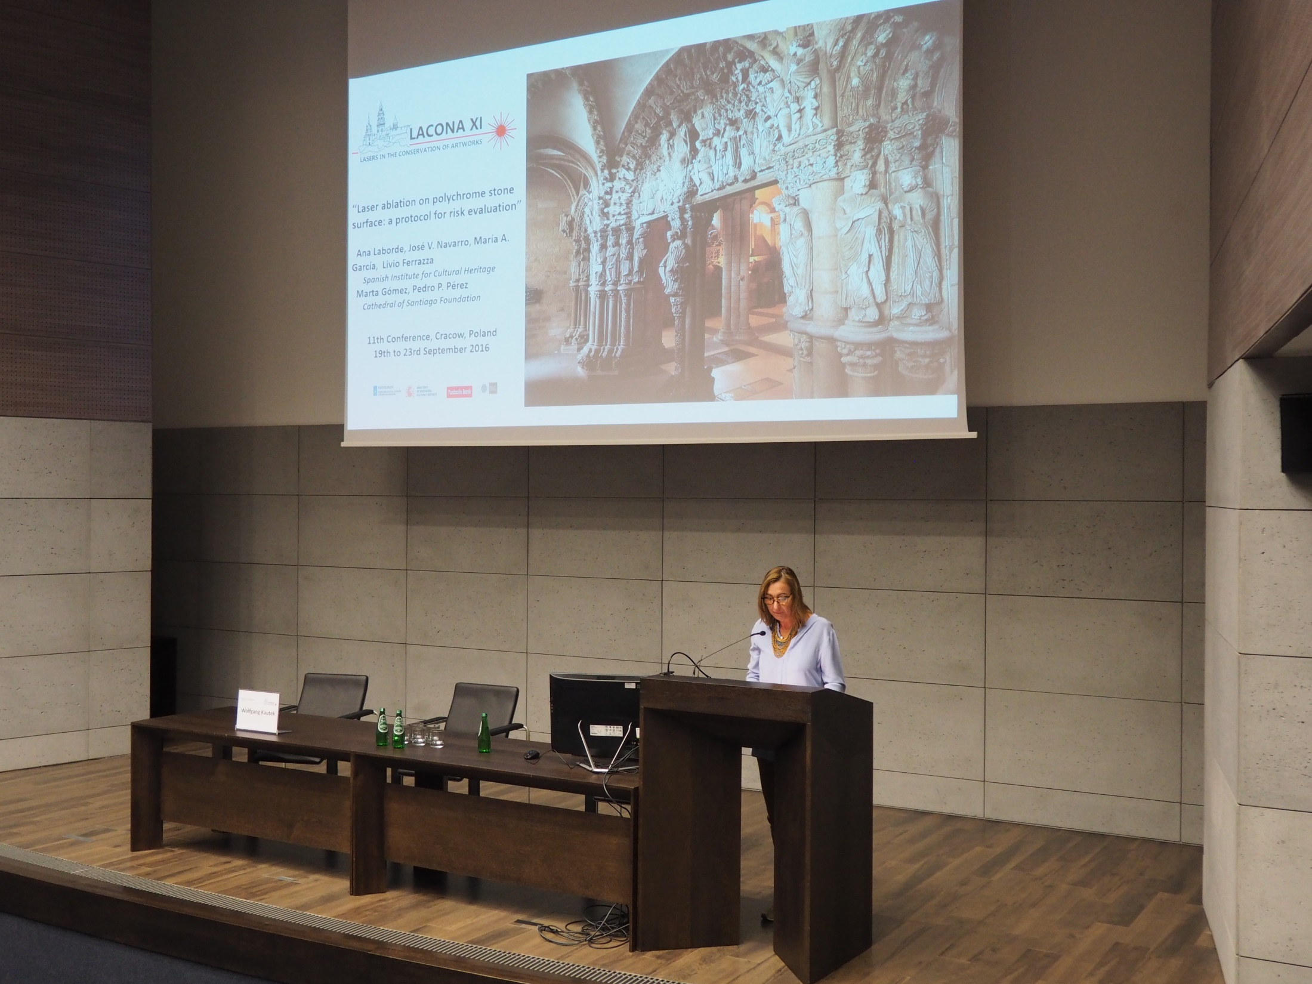
Notes:
Ana Laborde Marqueze,
Laser ablation on polychrome stone surface: a protocol for risk evaluation

Slide 29
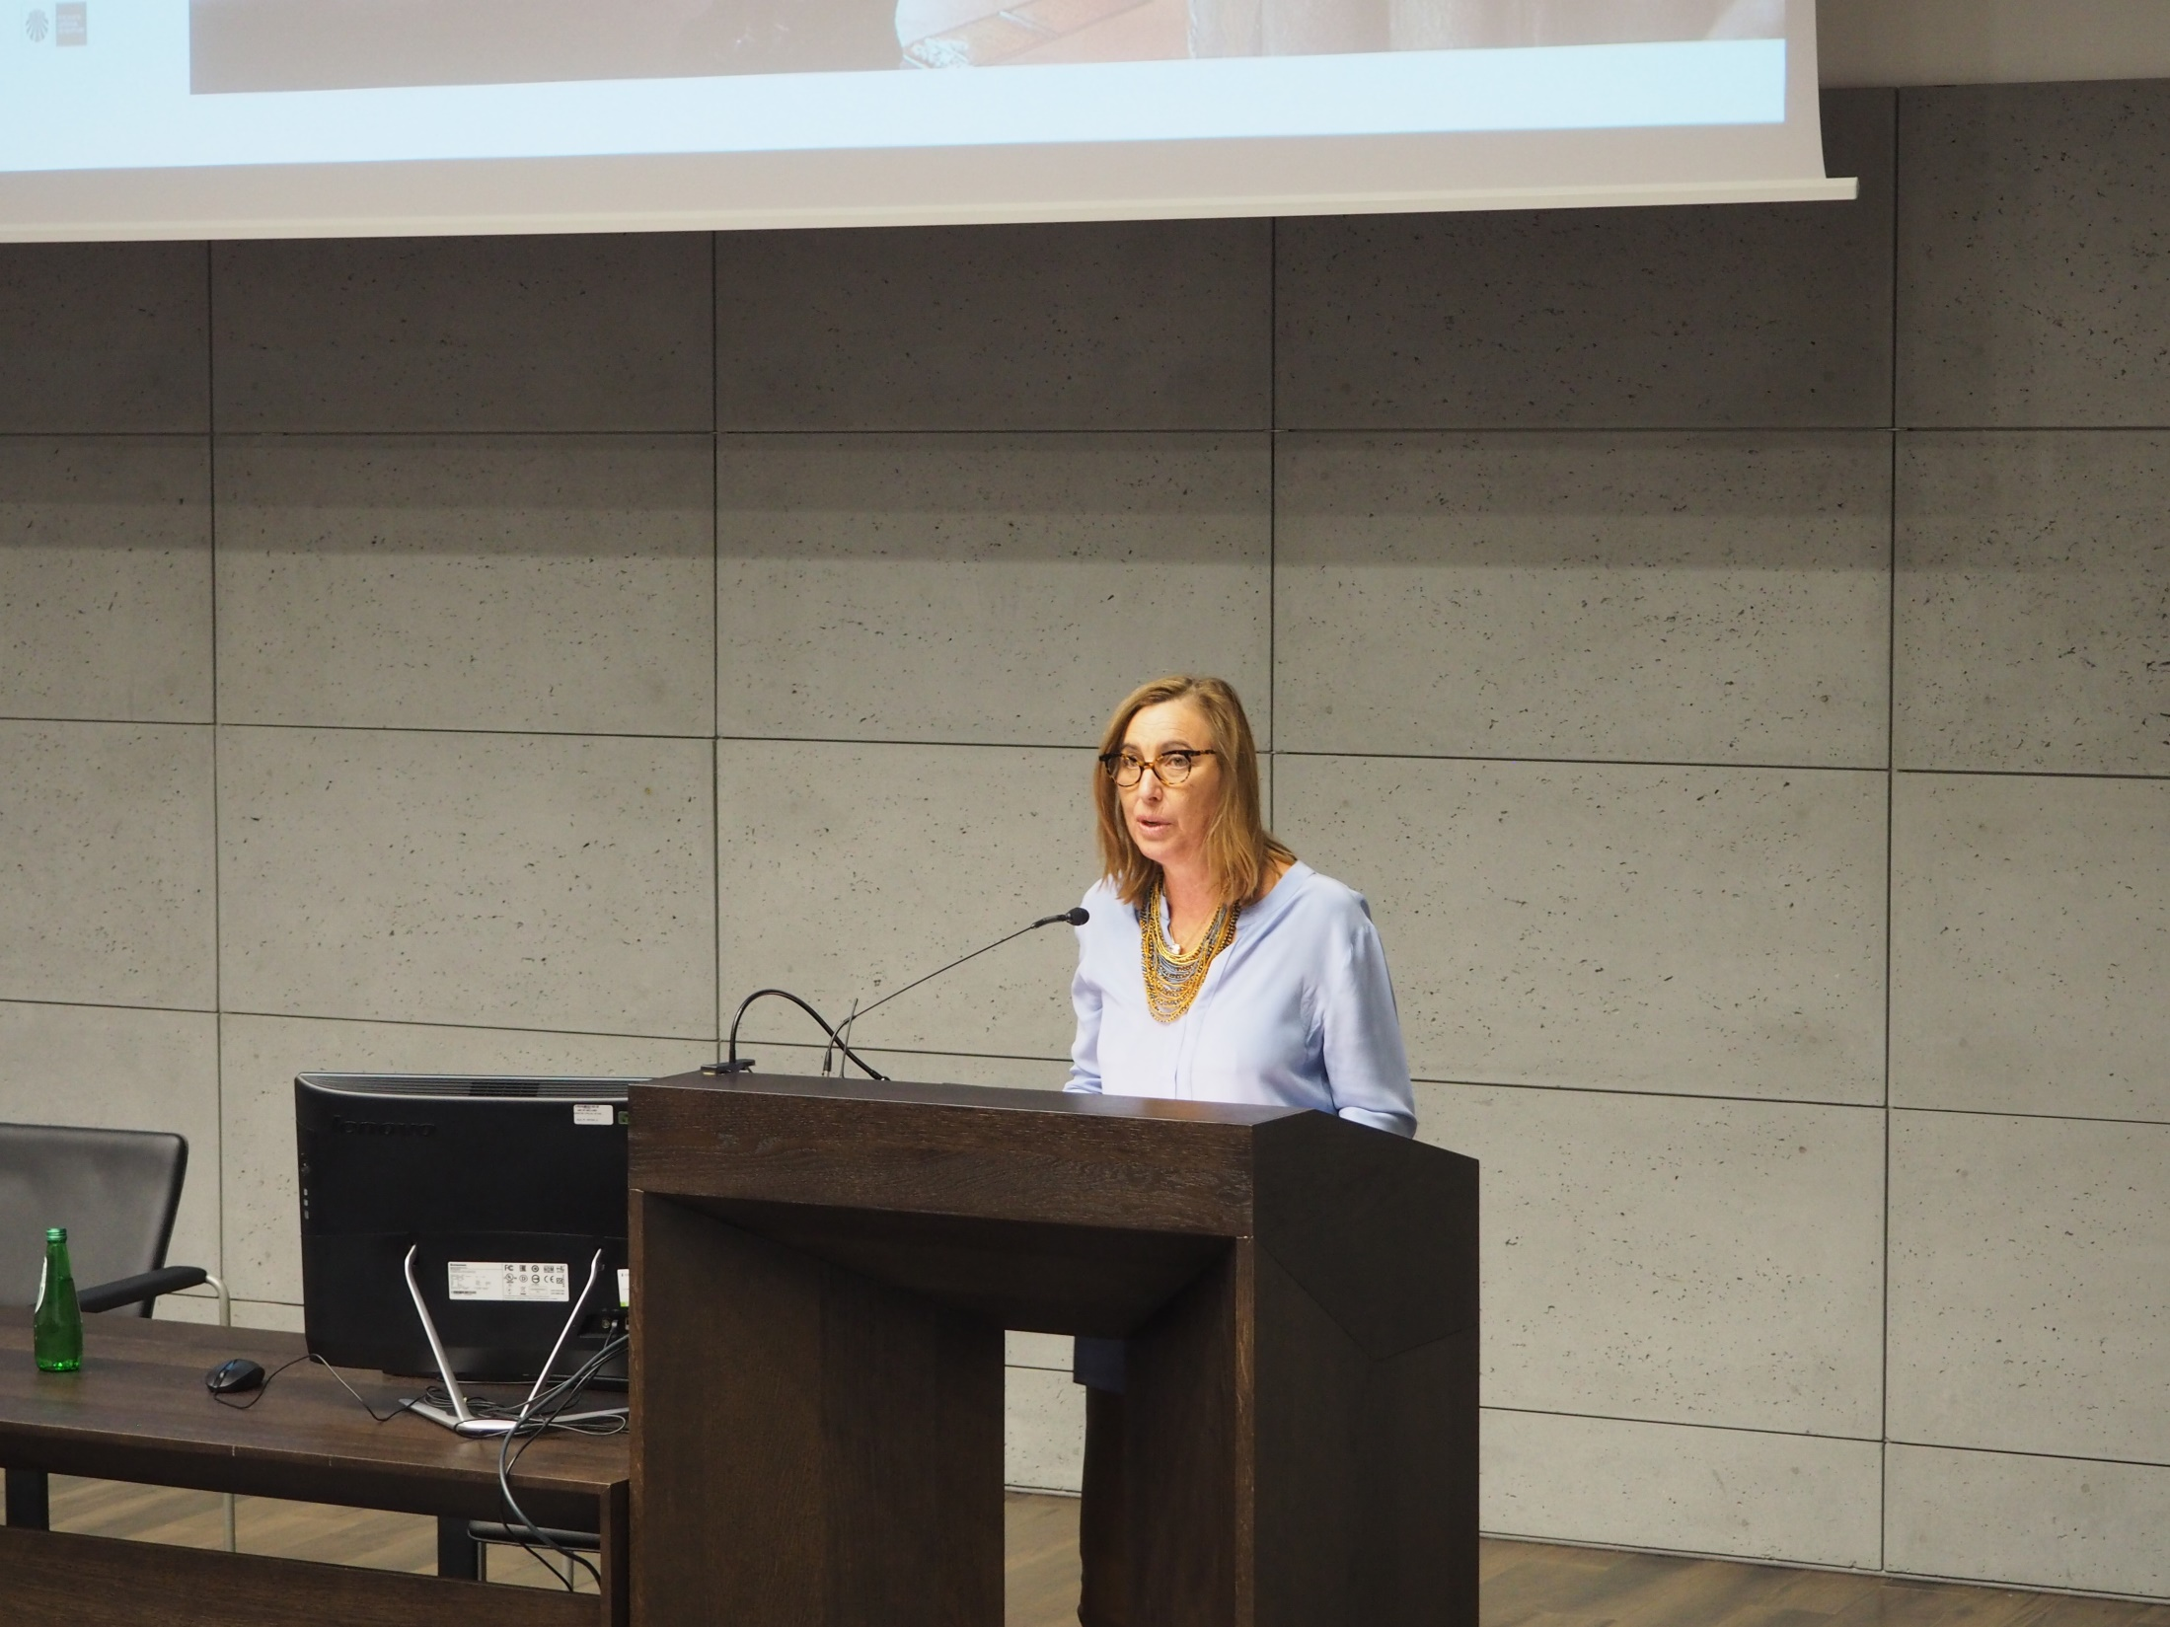
Notes:
Ana Laborde Marqueze,
Laser ablation on polychrome stone surface: a protocol for risk evaluation

Slide 30
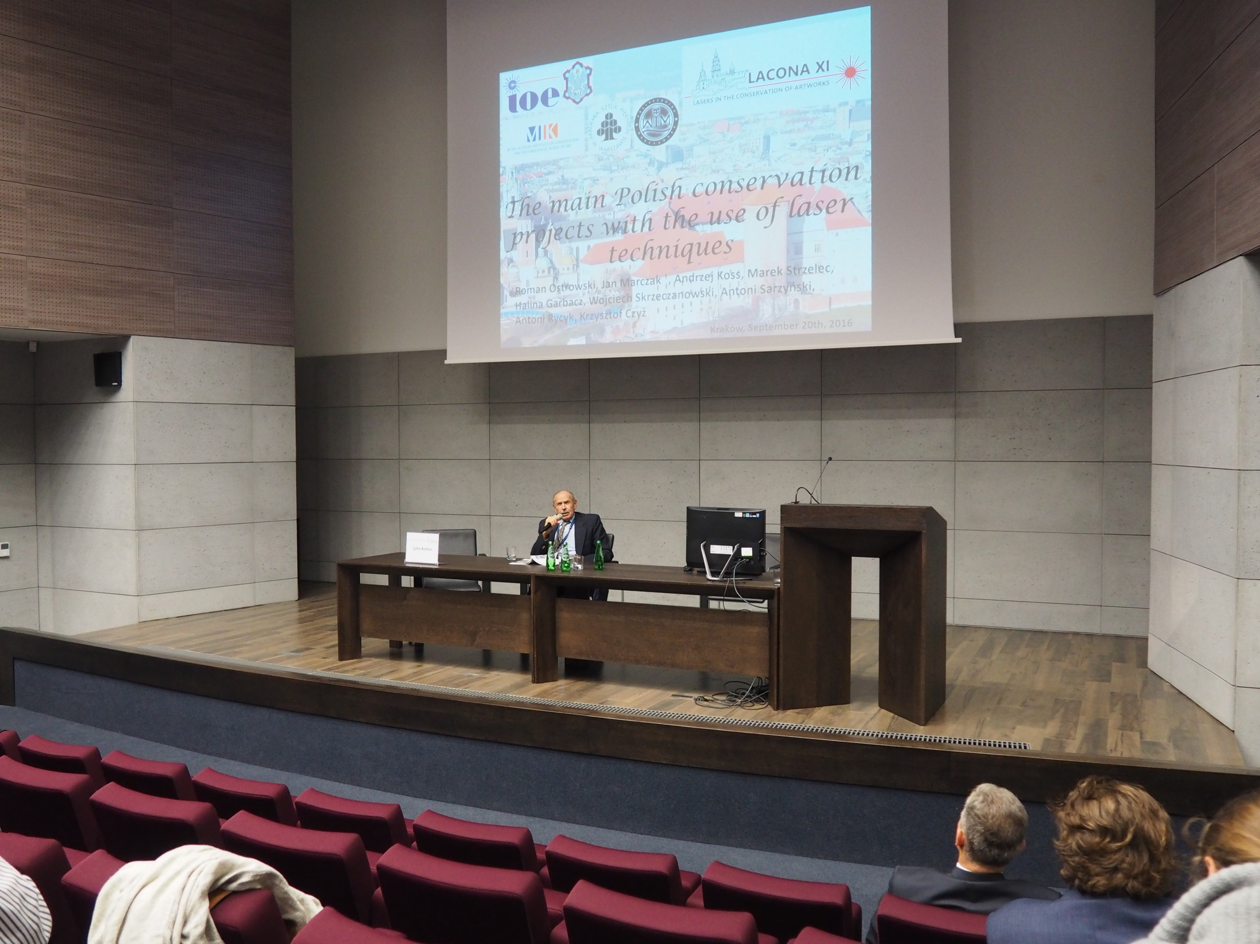
Notes:
Jahn Asmus - Chair

Slide 31
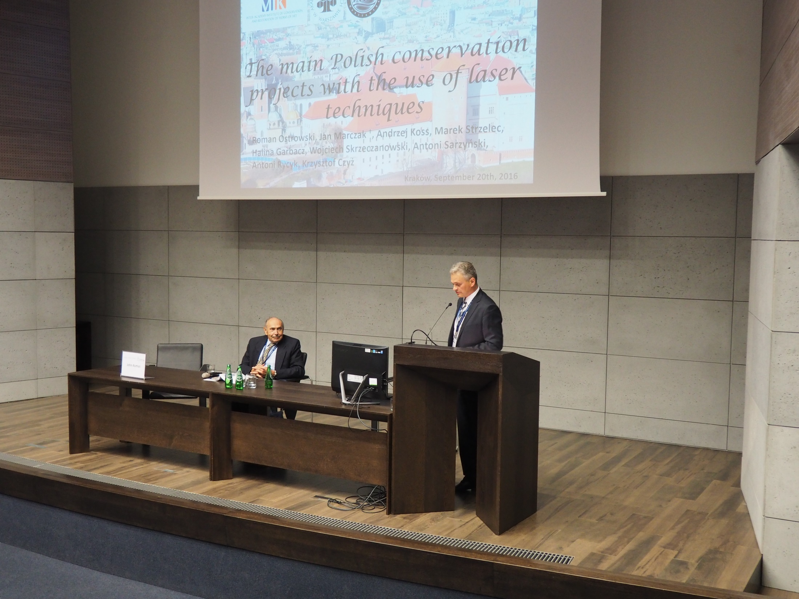
Notes:
Roman Ostrowski,
The main Polish conservation projects with the use of laser techniques – key-note lecture

Slide 32
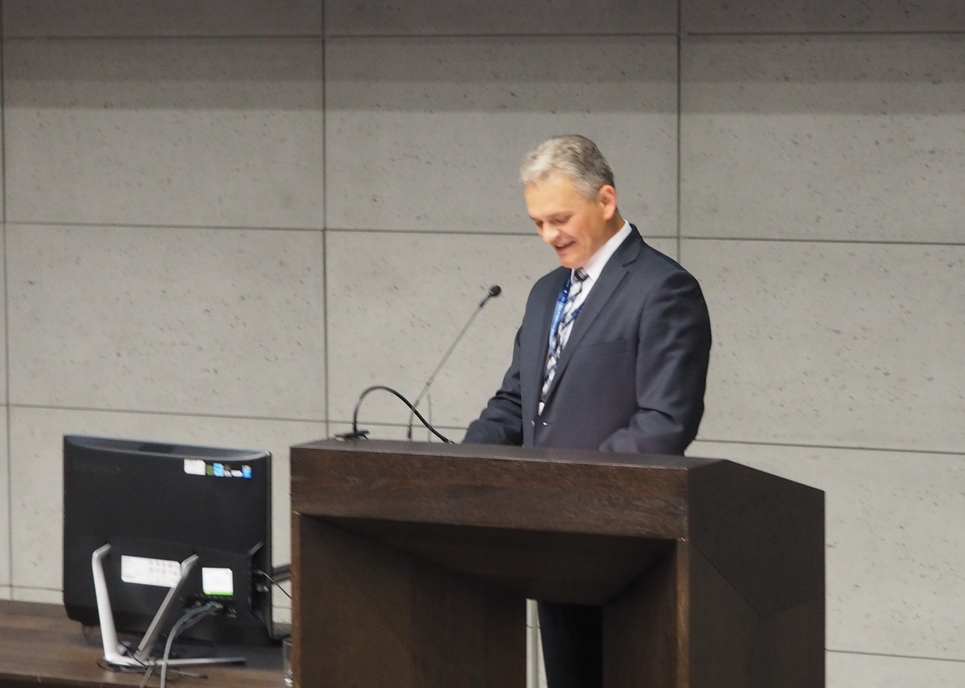
Notes:
Roman Ostrowski,
The main Polish conservation projects with the use of laser techniques – key-note lecture

Slide 33
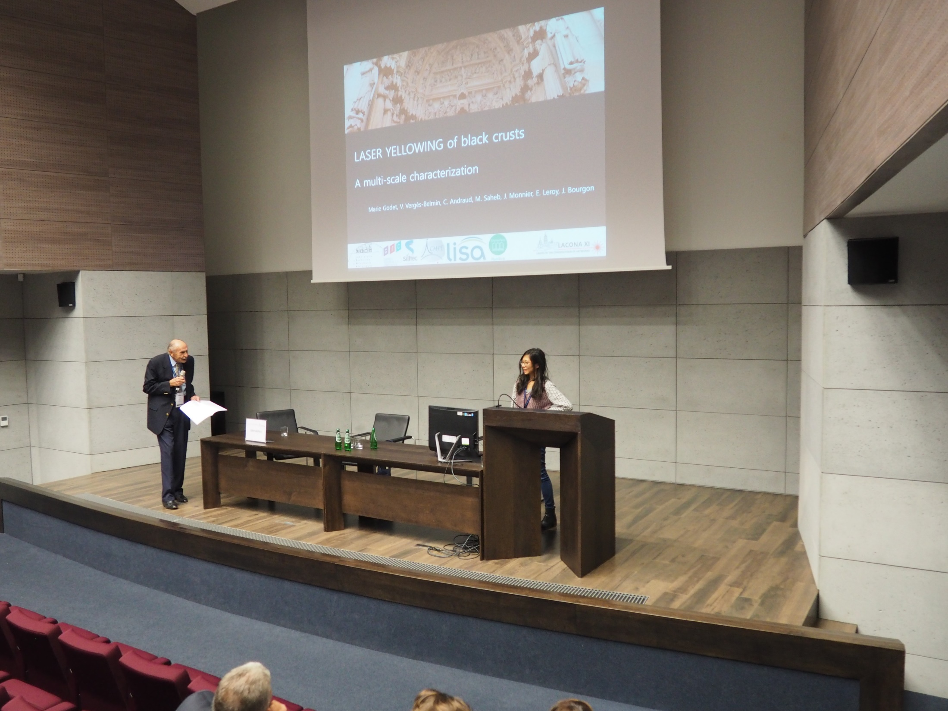
Notes:
Marie Godet
Laser yellowing effect: study of the nanophases created by laser irradiation of natural and model gypsum crusts using transmission electron microscopy (TEM) and electron paramagnetic resonance (EPR) spectroscopy.

Slide 34
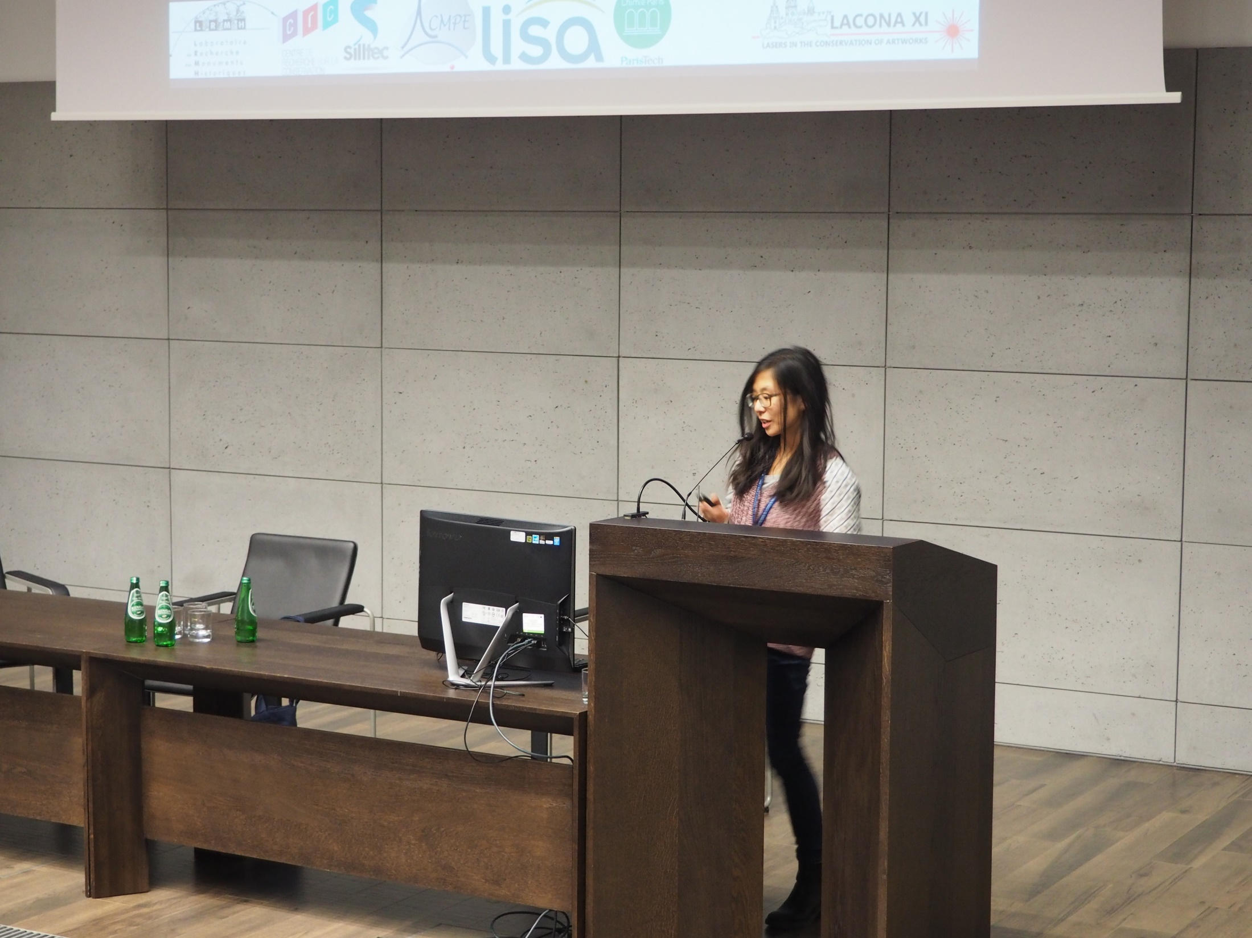
Notes:
Marie Godet
Laser yellowing effect: study of the nanophases created by laser irradiation of natural and model gypsum crusts using transmission electron microscopy (TEM) and electron paramagnetic resonance (EPR) spectroscopy.

Slide 35
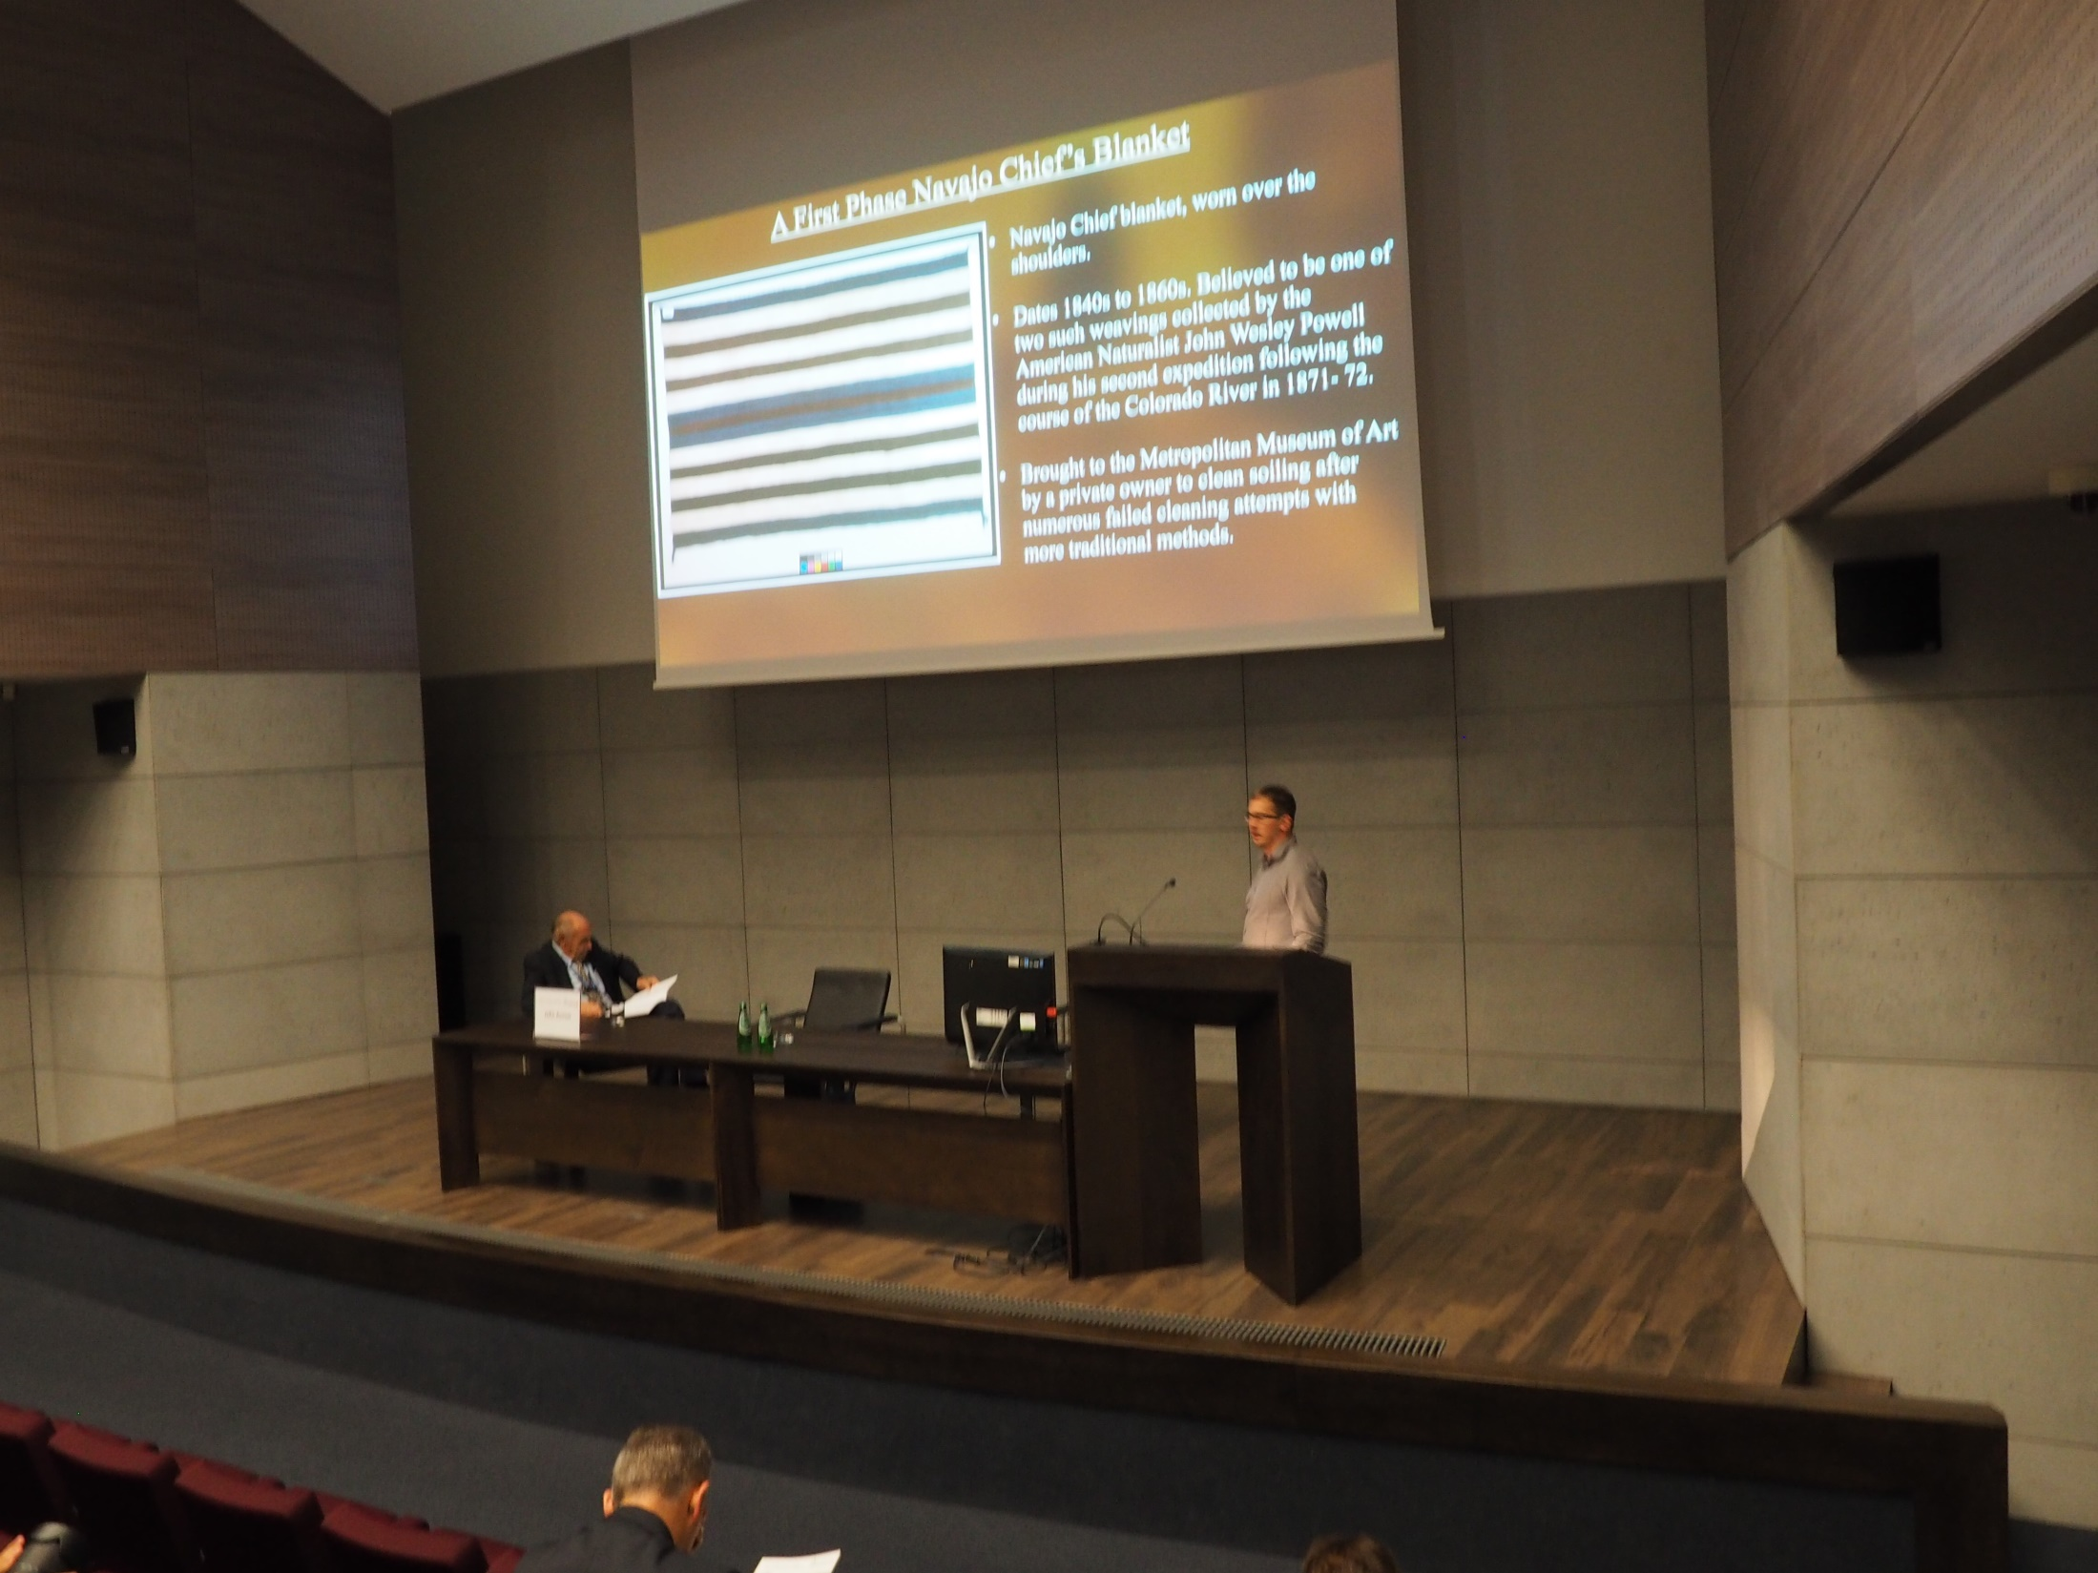
Notes:
Pablo Londero
Laser cleaning of a Navajo wool blanket by Nd:Yag

Slide 36
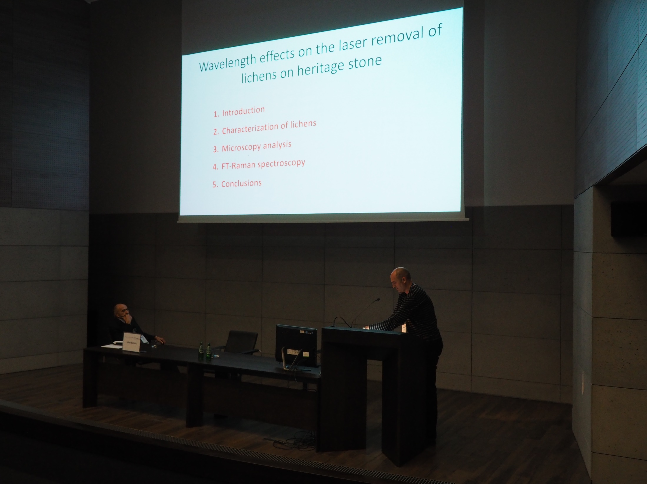
Notes:
Mikel Sanz
Wavelength effects on the laser removal of lichens on heritage stone

Slide 37
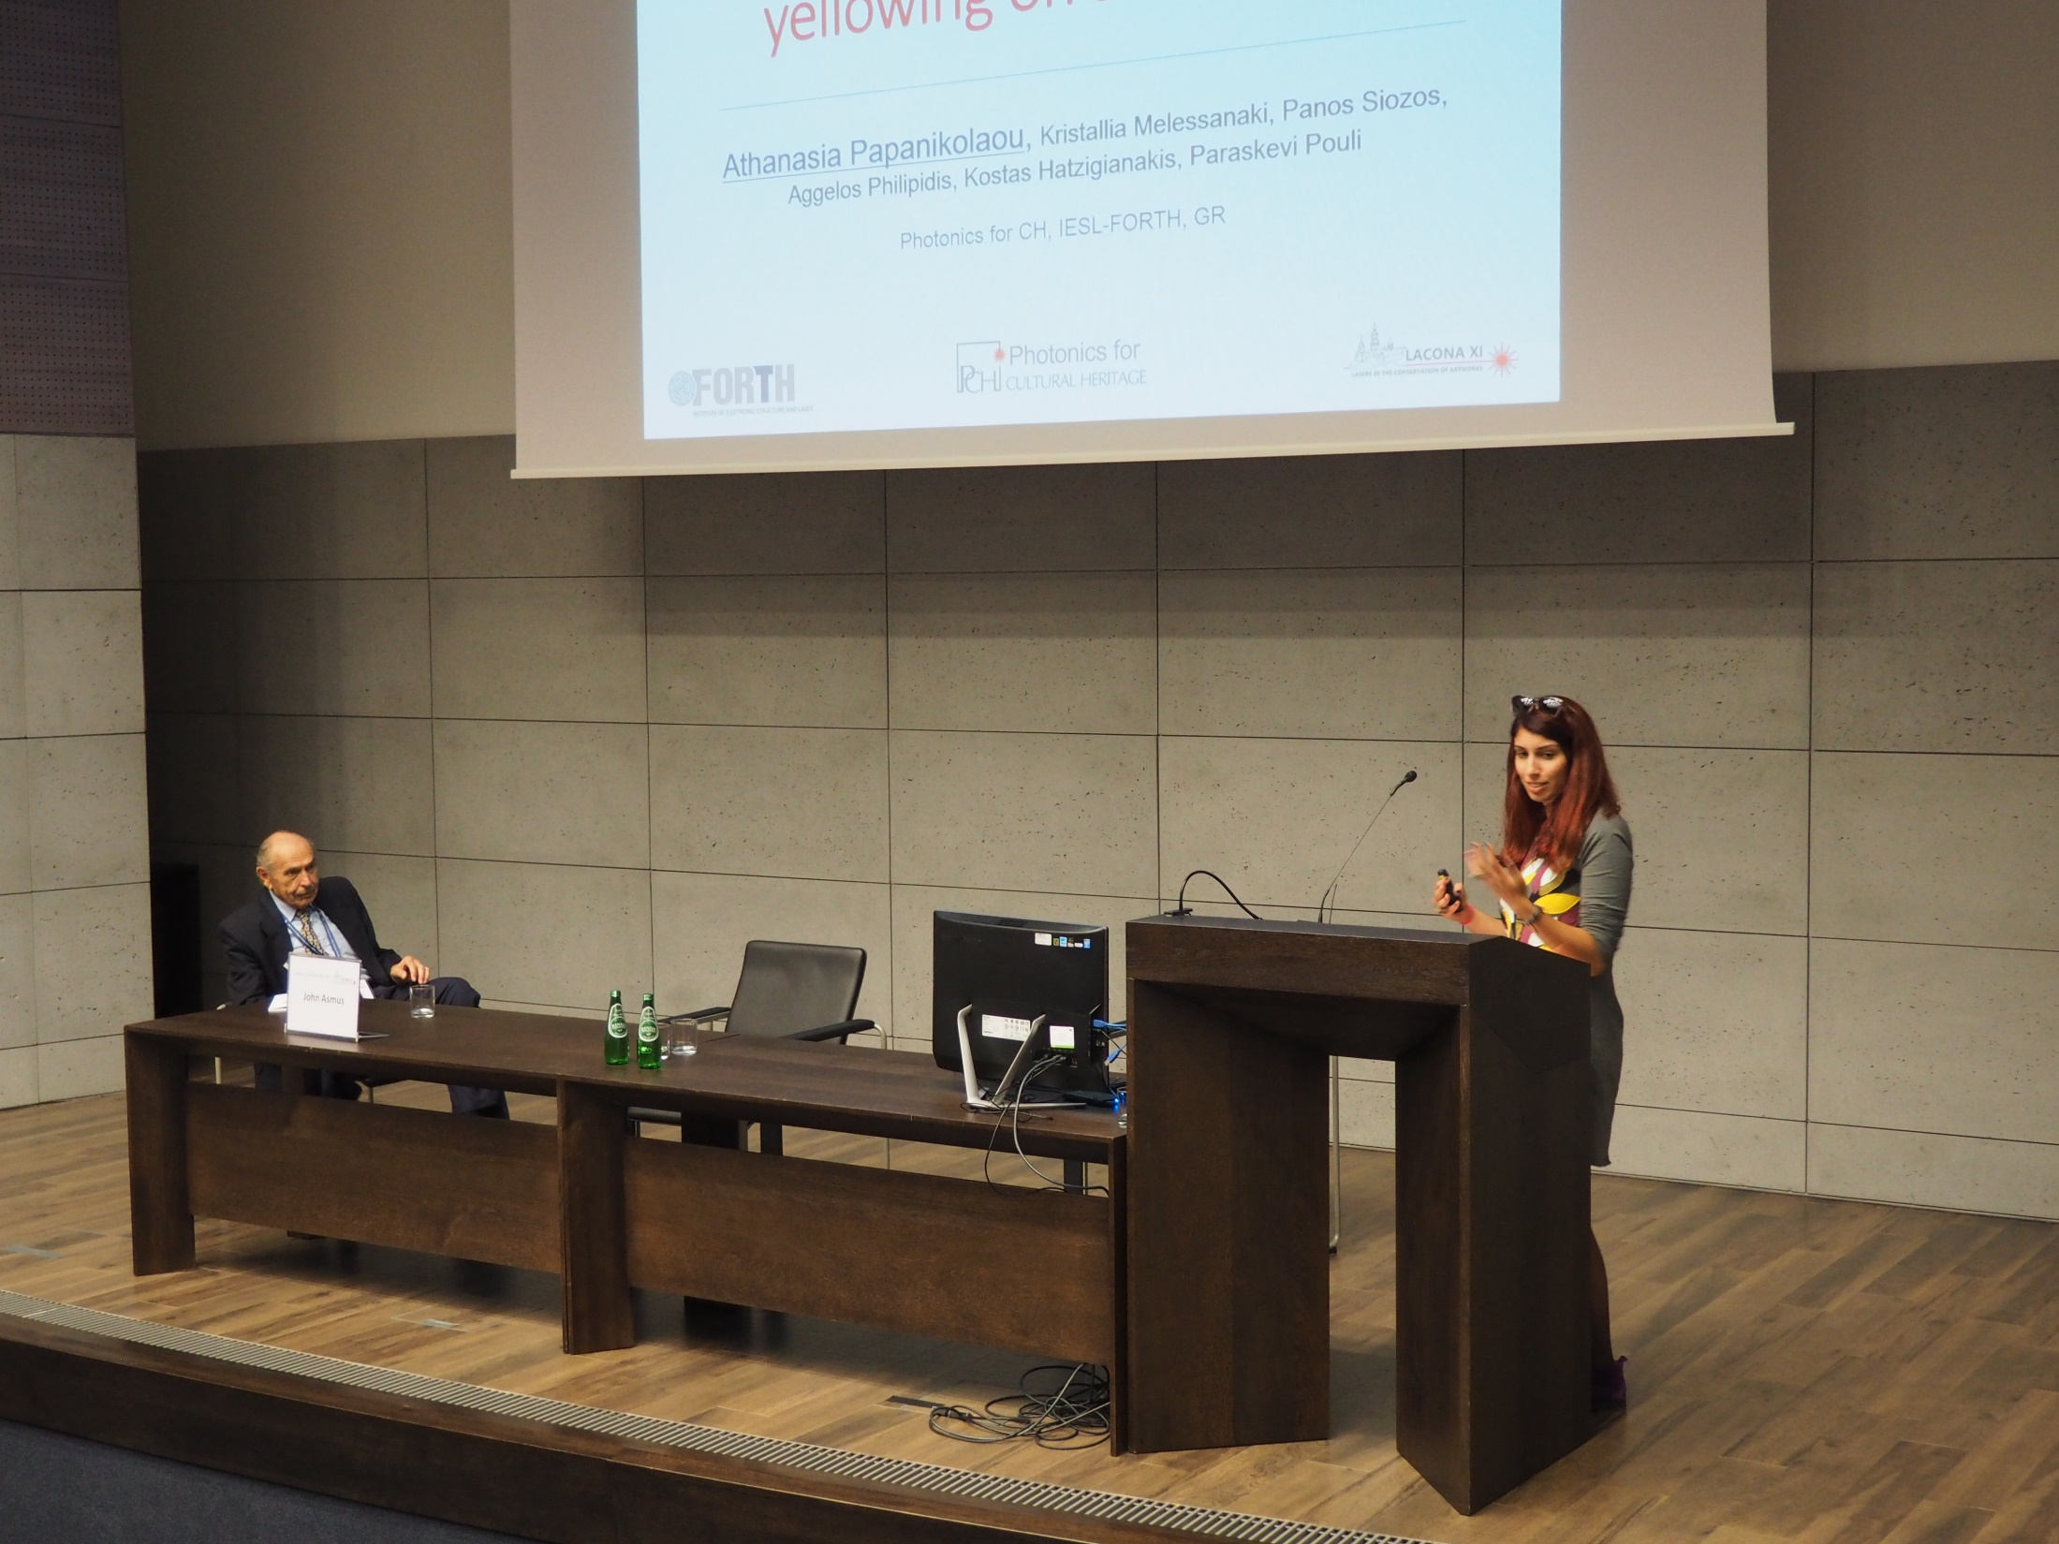
Notes:
Athanasia Papanikolaou
Towards the understanding of the two wavelength laser cleaning in avoiding yellowing on stonework

Slide 38
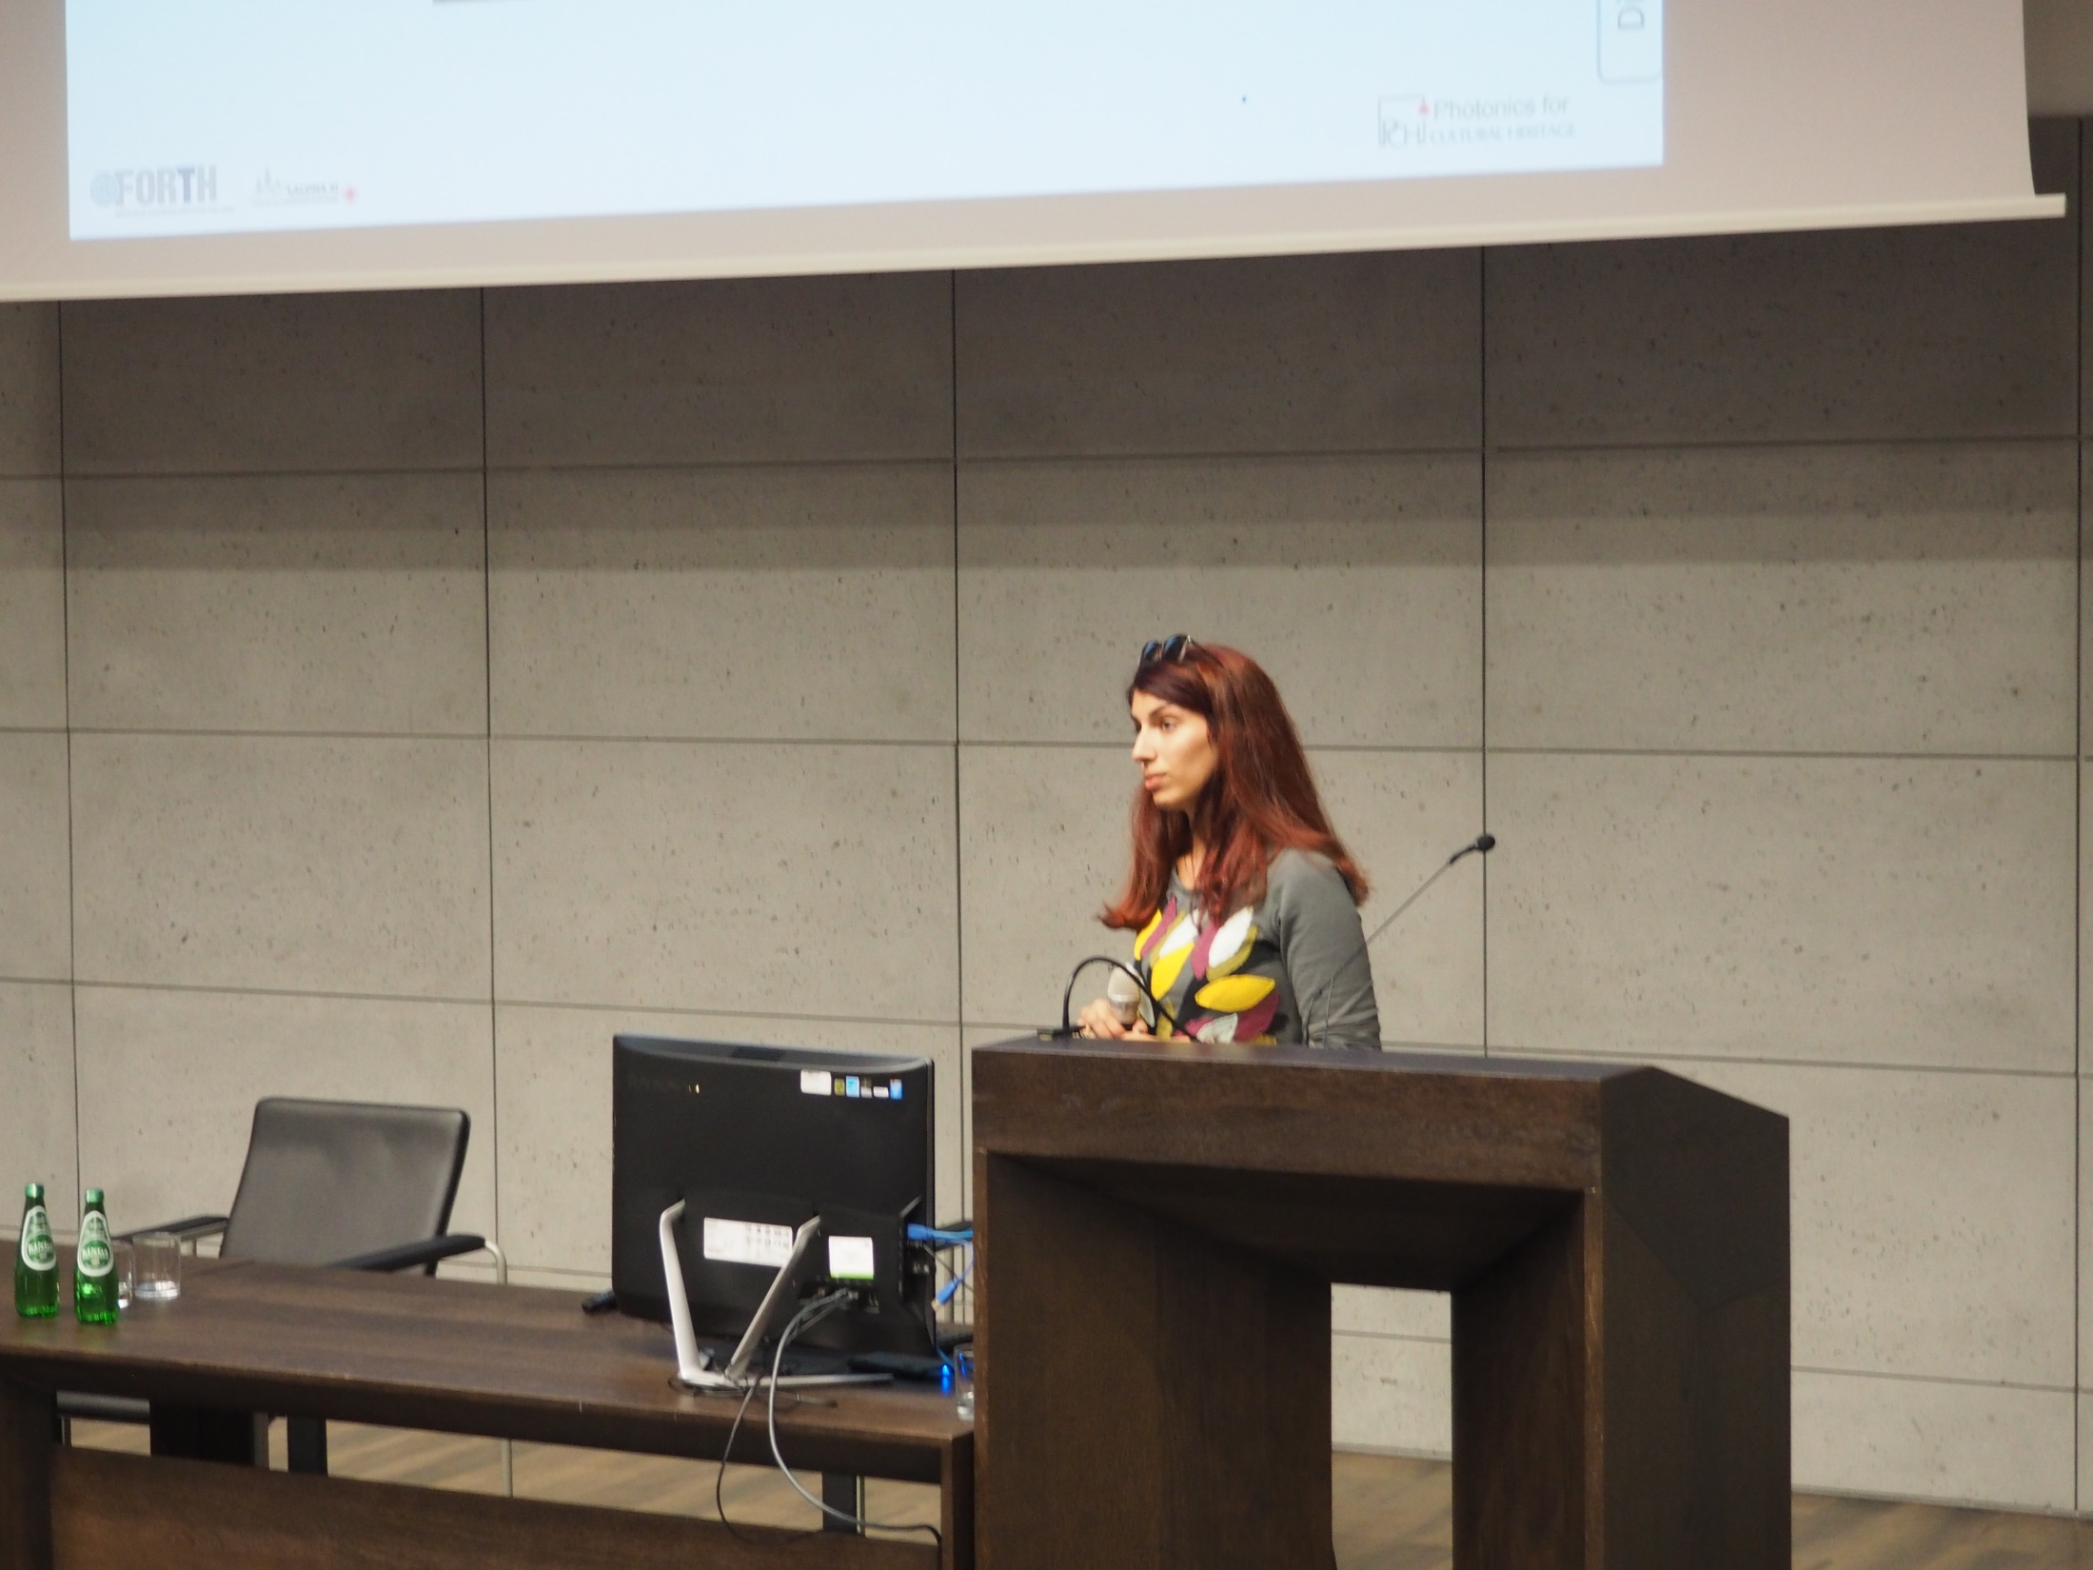
Notes:
Athanasia Papanikolaou
Towards the understanding of the two wavelength laser cleaning in avoiding yellowing on stonework

Slide 39
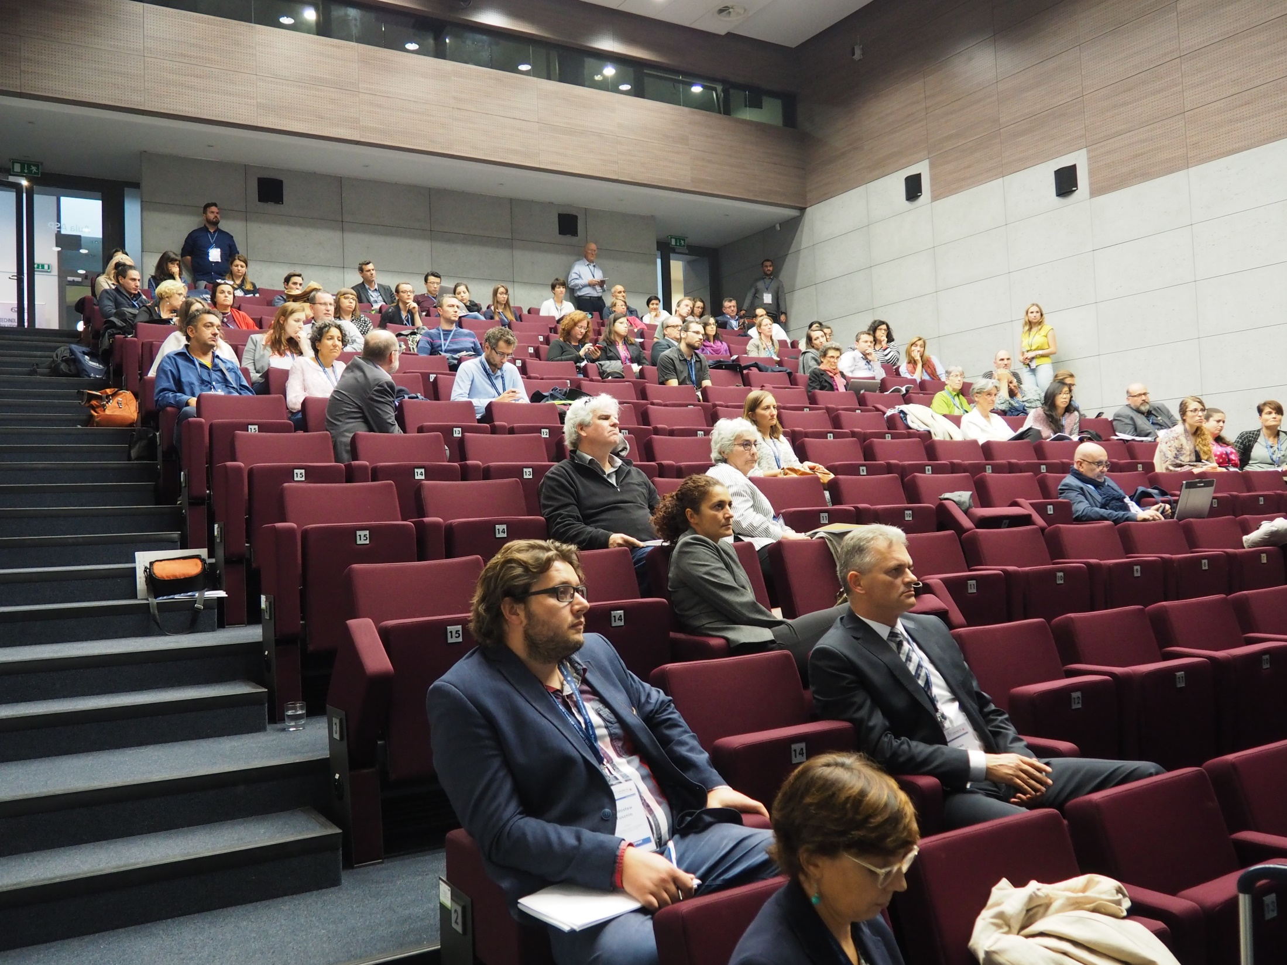

Slide 40
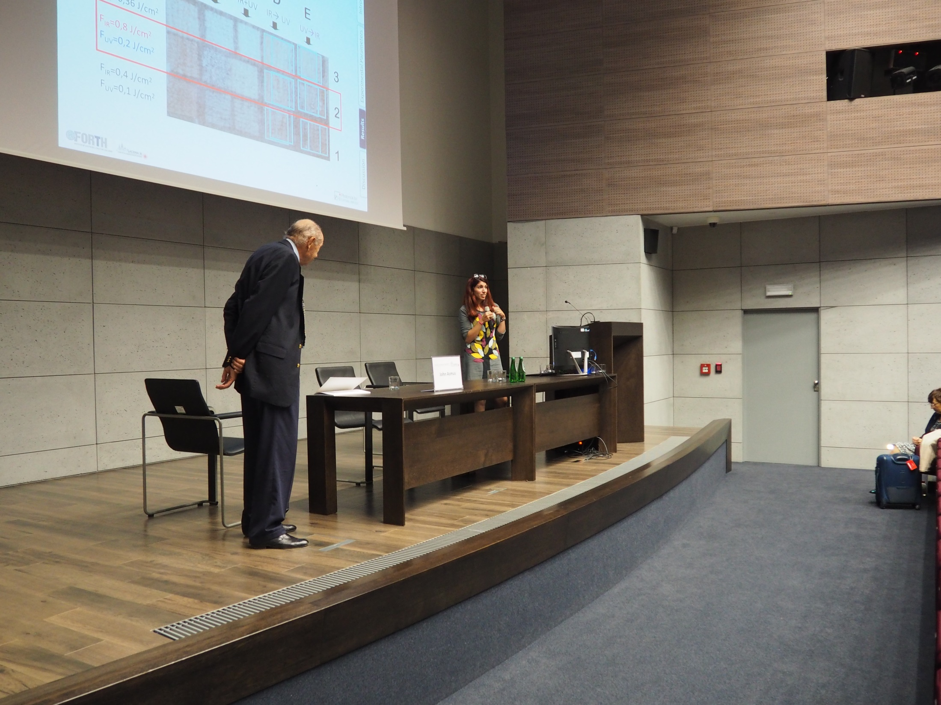
Notes:
Athanasia Papanikolaou & John Asmus (Chair)
Towards the understanding of the two wavelength laser cleaning in avoiding yellowing on stonework

Slide 41
Session 2: Case studies I
Jan Matejko Academy of Fine Arts
Tuesday, 20th September 2016
Kraków , Poland

Slide 42
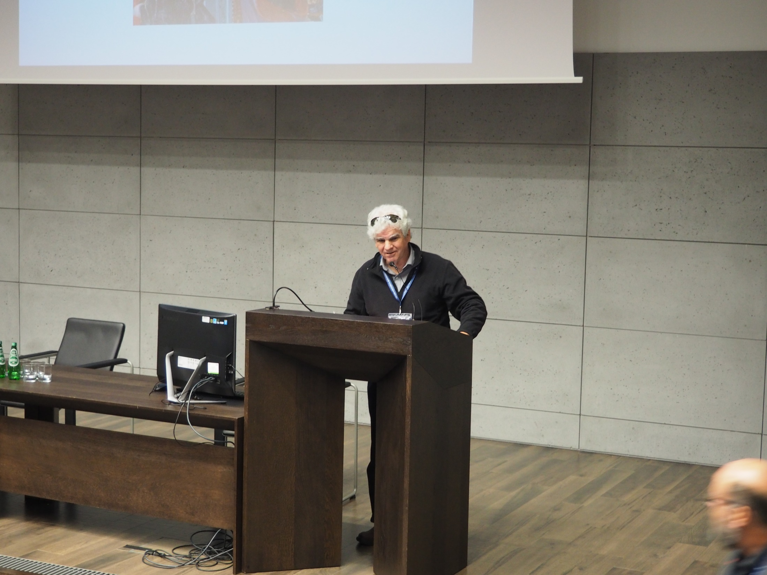
Notes:
William P. Brown
The removal of intractable materials with an Erbium:YAG laser at 2.94 mm from ancient tempera painting on panel .

Slide 43
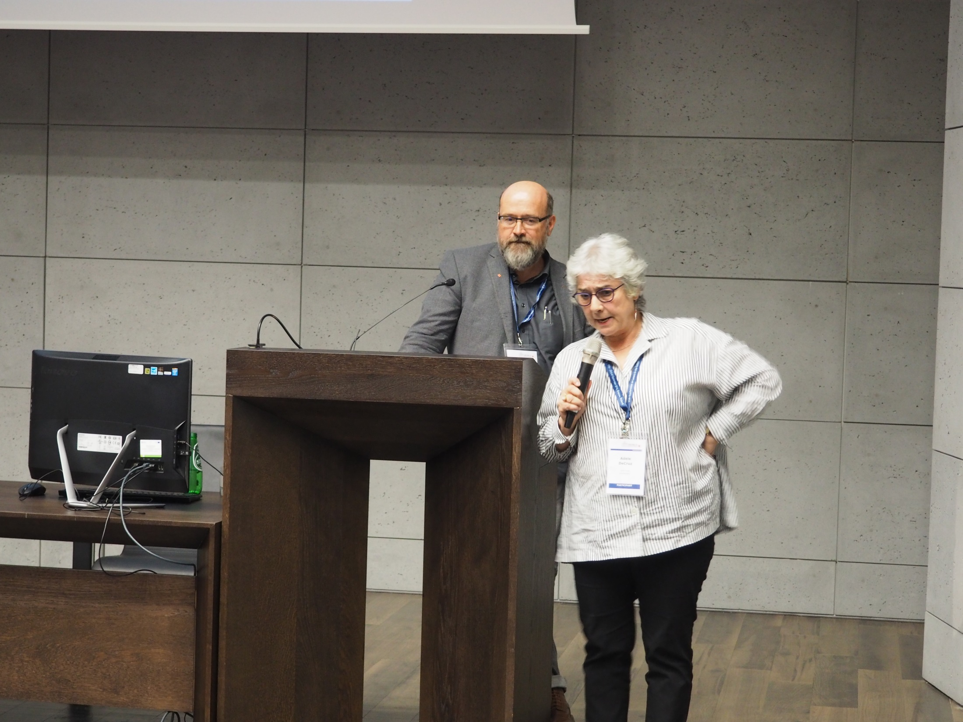
Notes:
Adele DeCruz & Johann Nimmrichter (Chair)
The removal of intractable materials with an Erbium:YAG laser at 2.94 mm from ancient tempera painting on panel .
,

Slide 44
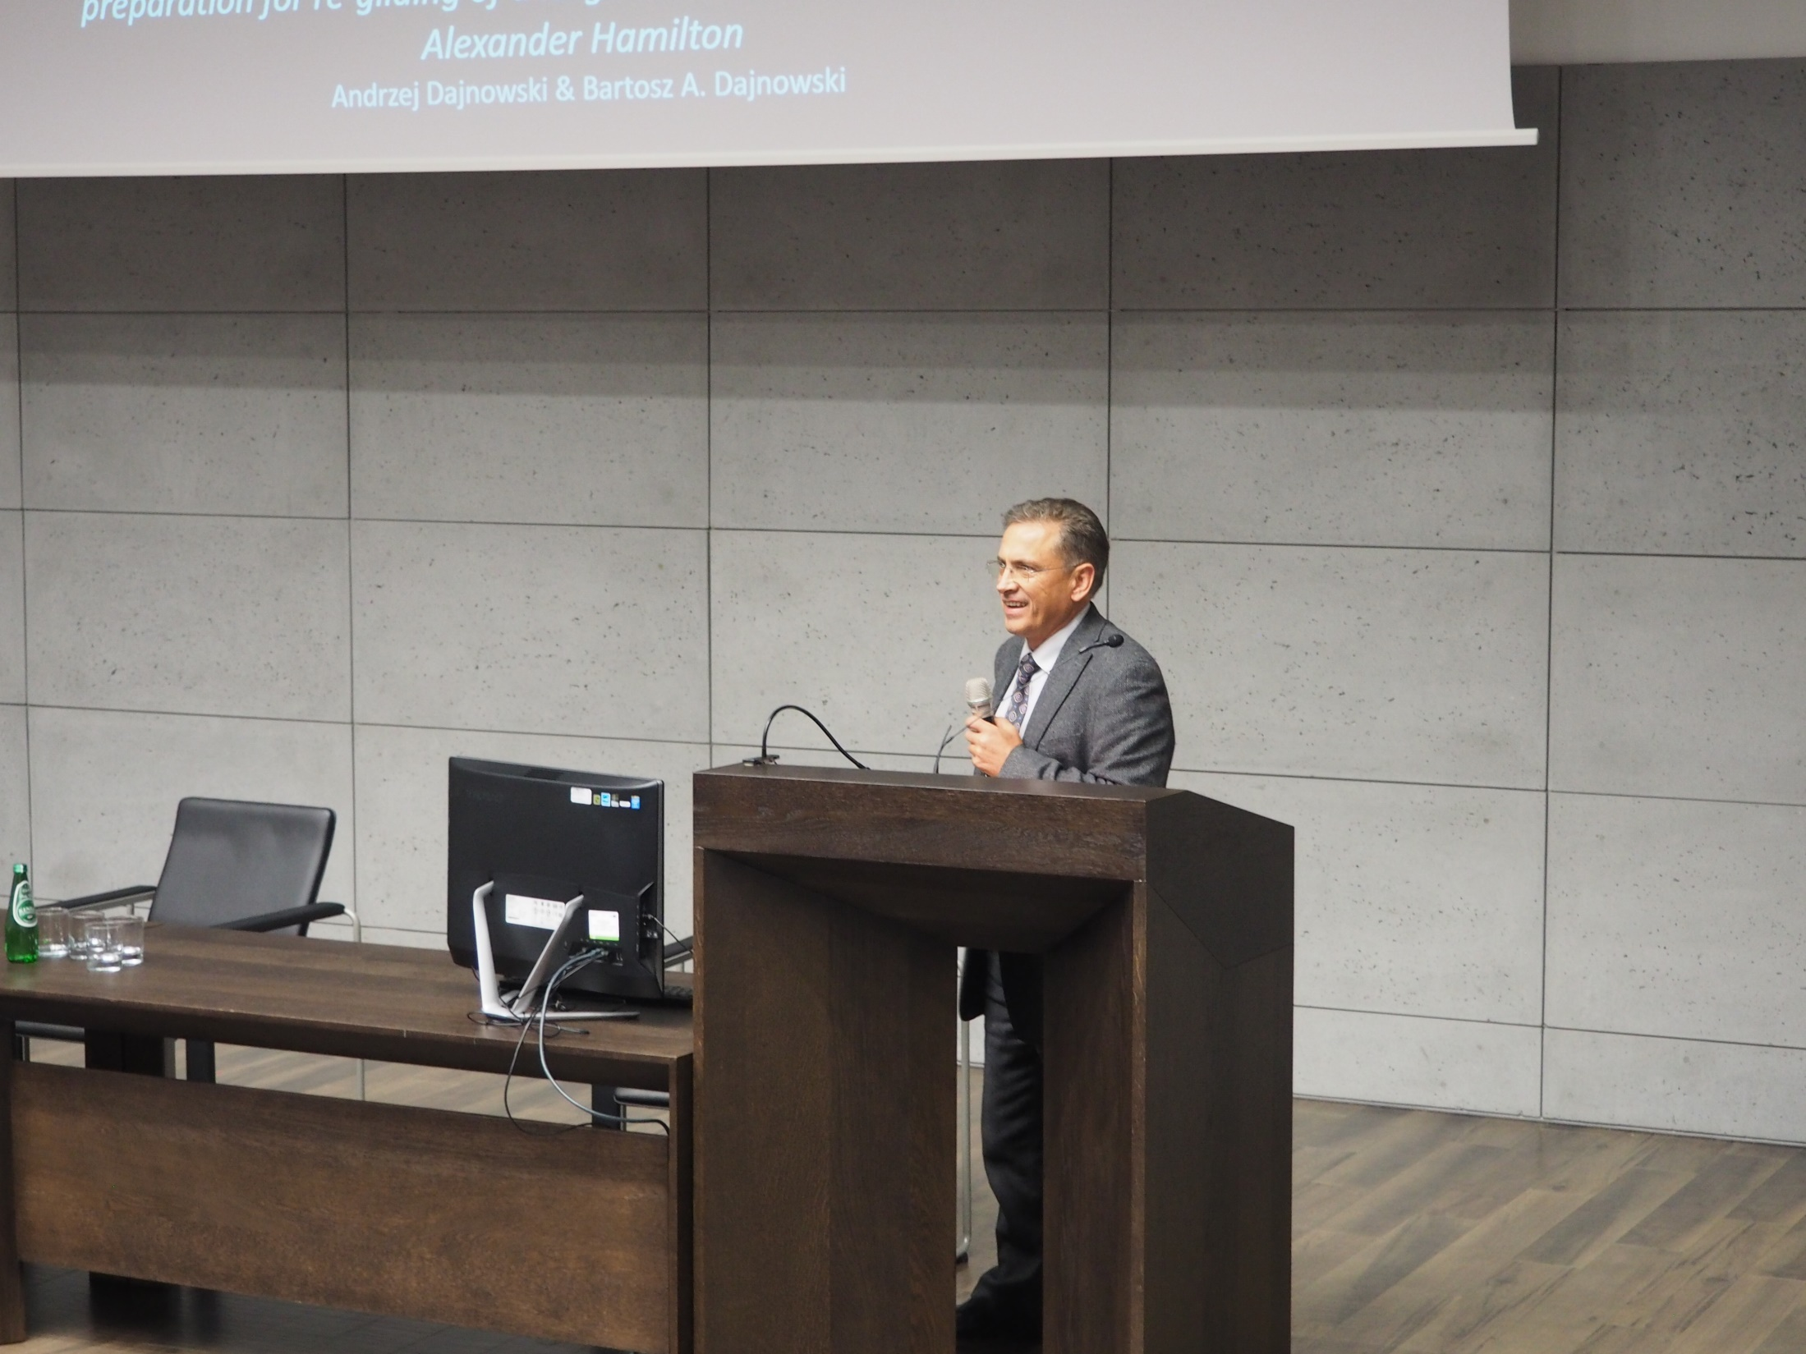
Notes:
Andrzej Dajnowski
Using the new G.C. Laser Cleaning System for cleaning and surface preparation for re-gilding of a large outdoor bronze monument of Alexander Hamilton

Slide 45
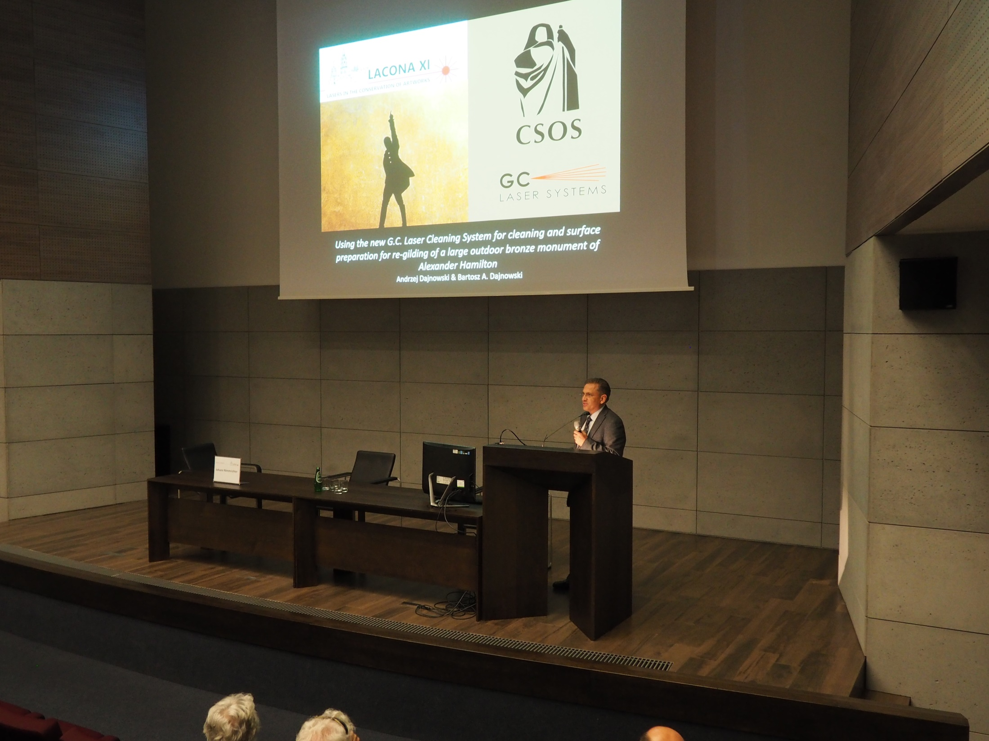
Notes:
Andrzej Dajnowski
Using the new G.C. Laser Cleaning System for cleaning and surface preparation for re-gilding of a large outdoor bronze monument of Alexander Hamilton

Slide 46
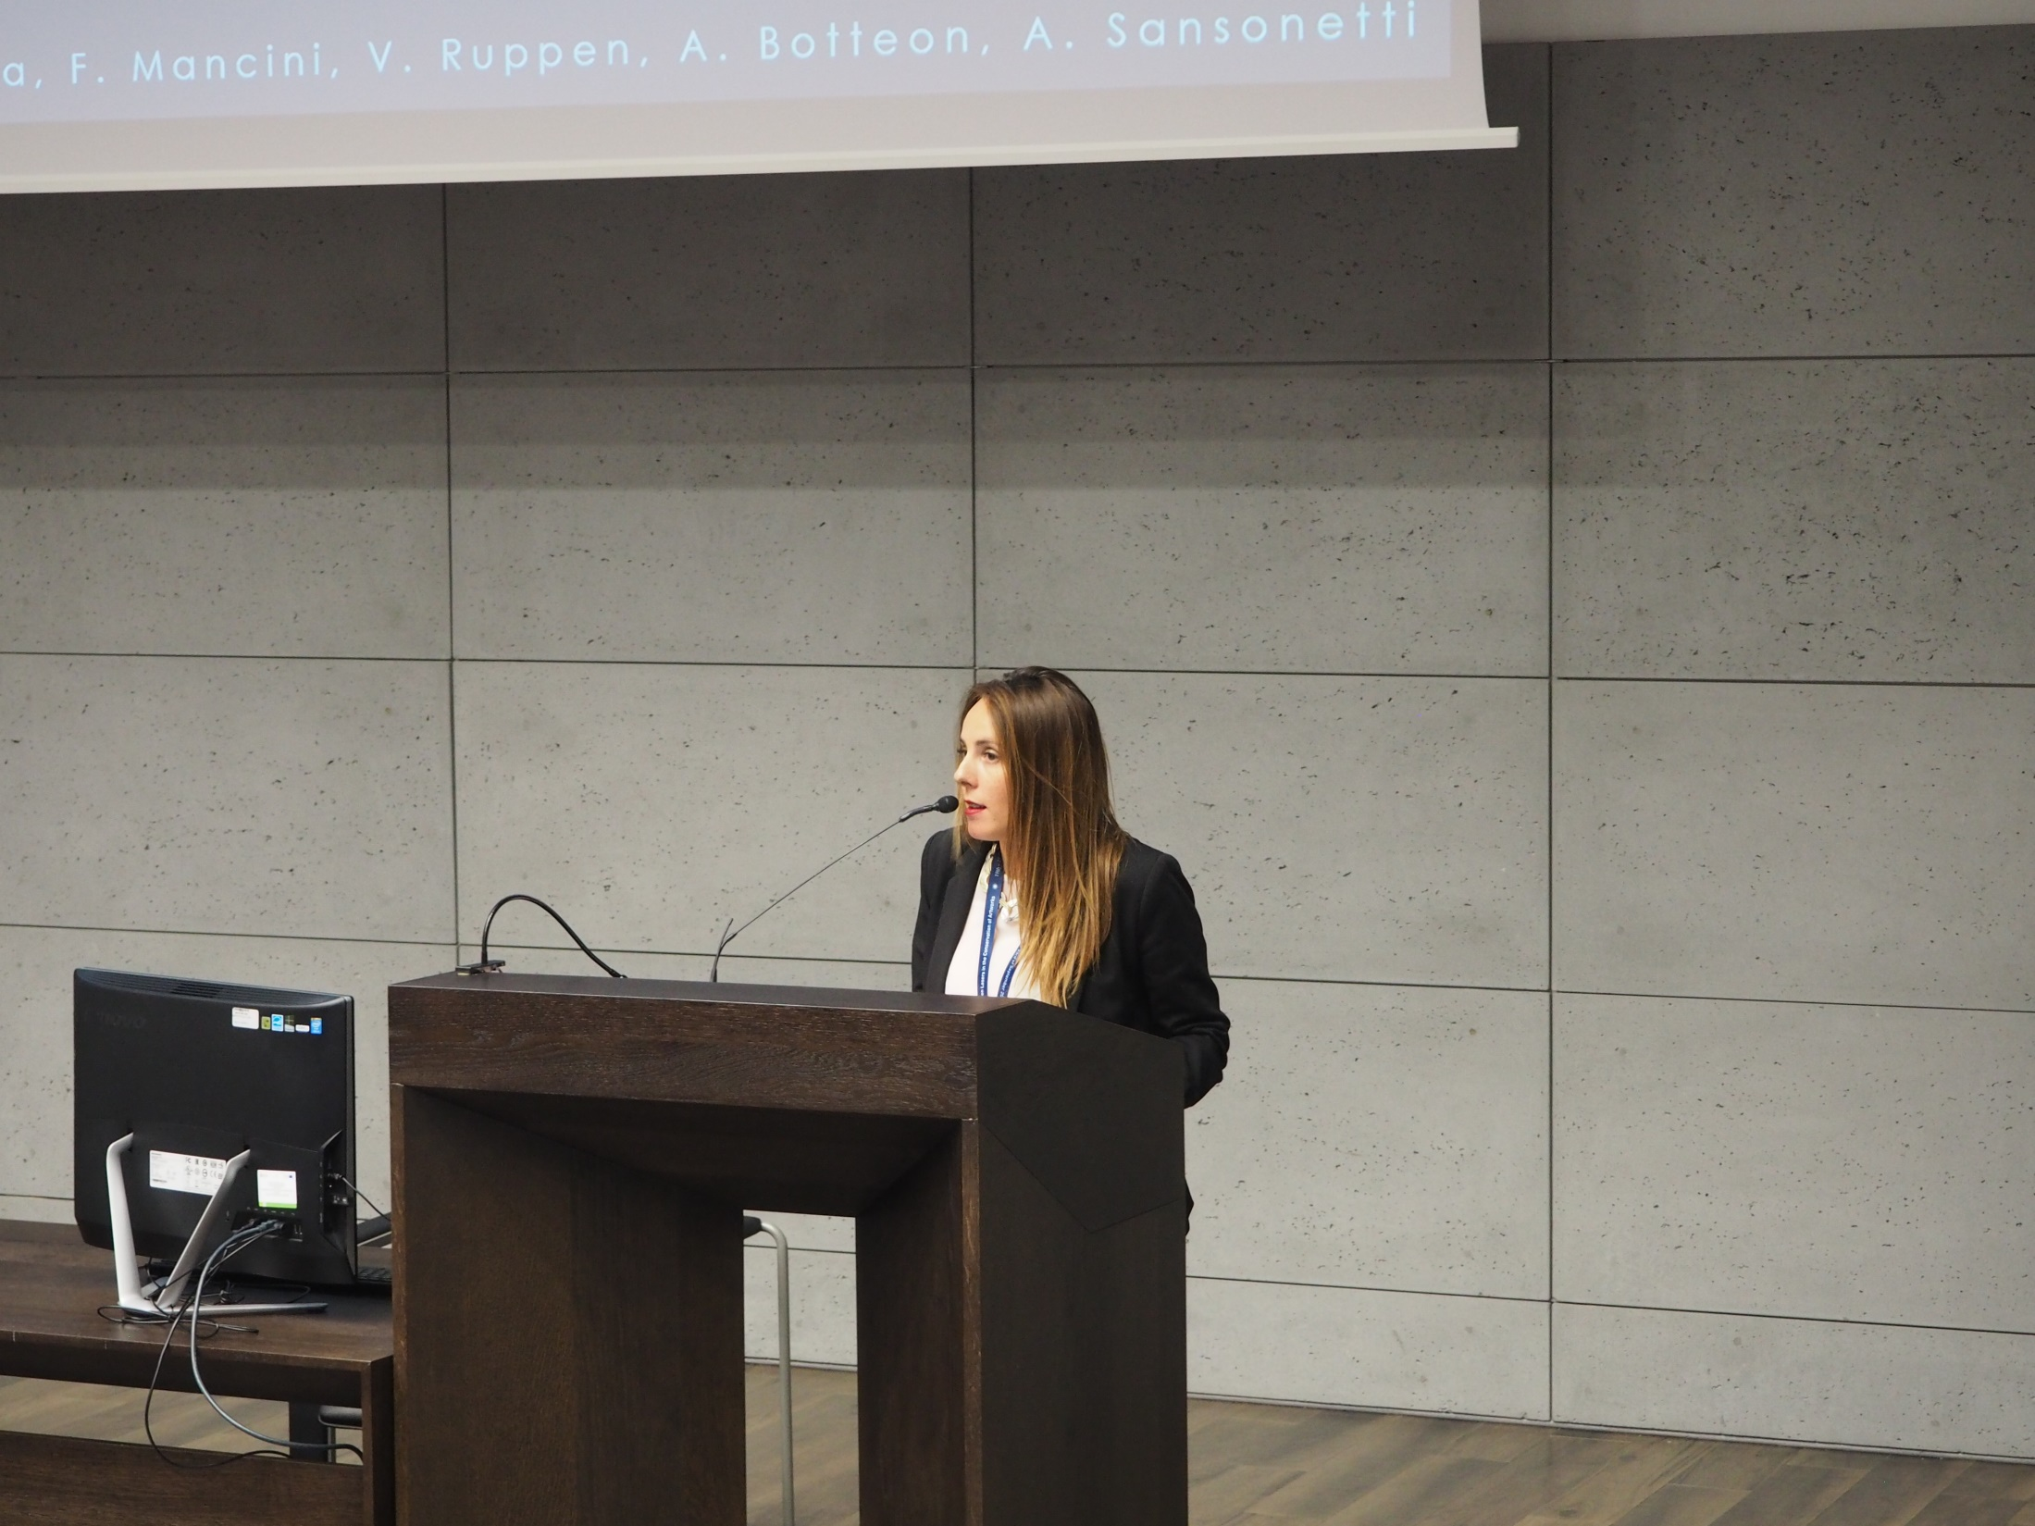
Notes:
Elisa Isella
Experiences at the Academy of Fine Arts of Brera: the application of laser-cleaning technology on three case studies of the historical heritage

Slide 47
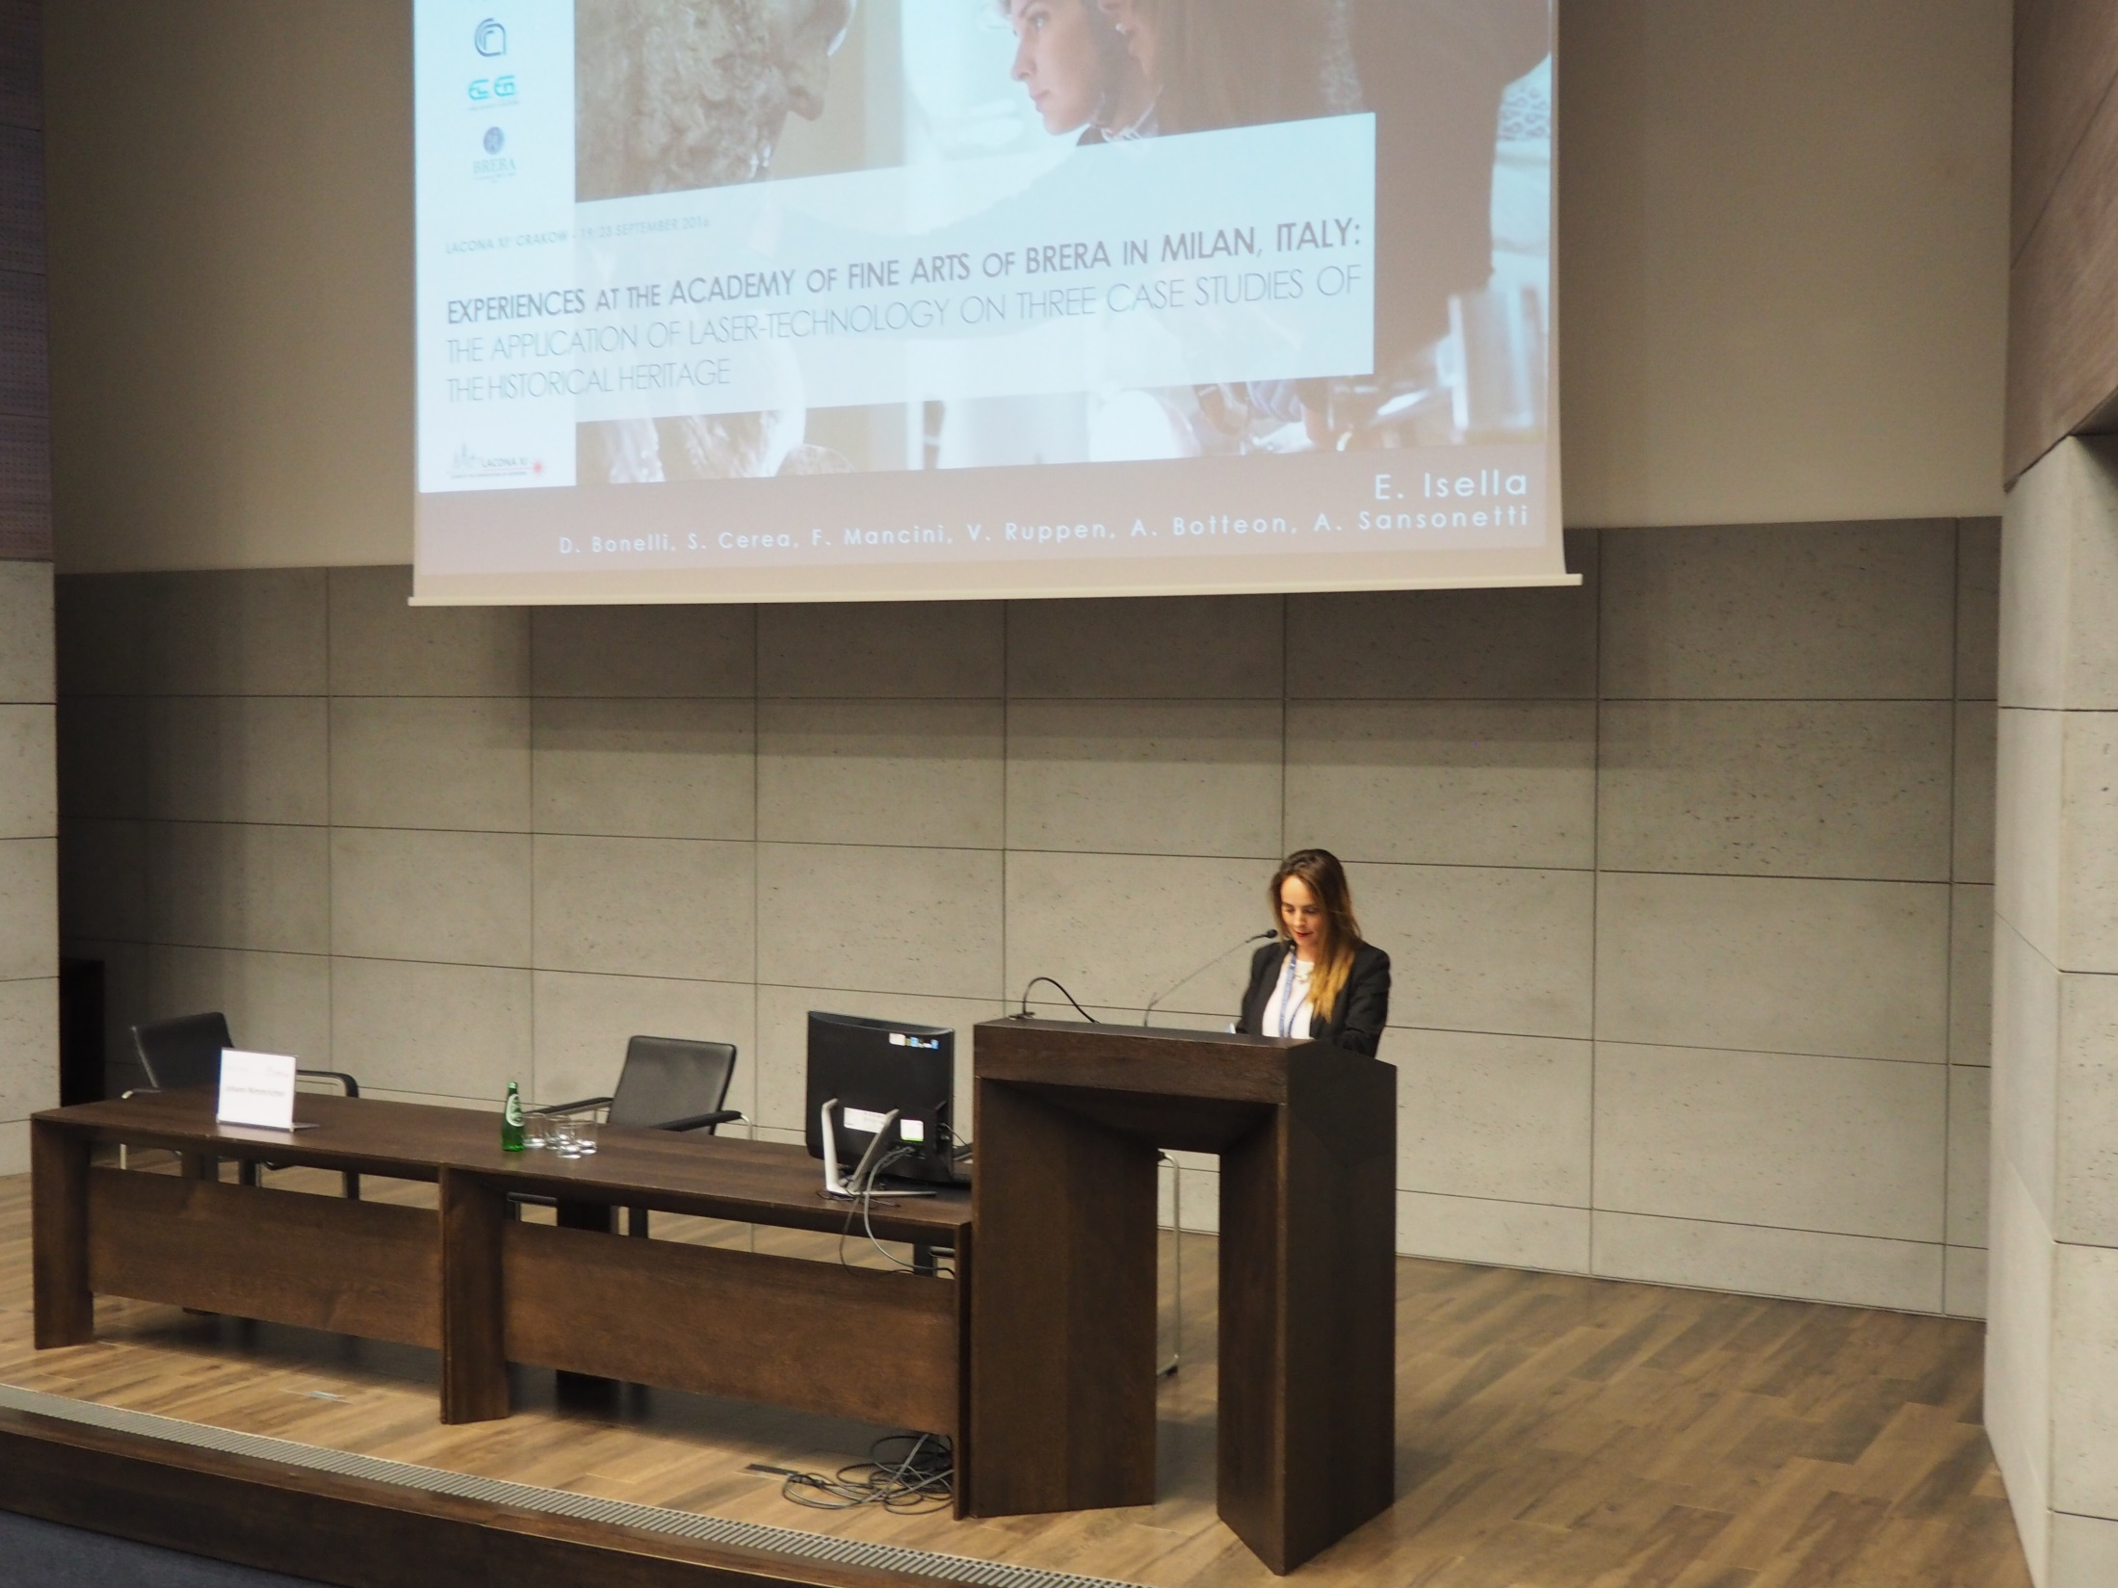
Notes:
Elisa Isella
Experiences at the Academy of Fine Arts of Brera: the application of laser-cleaning technology on three case studies of the historical heritage

Slide 48
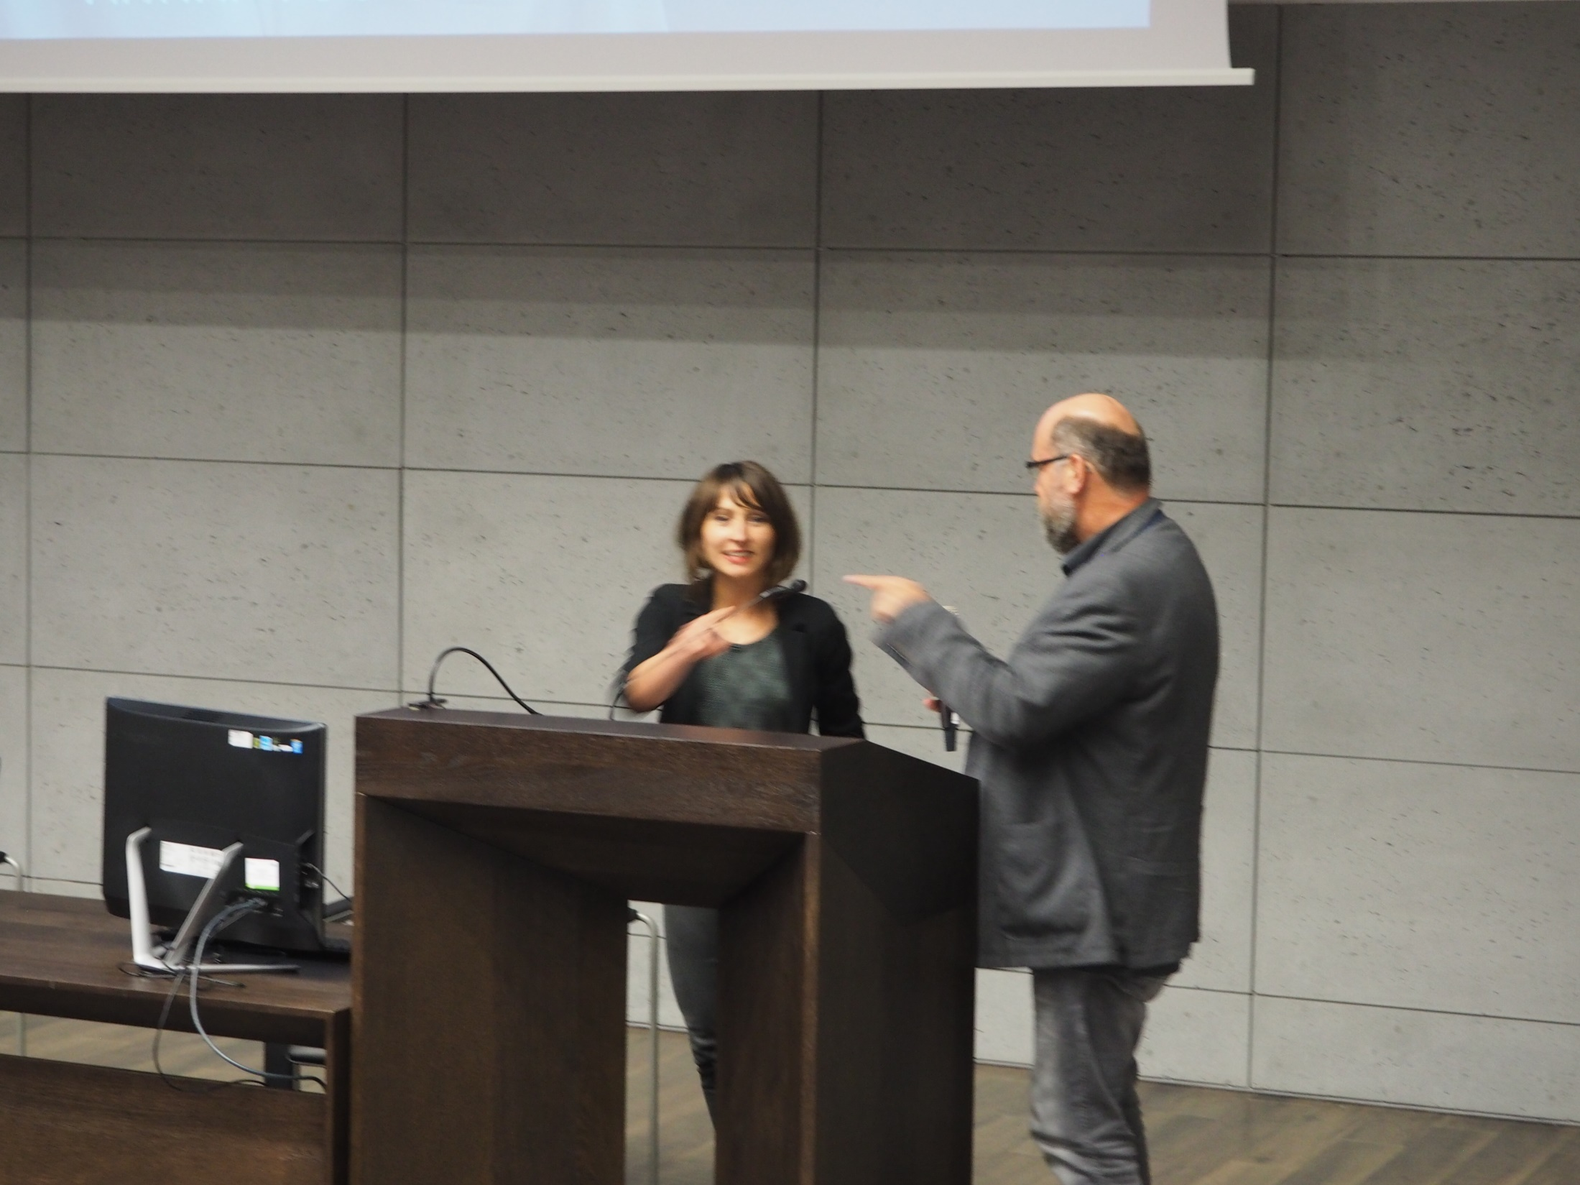
Notes:
Birgit Angelika Schmidt & Johann Nimmrichter (Chair)
Decontamination of biocidal loaded wooden artworks by means of laser and plasma processing

Slide 49
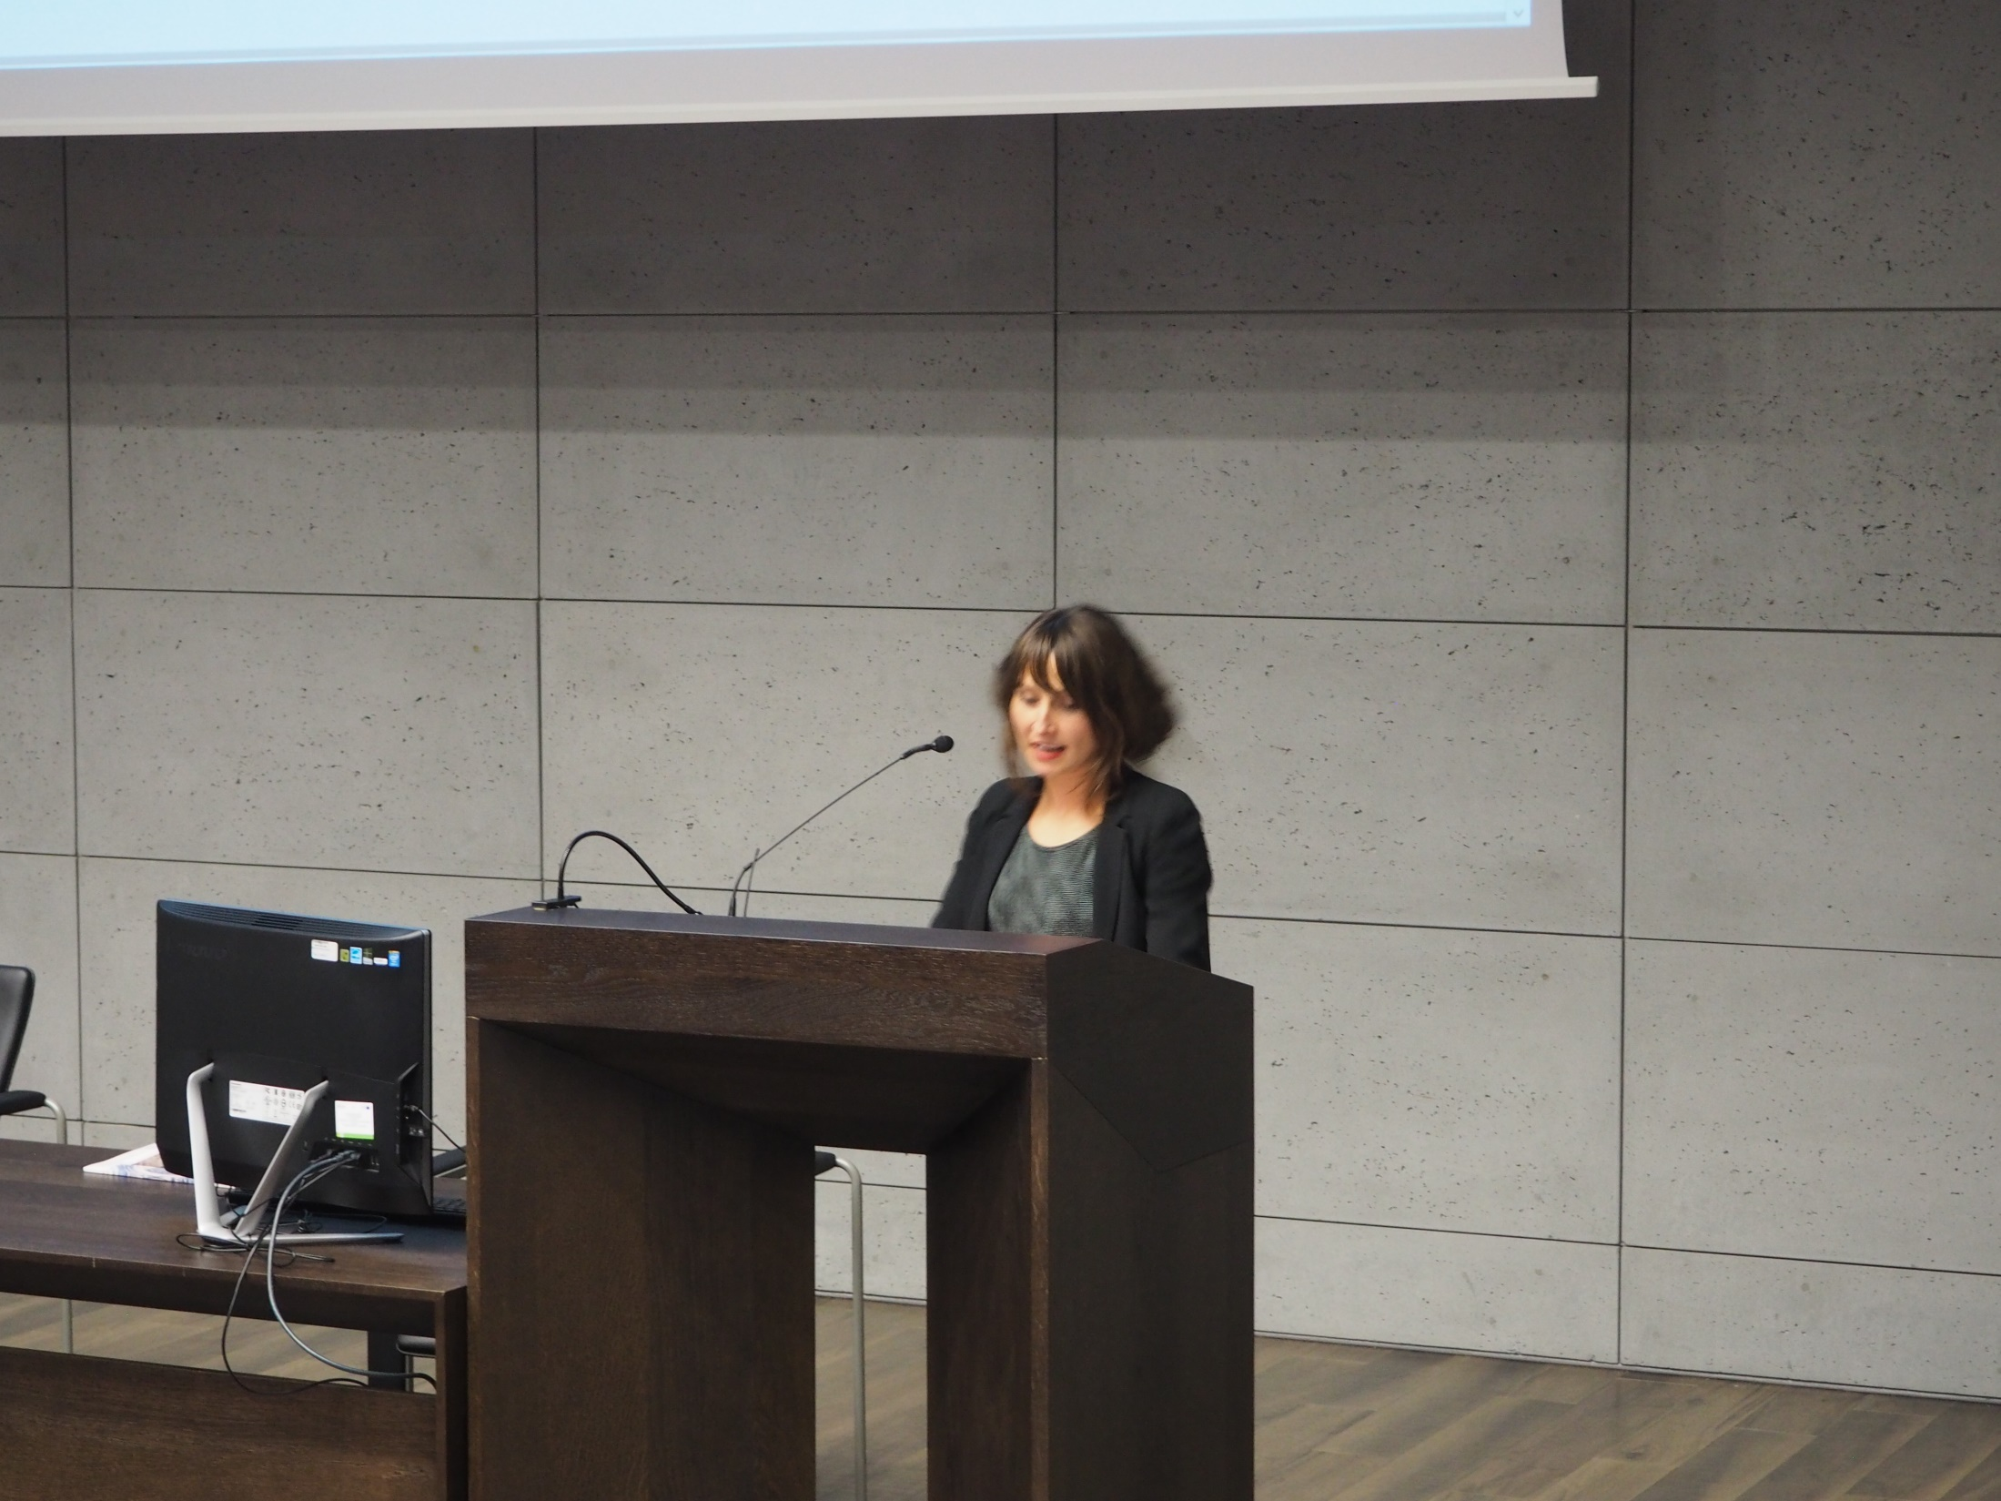
Notes:
Birgit Angelika Schmidt
Decontamination of biocidal loaded wooden artworks by means of laser and plasma processing

Slide 50
Visit to The Royal Archcathedral Basilica of Saints Stanislaus and Wenceslaus on the Wawel Hill Wednesday, 21st September 2016
Kraków , Poland

Slide 51
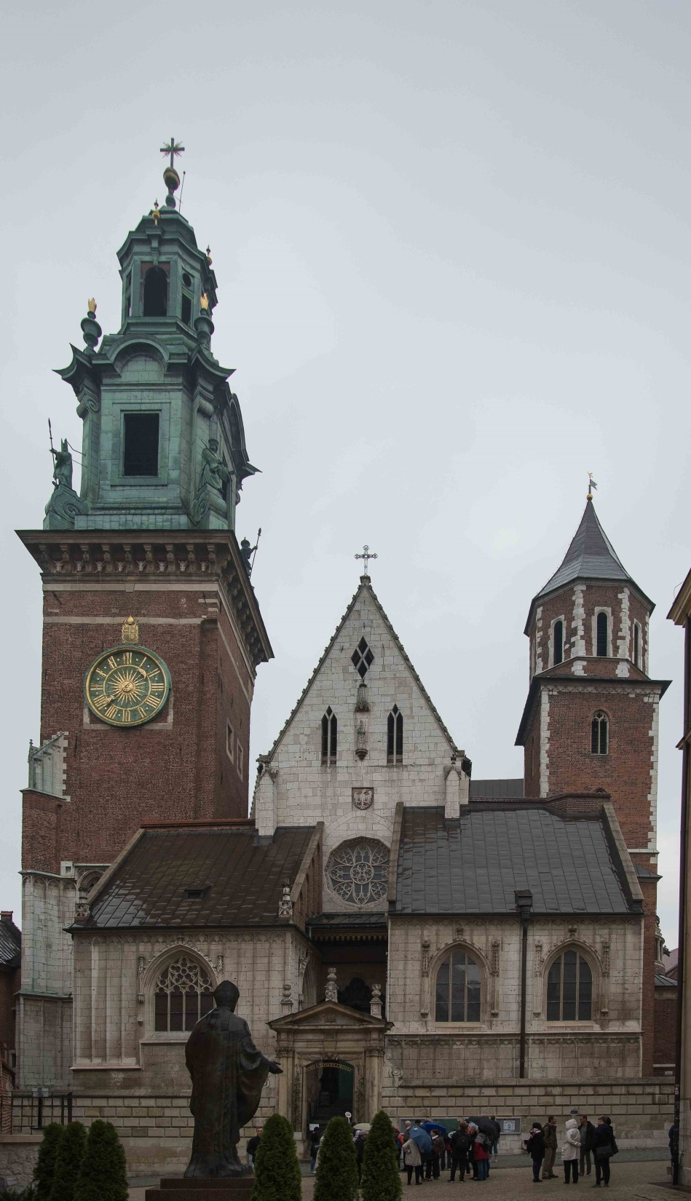
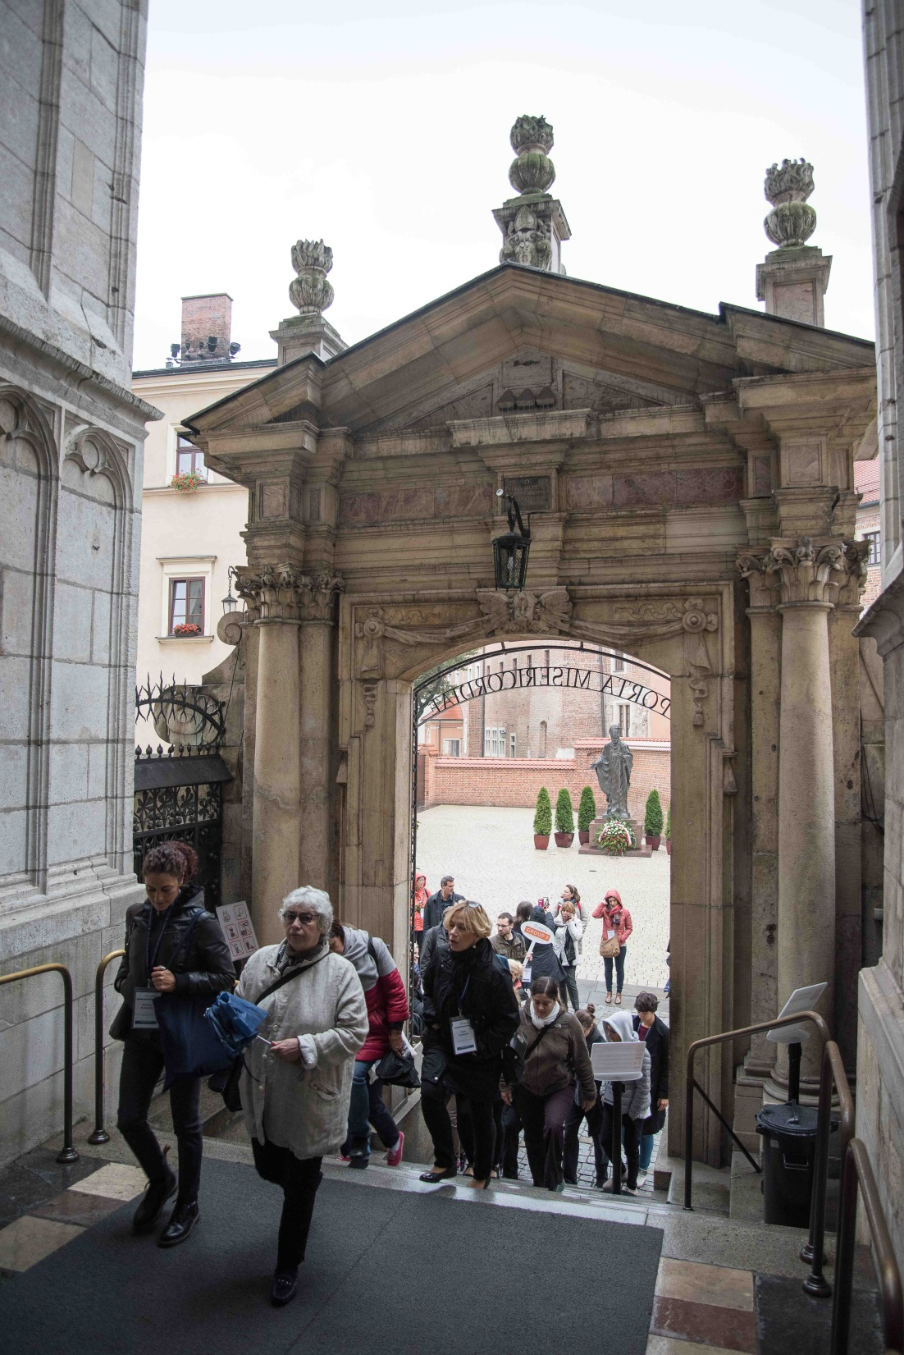

Slide 52
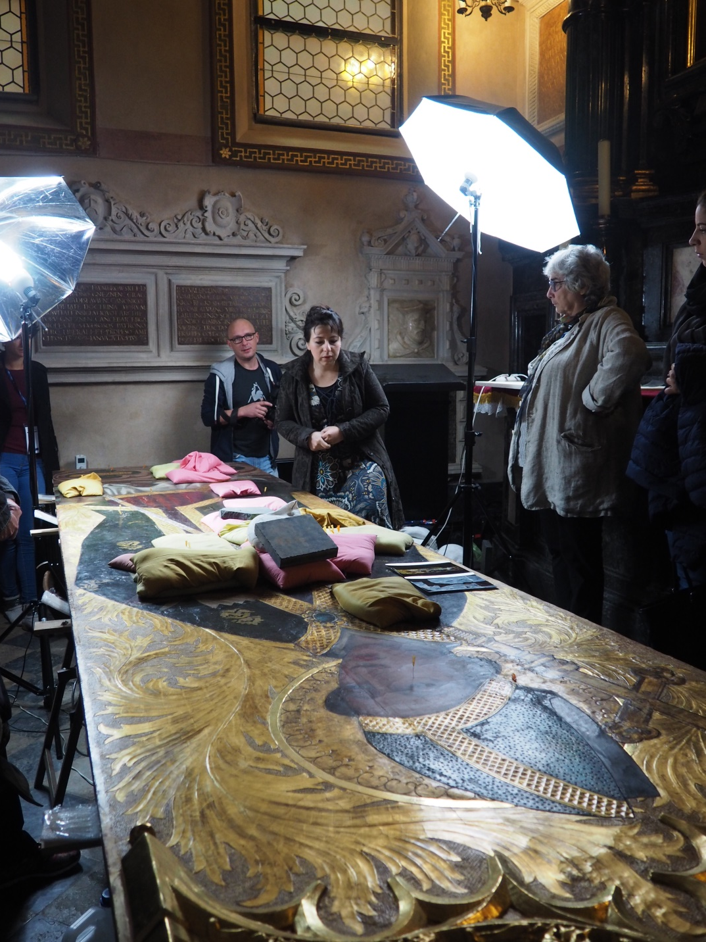
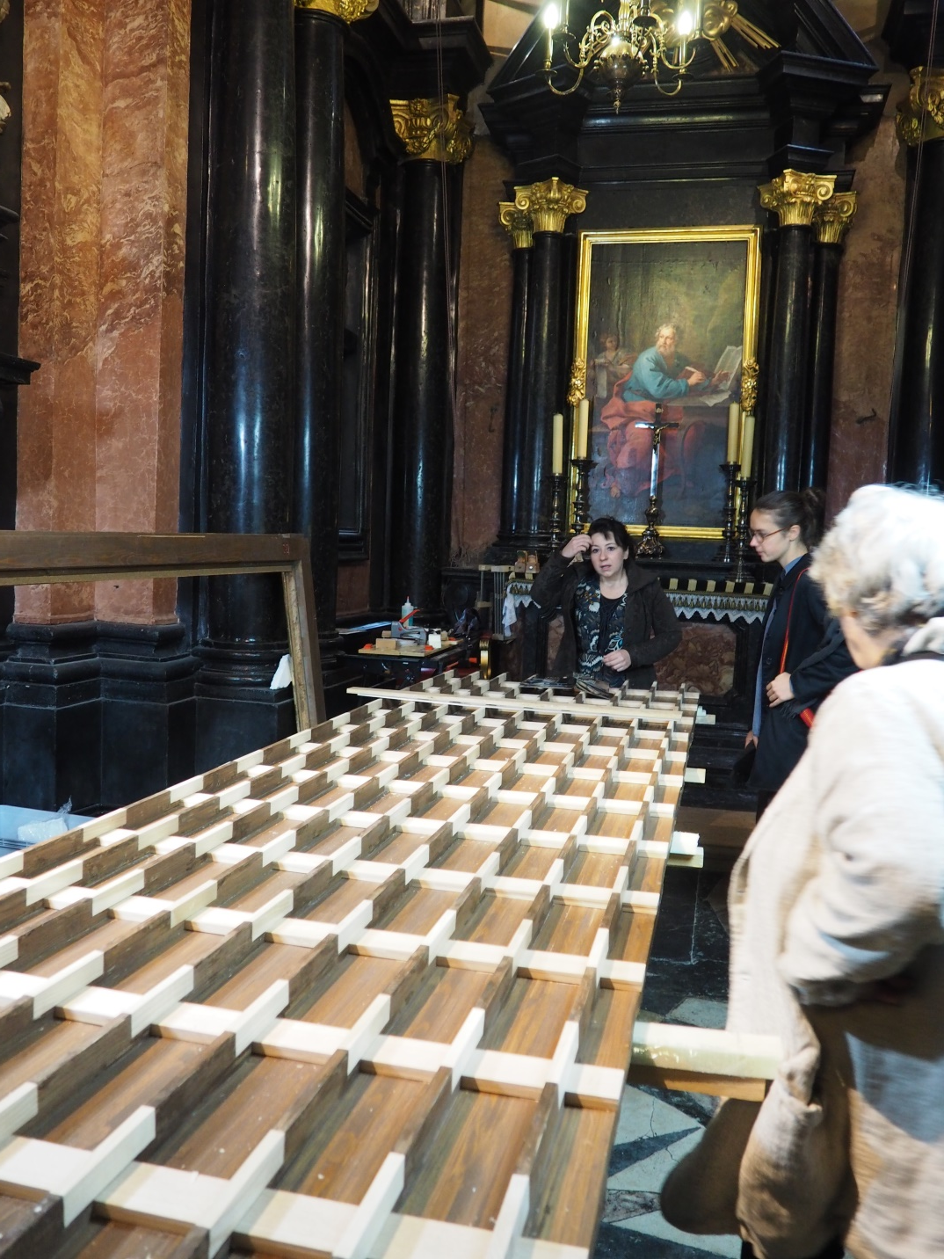
Notes:
Meeting with dr Aleksandra Hola

Slide 53

Notes:
Meeting with dr Aleksandra Hola

Slide 54


Slide 55


Notes:
Professor Ireneusz Płuska at Sigismund's Chapel

Slide 56



Slide 57


Slide 58


Slide 59


Slide 60
Session 3: Miscellaneous topics
Jan Matejko Academy of Fine Arts
Wednesday, 21st September 2016
Kraków , Poland

Slide 61

Notes:
Gaël Latour
Investigation of parchment alteration by correlative nonlinear optical microscopy and infrared nanoscopy – key-note lecture

Slide 62

Notes:
Gaël Latour & Manfred Schreiner (Chair)
Investigation of parchment alteration by correlative nonlinear optical microscopy and infrared nanoscopy – key-note lecture

Slide 63

Notes:
Wolfgang Kautek
Laser-induced particle desorption and adhesion force investigations

Slide 64

Notes:
Mohamed Oujja
LIF-Raman-LIBS analysis of heritage stones with a single set-up using UV pulsed laser excitation

Slide 65

Notes:
Mohamed Oujja & Manfred Schreiner (Chair)
LIF-Raman-LIBS analysis of heritage stones with a single set-up using UV pulsed laser excitation

Slide 66

Notes:
Roger M. Groves
Spectral imaging of Dutch gilt leather for improved conservation strategies

Slide 67

Notes:
Paraskevi Pouli
Building comprehensive management systems for handling and disseminating information recorded upon laser analysis, diagnosis and conservation

Slide 68
Session 3: Instrument presentations and announcements
Jan Matejko Academy of Fine Arts
Wednesday, 21st September 2016
Kraków , Poland

Slide 69

Notes:
Martin Cooper - Chair

Slide 70

Notes:
Bartosz Dajnowski
Using a new laser cleaning technology in the USA on works of art and architecture: introducing the GC-1 Laser Cleaning System

Slide 71

Notes:
Bartosz Dajnowski
Using a new laser cleaning technology in the USA on works of art and architecture: introducing the GC-1 Laser Cleaning System

Slide 72

Notes:
Lee Drake
MicroLIBS analysis of archaeological objects: elements analysis and fingerprinting

Slide 73

Notes:
Lee Drake
MicroLIBS analysis of archaeological objects: elements analysis and fingerprinting

Slide 74


Slide 75

Notes:
Laura Bartoli
El.En. laser systems for restoration of CH objects

Slide 76
Session 4: Coherent light-based methods for imaging, documentation and examination of objects and structures
Jan Matejko Academy of Fine Arts
Thursday, 22nd September 2016
Kraków , Poland

Slide 77

Notes:
Marta Castilleo - Chair

Slide 78

Notes:
Haida Liang,
An examination of the complementary use of optical coherence tomography (OCT) and non-linear microscopy – key-note lecture

Slide 79

Notes:
Haida Liang,
An examination of the complementary use of optical coherence tomography (OCT) and non-linear microscopy – key-note lecture

Slide 80

Notes:
Adele DeCruz,
A study in the use of optical coherence tomography to examine depth of penetration into varnish layers ablated by the Er:YAG laser pulse at 2.94 µm

Slide 81

Notes:
Adele DeCruz & Marta Castilleo (Chair)
A study in the use of optical coherence tomography to examine depth of penetration into varnish layers ablated by the Er:YAG laser pulse at 2.94 µm

Slide 82

Notes:
Magdalena Iwanicka
Optical coherence tomography and reflection FTIR as complementary tools for examination of varnish layers in Vincent van Gogh’s Sunflowers– preliminary results

Slide 83

Notes:
Magdalena Iwanicka
Optical coherence tomography and reflection FTIR as complementary tools for examination of varnish layers in Vincent van Gogh’s Sunflowers– preliminary results

Slide 84

Notes:
Sotiria Kogou
Non-invasive multi-modal analysis of Cave 465 murals in Dunhuang, China

Slide 85

Notes:
Sotiria Kogou
Non-invasive multi-modal analysis of Cave 465 murals in Dunhuang, China

Slide 86

Notes:
Claudia Daffara
Laser conoscopic holography for the assessment of the effects of traditional and innovative cleaning treatments of silver

Slide 87

Notes:
Claudia Daffara
Laser conoscopic holography for the assessment of the effects of traditional and innovative cleaning treatments of silver

Slide 88

Notes:
Sotiris Psilodimitrakopoulos
Effect of aging in starch based adhesives, studied using second harmonic generation imaging microscopy

Slide 89

Notes:
Sotiris Psilodimitrakopoulos
Effect of aging in starch based adhesives, studied using second harmonic generation imaging microscopy

Slide 90

Notes:
Alice Dal Fovo
Nonlinear imaging techniques (NLO) for painting investigation

Slide 91

Notes:
Alice Dal Fovo & Marta Castilleo (Chair)
Nonlinear imaging techniques (NLO) for painting investigation

Slide 92
Poster pitch & poster session
Jan Matejko Academy of Fine Arts
Thursday, 22nd September 2016
Kraków , Poland

Slide 93

Notes:
Selçuk Aktürk
Cleaning performance of femtosecond and nanosecond laser pulses for artificially soiled papers with sizing

Slide 94

Notes:
Magdalena Iwanicka
Optical coherence tomography for monitoring of the laser cleaning of ceramic tiles

Slide 95

Notes:
Alice Dal Fovo
Thinning of oxalate patina with Er:YAG laser stand-alone and in combination with Agar and Carbogel systems

Slide 96

Notes:
Sotiria Kogou
A study of illuminated manuscripts using optical coherence tomography and non-invasive spectroscopic techniques

Slide 97

Notes:
María Vega Cańamares Arribas,
SERS analysis of Fuchsine and Diamond Green G on Ag nanoparticles prepared by photoreduction

Slide 98

Notes:
Wolfgang Kautek
Stratigraphy by multiple wavelength laser-induced breakdown spectroscopy

Slide 99

Notes:
Maria-Mihaela Manea
Raman spectroscopy and associated techniques used in the pre-screening stage of radiocarbon dating process

Slide 100

Notes:
Václava Antušková
Guanine - an unexpected organic pigment identified in the polychrome of the wood sculpture using the method of Raman microspectroscopy

Slide 101

Notes:
Anna Rogulska
The forgotten Baroque Master - authentication investigations of the painting attributed to J.J. Knechtel

Slide 102

Notes:
Kateřina Tomšová
Investigation of techniques of gilding and tin-relief decoration in Bohemian panel paintings from the gothic period

Slide 103

Notes:
Athanasia Papanikolaou
Multispectral imaging to unveil the drawings and colours of a burnt Minoan wall painting showing a “Female figure in sanctuary/shrine”

Slide 104


Slide 105


Slide 106


Slide 107


